Slide 1
Significant changes to the NEC
2020 Edition

Slide 2
210.8 – GFCI Protection for personnel
... The distance shall be measured by the shortest path the supply cord would follow without piercing a… fixed barrier, or… passing through a window.
The language about passing through doors and doorways is removed, meaning you now must measure through doorways and into cabinets.

Slide 3
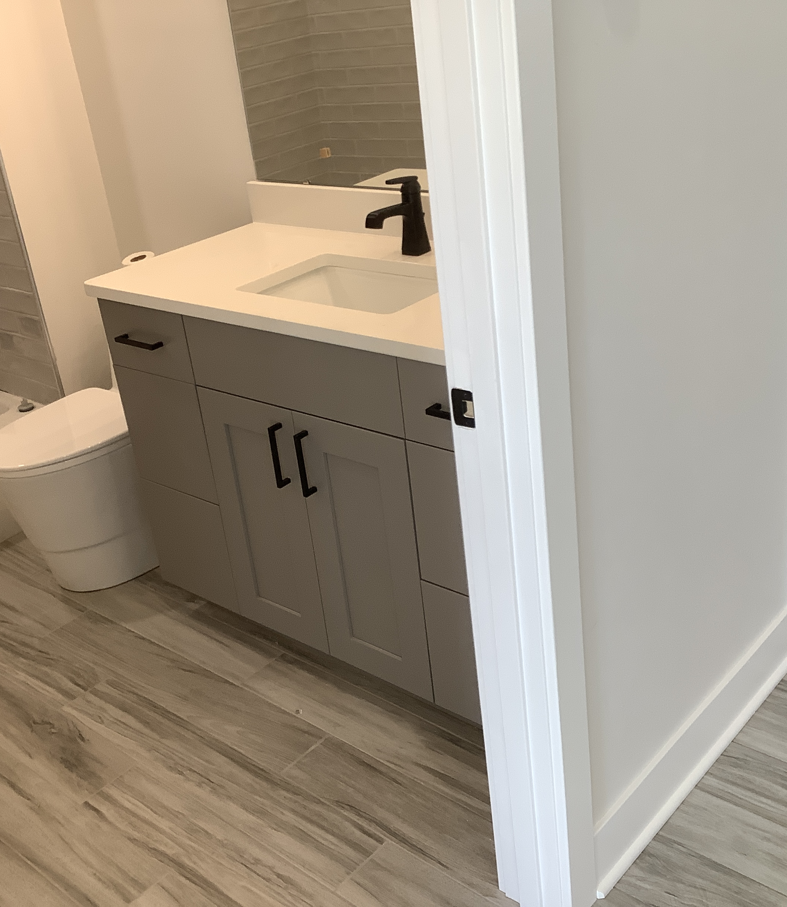
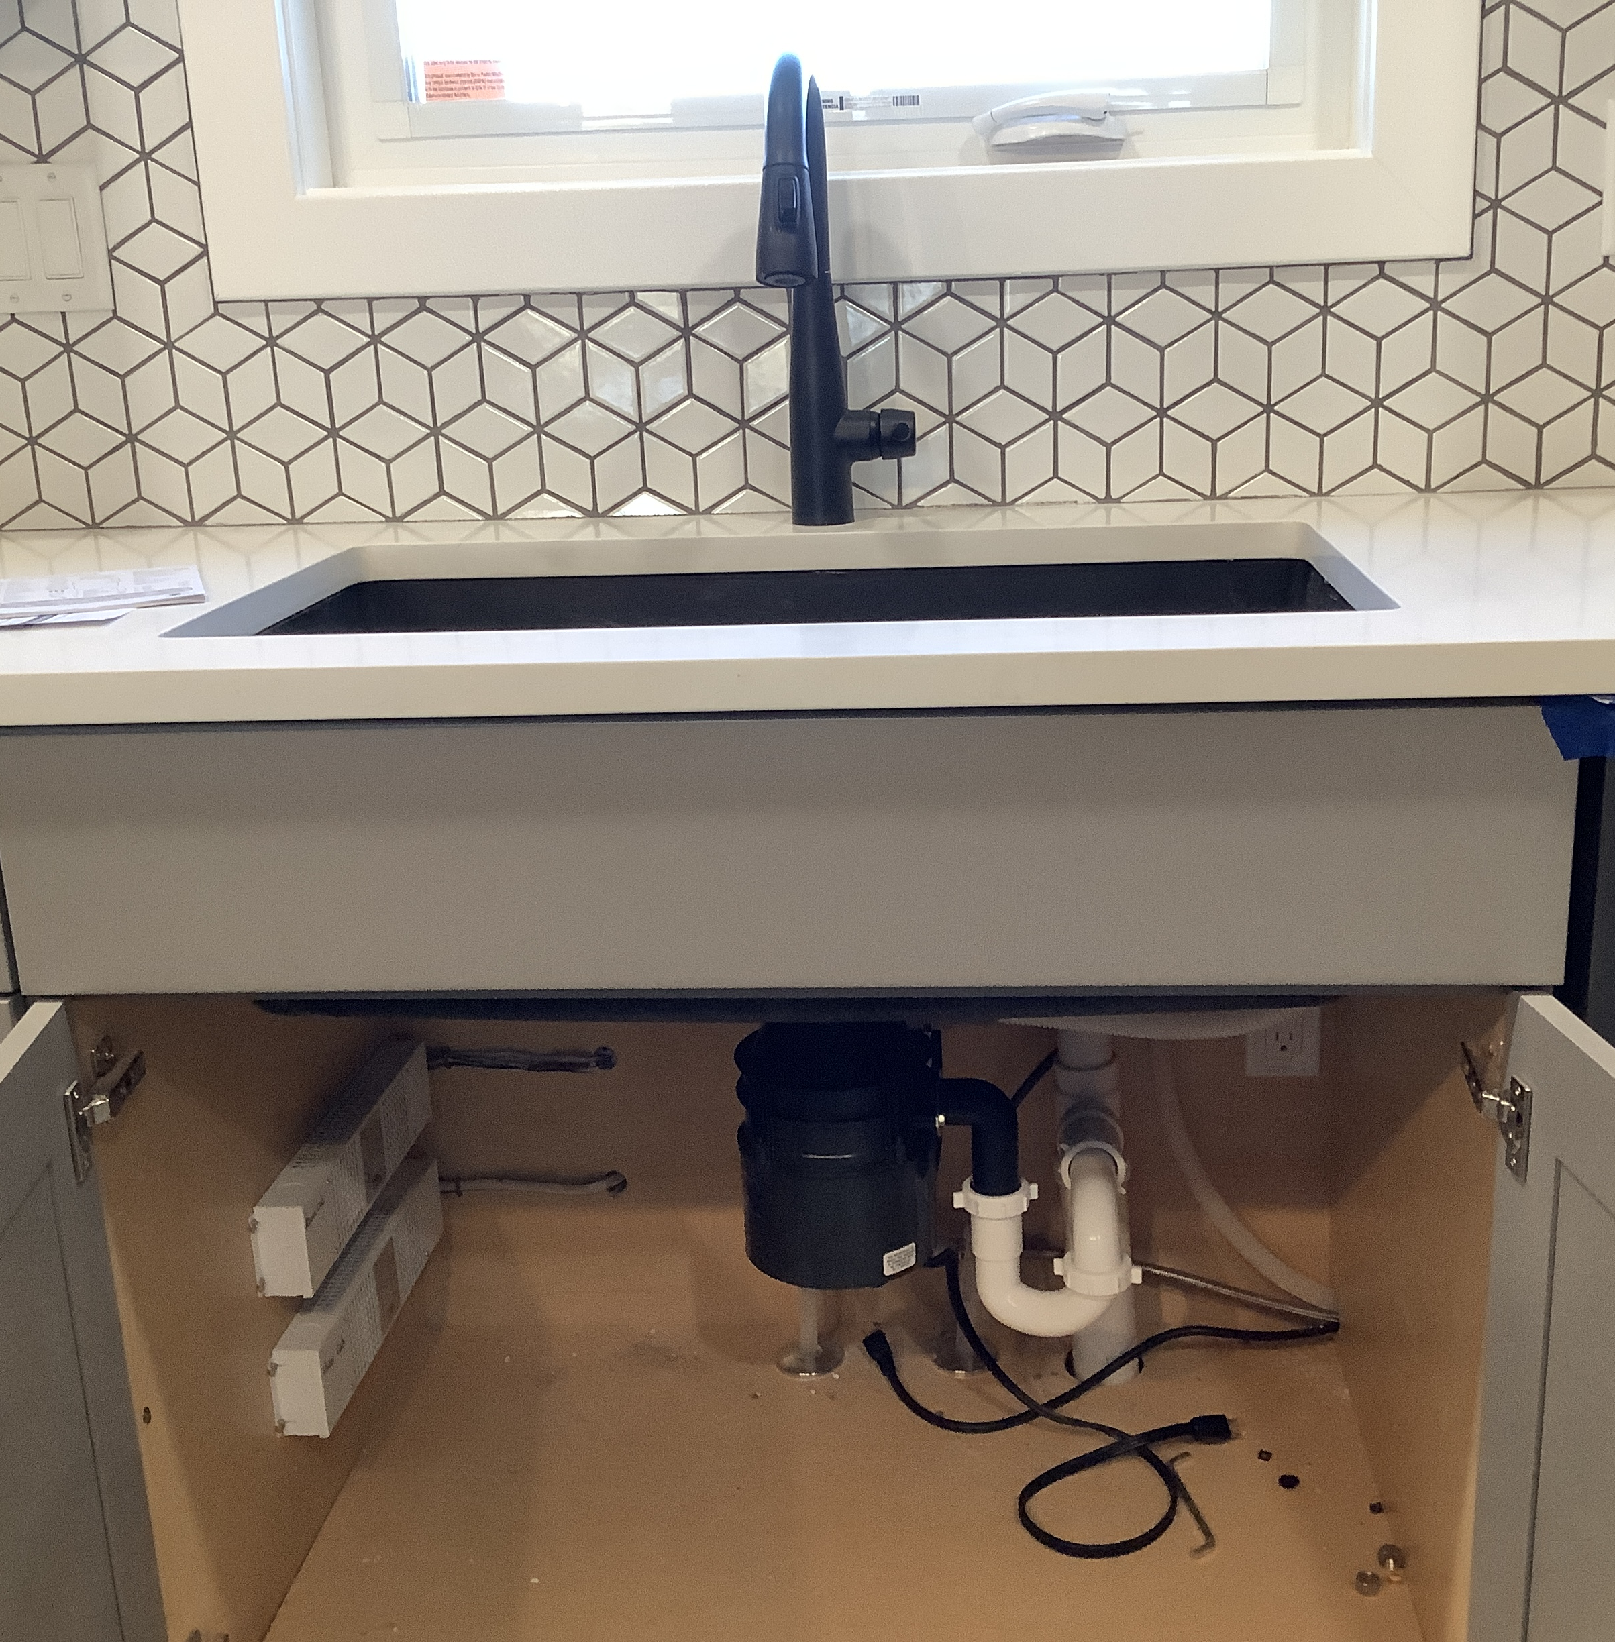
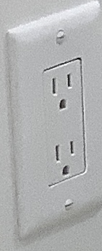
Both outlets are less than 6’ from the rim of the sink, so they have to be GFCI protected according to the 2020 NEC.

Slide 4
210.8 (A) – Dwelling Units
All 125-volt through 250-volt receptacles installed in the locations specified in 210.8(A)(1) through (A)⁠(11) and supplied by single-phase branch circuits rated 150 volts or less to ground shall have ground-fault circuit-interrupter protection for personnel.

Slide 5
210.8 (A) – Dwelling Units
All 125-volt through 250-volt receptacles installed in the locations specified in 210.8(A)(1) through (A)⁠(11) and supplied by single-phase branch circuits rated 150 volts or less to ground shall have ground-fault circuit-interrupter protection for personnel.
(5) – Basements.
Exception – Dedicated fire alarm or burglar alarms.

Slide 6
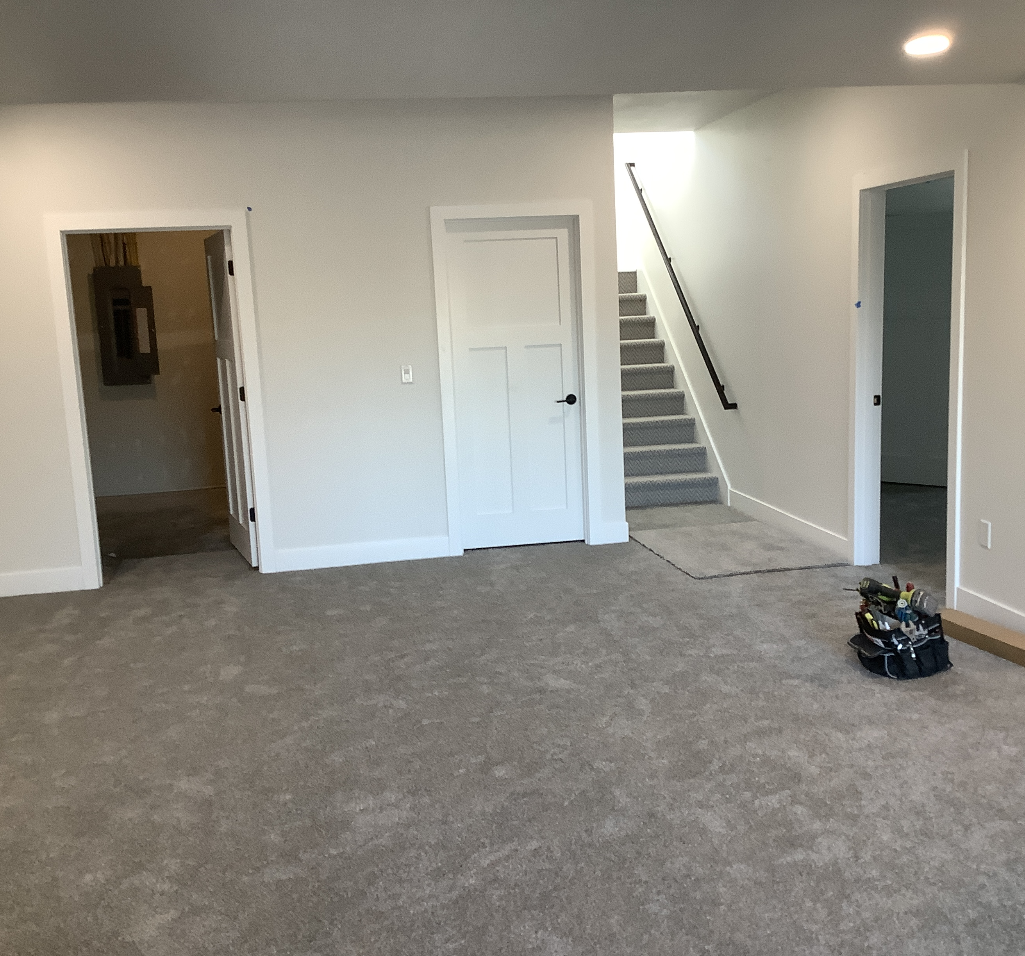
Impact:
All receptacles in basements, finished or unfinished.

Slide 7
210.8 (A) – Dwelling Units
All 125-volt through 250-volt receptacles installed in the locations specified in 210.8(A)(1) through (A)⁠(11) and supplied by single-phase branch circuits rated 150 volts or less to ground shall have ground-fault circuit-interrupter protection for personnel.
Laundry areas & any receptacle within 6’ of a sink

Slide 8

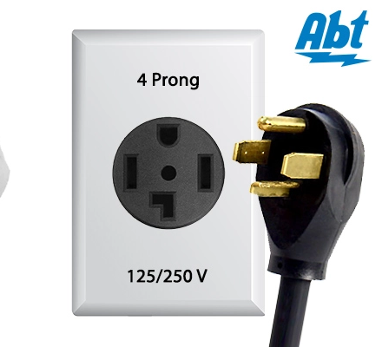
Impact:
Dryers in a laundry room & electric ranges within 6’ of a sink

Slide 9
210.8 (d) – Specific Appliances
GFCI protection shall be provided for outlets serving appliances specified in 422.5(A).
New to 422.5(A) are:
Sump pumps

Slide 10
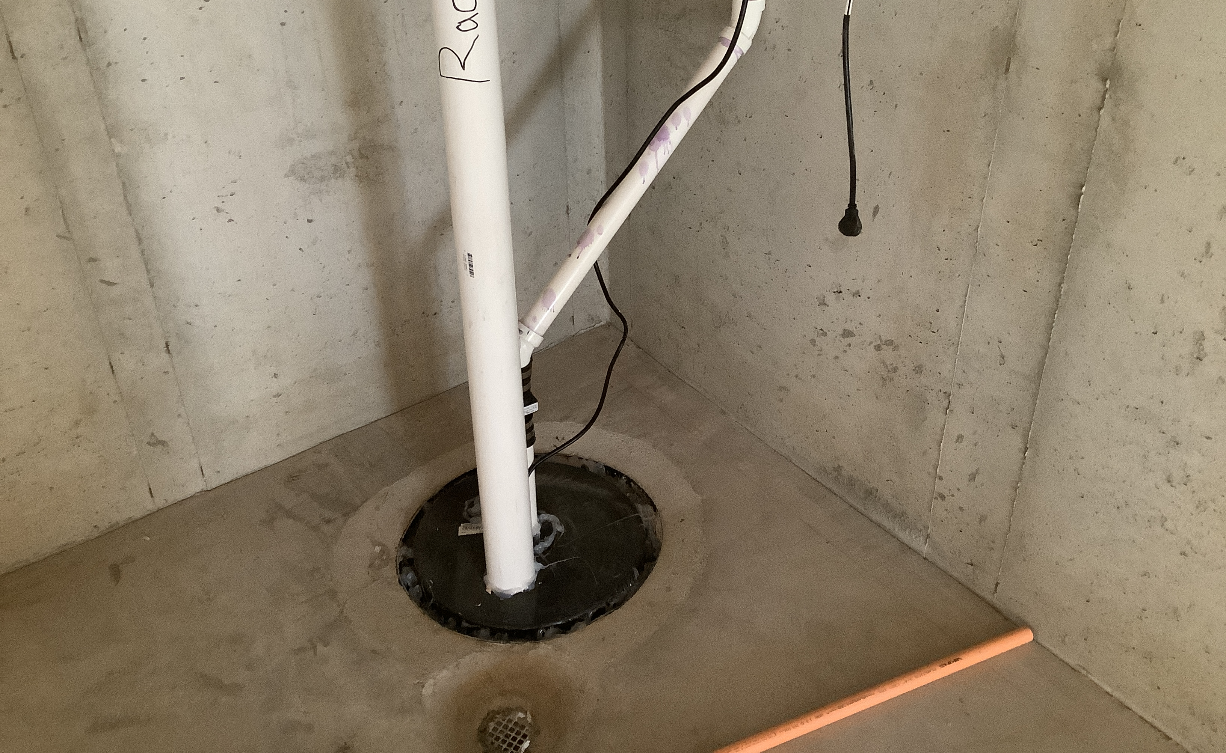

Slide 11
210.8 (F) – Outdoor Outlets
All outdoor outlets for dwellings… that are supplied by single-phase branch circuits rated 150 volts to ground or less, 50 amperes or less, shall have ground-fault circuit-interrupter protection for personnel.
Exception: Lighting outlets other than those covered in 210.8(C)

Slide 12
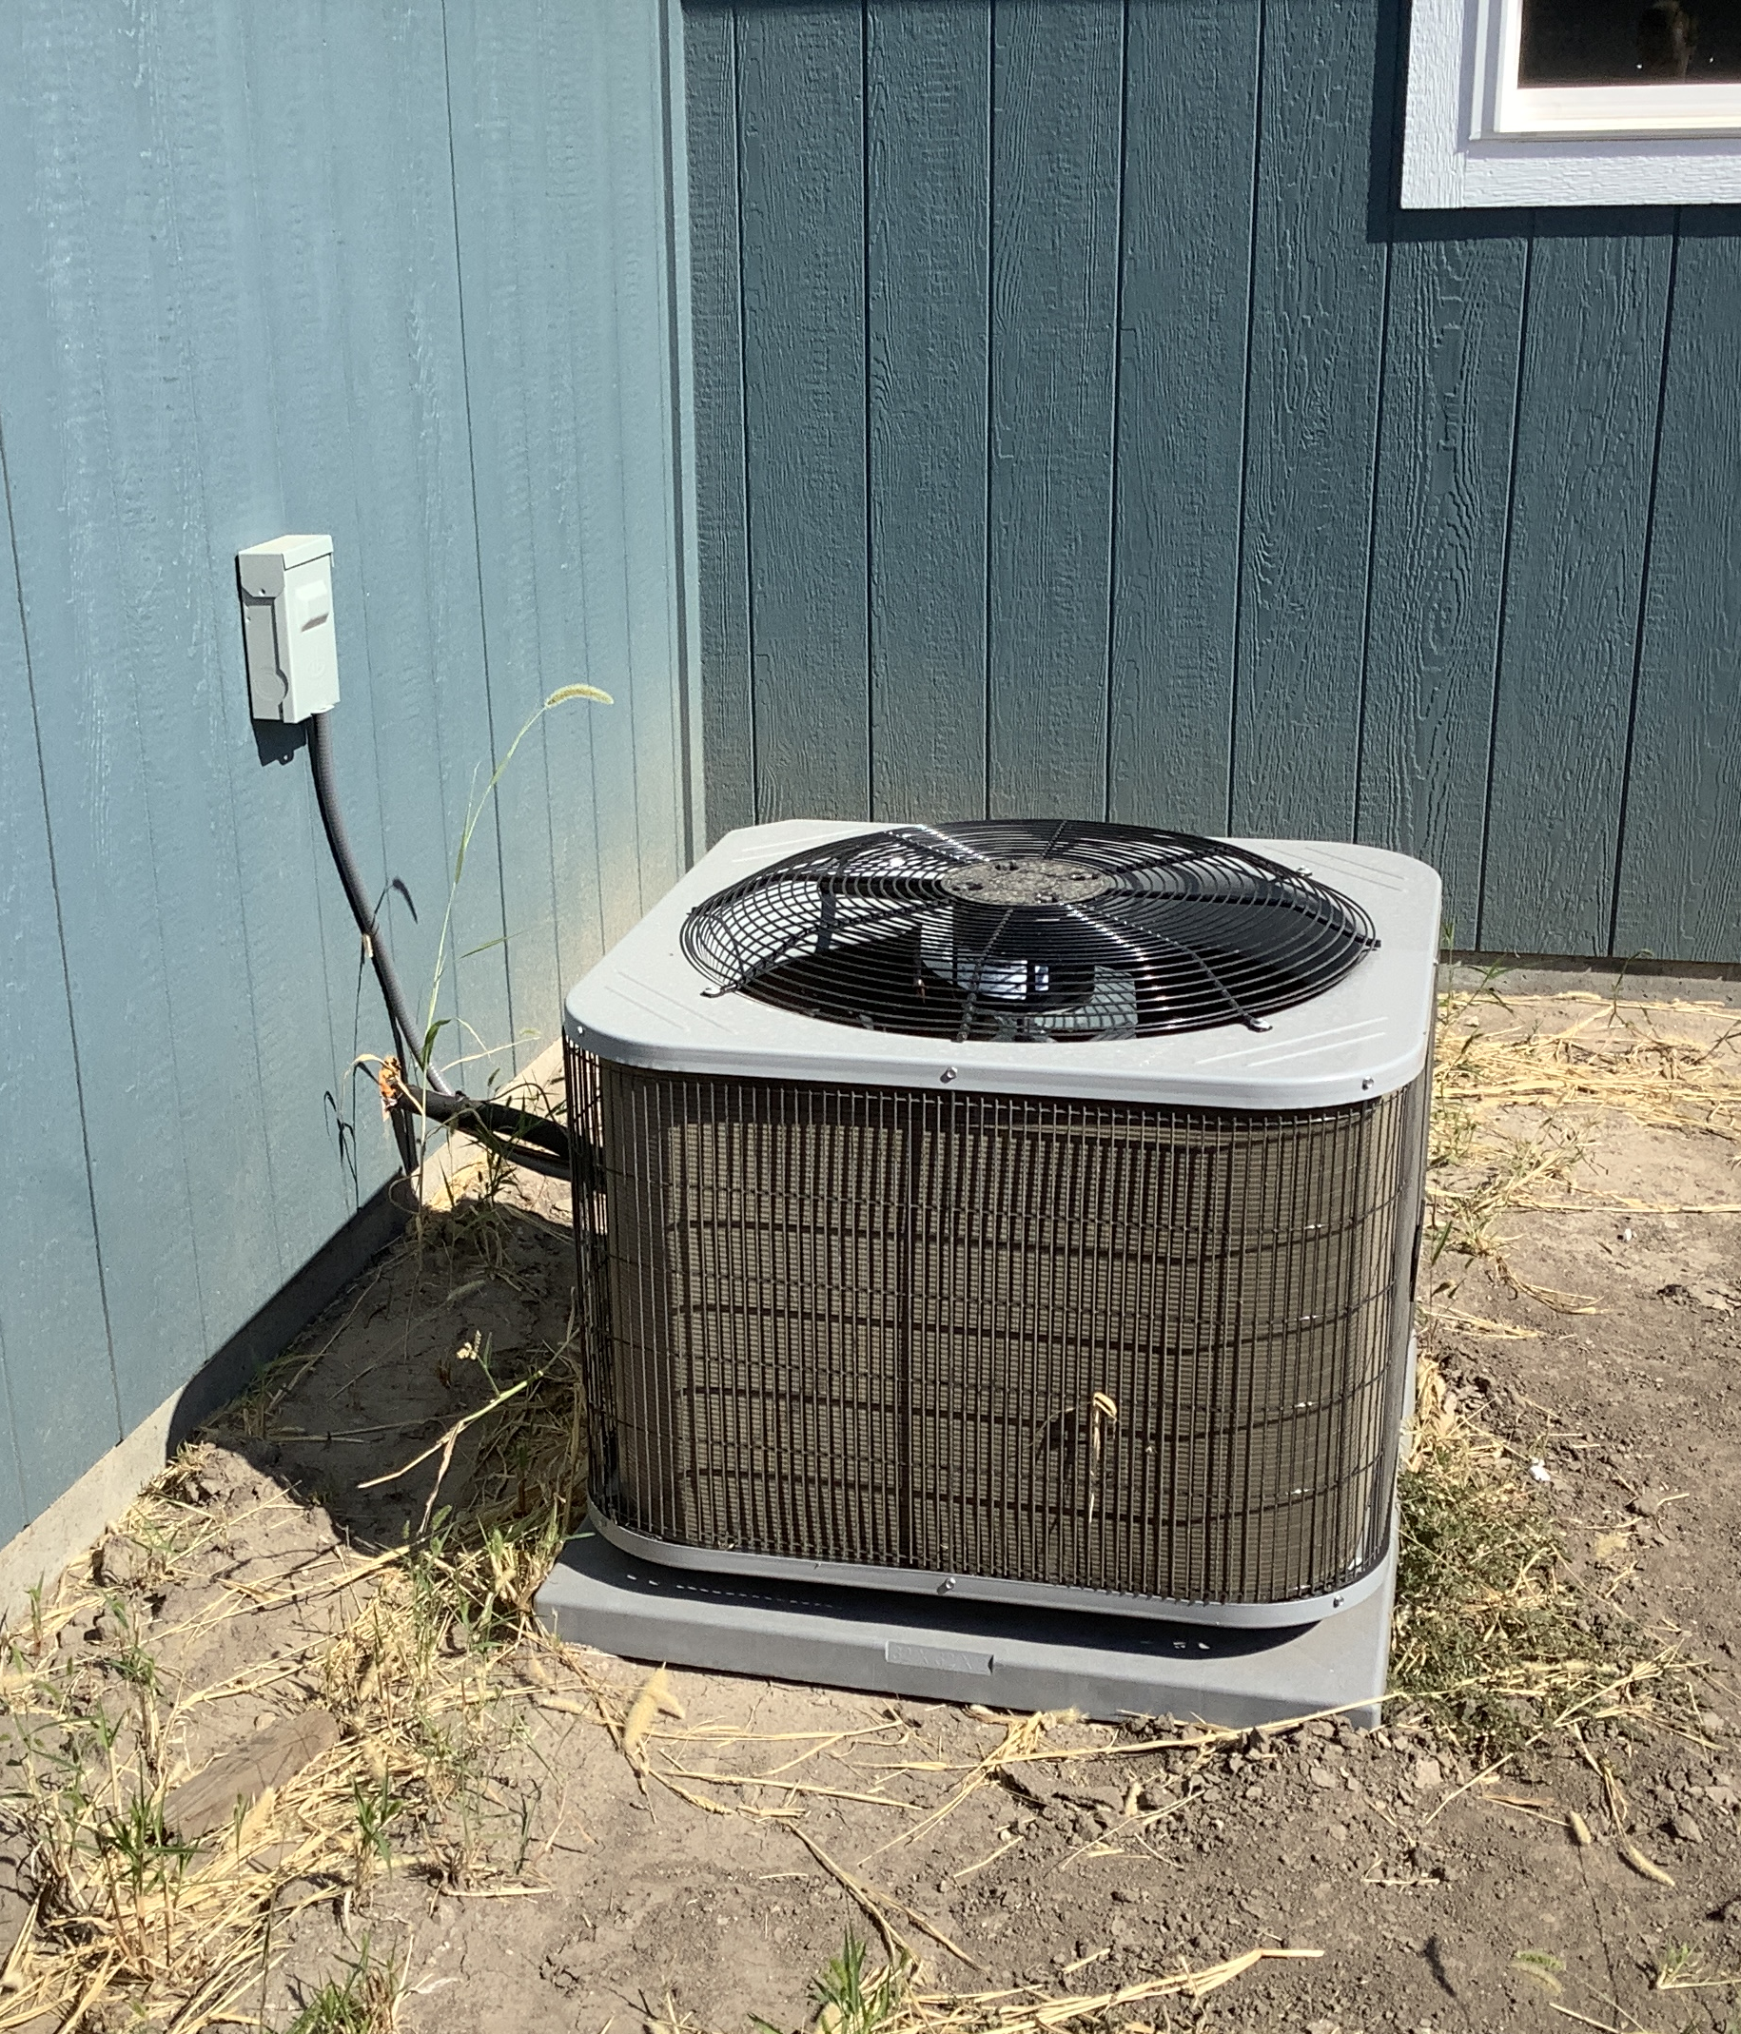

All outdoor condensing units, any other “outlets” aside from lighting outlets.

Slide 13
210.12 - AFCI Protection for Branch Circuits
All 120v, single phase, 15- and 20-ampere branch circuits supplying outlets or devices in dwelling unit kitchens, family rooms, dining rooms, living rooms, parlors, libraries, dens, bedrooms, closets, hallways, laundry areas, or similar rooms or areas.
Note: Garages, attics, and bathrooms are not listed.

Slide 14
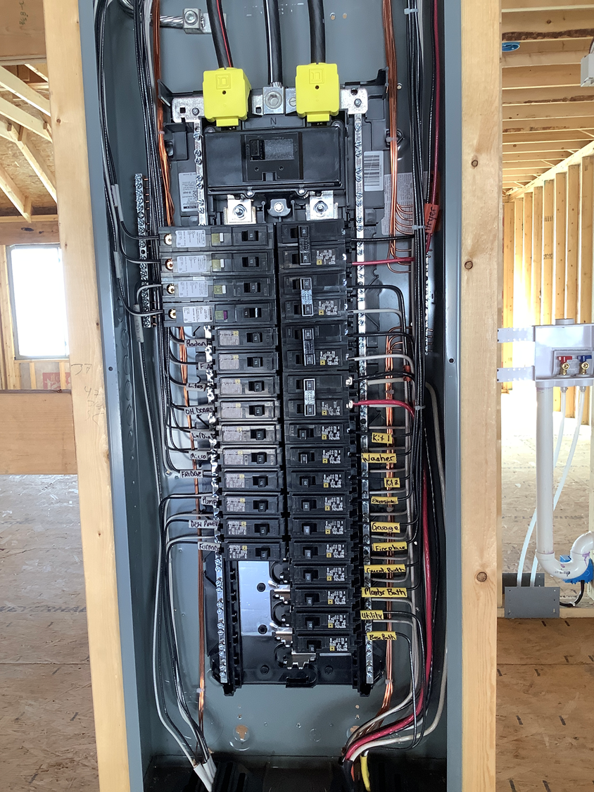
Impact:
Most rooms in a house, excluding garages, attics, and bathrooms.
NOTE: this code cycle change was not a significant increase in AFCI requirements, but previous local amendments have put our jurisdiction well behind on this issue.

Slide 15
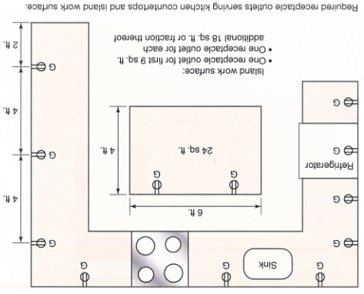
E3901.4.2 island and peninsular countertops
New code section calls for one receptacle outlet for the first 9 sq ft., and one more for each additional 18 sq ft.
New language does NOT specify receptacle spacing or location.
Amended during adoption process

Slide 16
IRC – R314.3 Location of smoke alarms
In the hallway and in the room open to the hallway in dwelling units where the ceiling height of a room open to a hallway serving bedrooms exceeds that of the hallway by 24 inches or more.

Slide 17
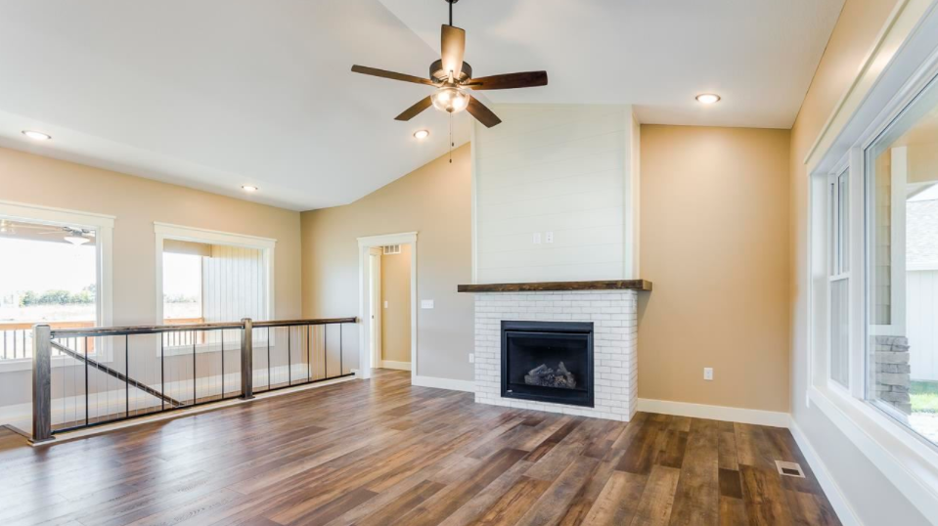
More than 24”

Slide 18
230.62(C) – Barriers
Barriers shall be placed in service equipment such that no uninsulated, ungrounded service busbar or service terminal is exposed to inadvertent contact by persons or maintenance equipment while servicing load terminations.

Slide 19
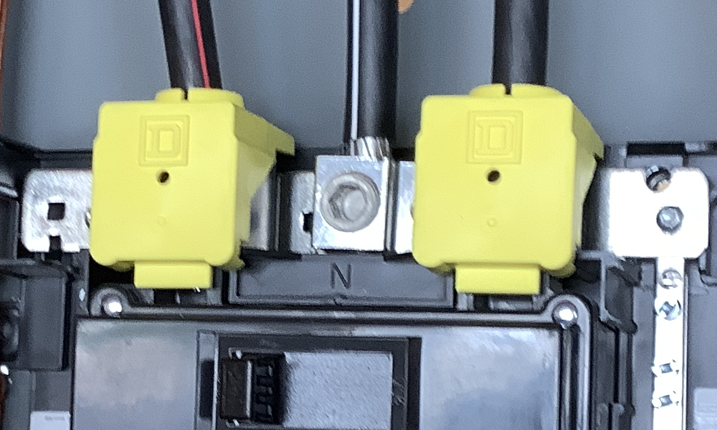

Slide 20
230.67 – Surge Protection
(A) All services supplying a dwelling unit shall be provided with a surge-protective device (SPD).
(B) The SPD shall be an integral part of the service equipment or immediately adjacent thereto.
(C) The SPD shall be Type 1 or Type 2 SPD.
See Article 242, Part II

Slide 21
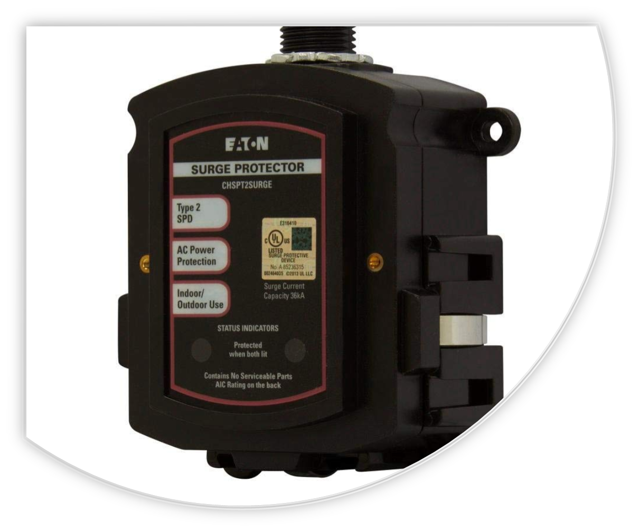
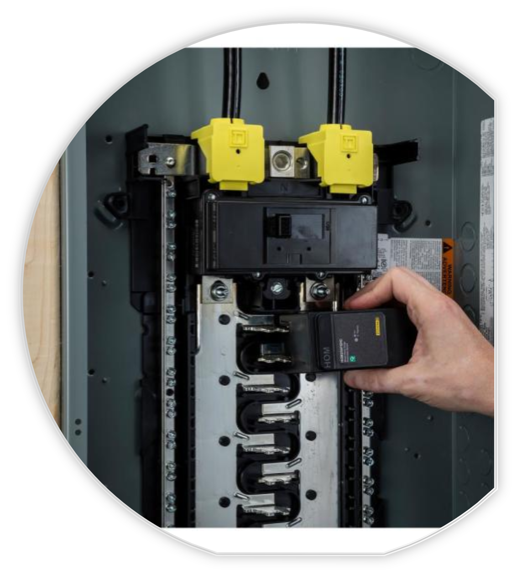
Impact:
All new services, including rebuilds on existing structures will require surge protection

Slide 22
300.25 – Exit Enclosures (Stair Towers)
Where an exit enclosure (stairwell) is required to be separated from the building, only electrical wiring methods serving equipment permitted by the AHJ to be located in the exit enclosure shall be installed within the exit enclosure.

Slide 23
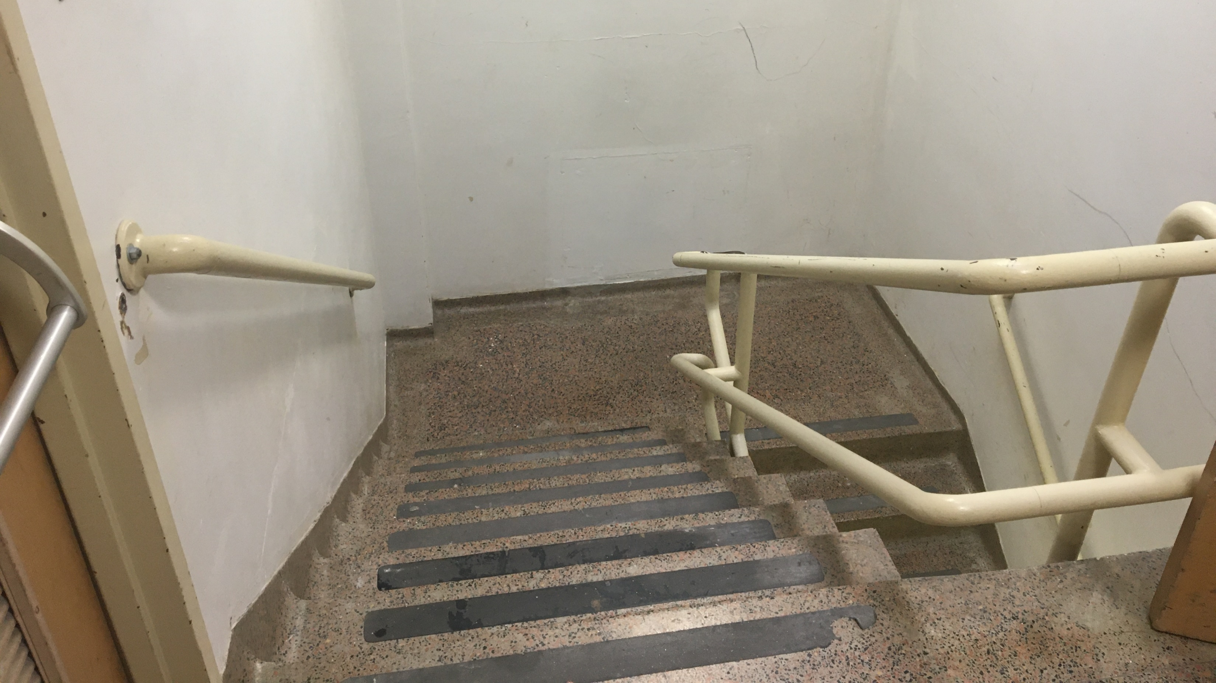

Slide 24
314.27(C) – Boxes at Ceiling Fans
Outlet boxes mounted in ceilings of habitable rooms of dwelling occupancies in a location acceptable for the installation of a ceiling-suspended paddle fan shall be listed for the sole support of ceiling-suspended (paddle) fan.

Slide 25
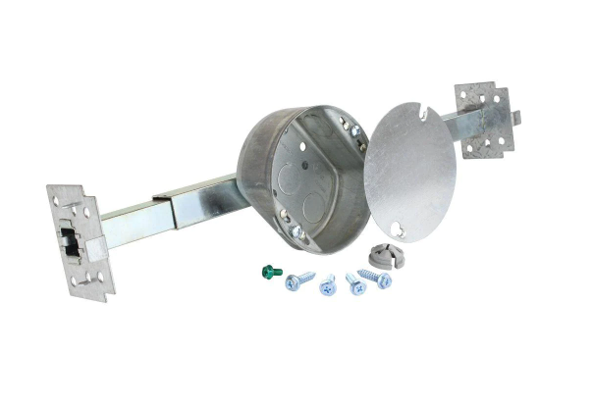
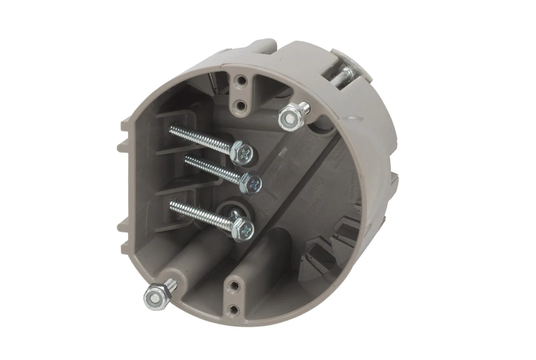
Impact:
Every ceiling outlet box in every habitable room, “acceptable” for installation of a ceiling fan shall be able to support a fan, whether installed or not.
NOTE: seeking input on this issue, we do plan to amend out this requirement for any outlet box for smoke or CO alarm.

Slide 26
E3905.8 Boxes at fan outlets
Outlet boxes mounted in the ceilings of habitable rooms in a location acceptable for the installation of a ceiling-suspended (paddle) fan shall be capable of supporting a ceiling fan, except:
Consider language: Outlet Boxes withing x feet of a perimeter wall
Exempt: Outlet boxes for smoke or CO alarms.
D

Slide 27
320.80, 330.80, 338.10(B)(4)(a)(2)
Bundling of Cables
AC cable, MC cable, SE cable, and NM cable shall be derated if bundled (more than two conductors in contact) and in contact with thermal insulation, caulk, sealing foam, etc.
Proper spacing and securing of these cables will prevent the need to adjust ampacity

Slide 28
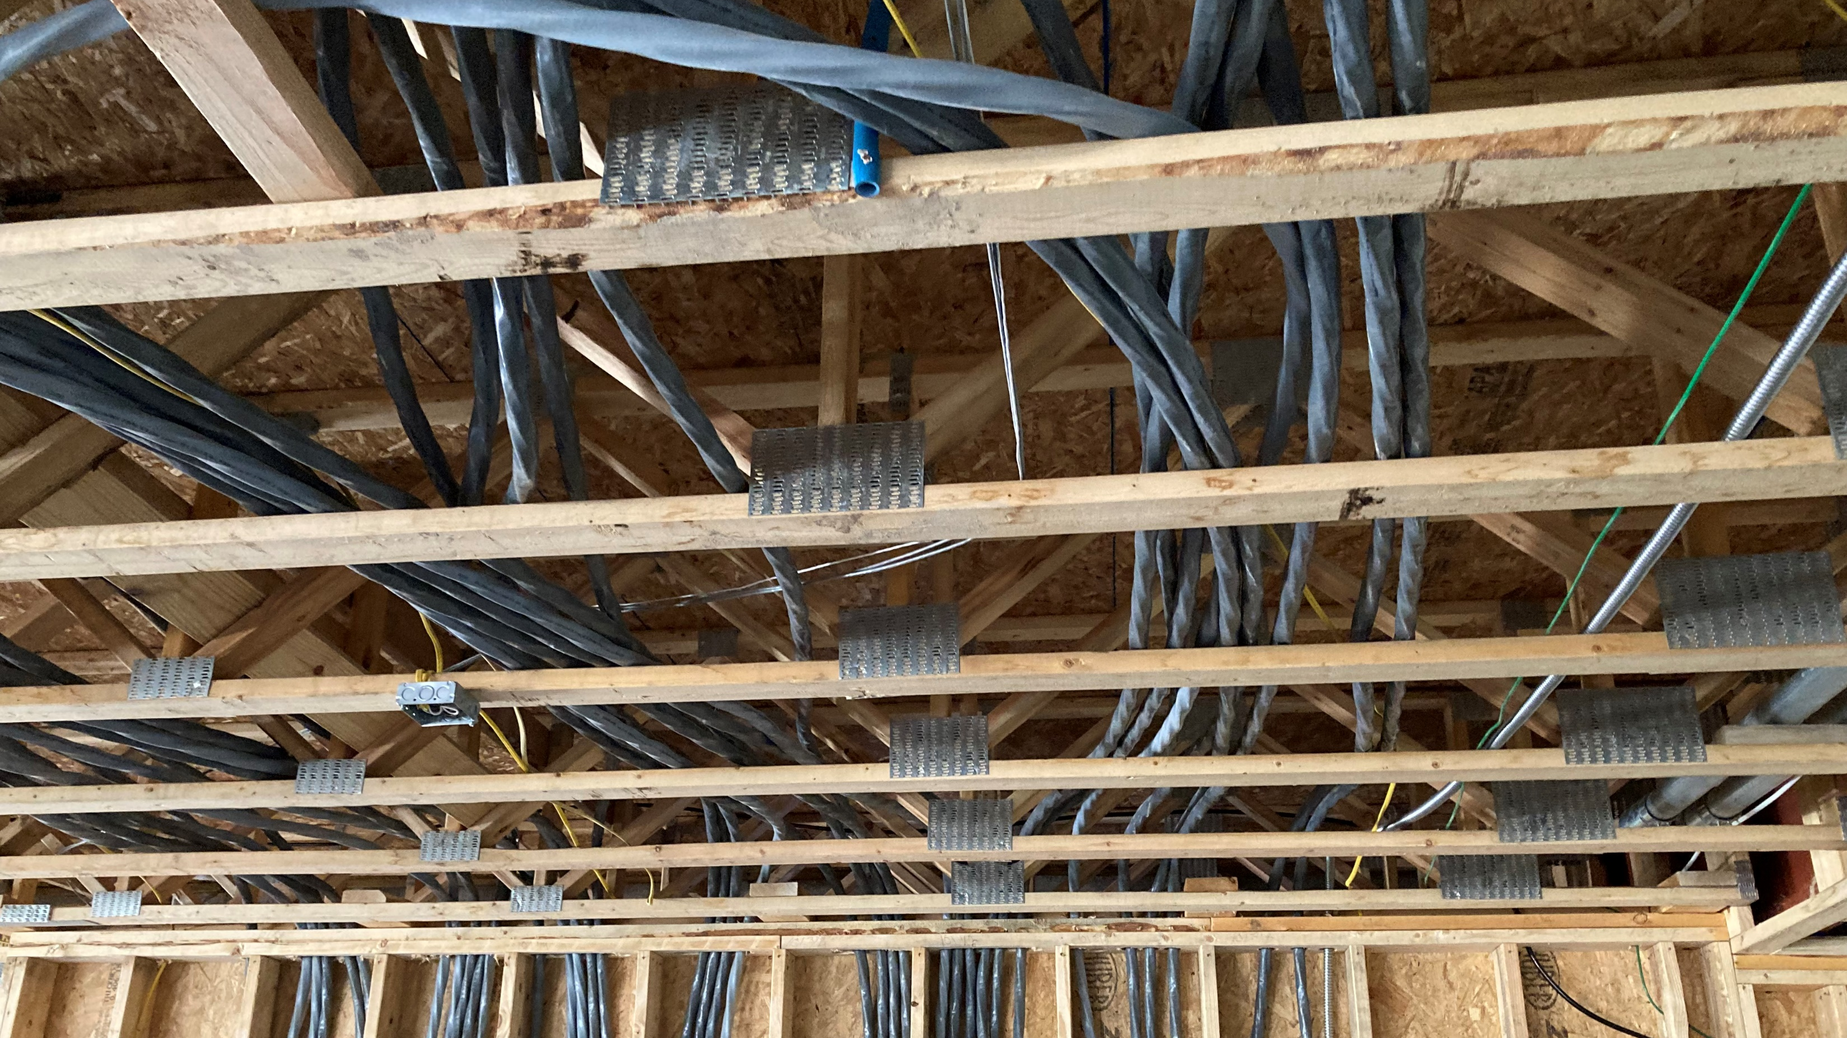

Slide 29
334.30 - NM cable Service loops
NM cable must be secured within 12” of the box if the box has an integral clamp, or within 8” of the box if it doesn’t have a clamp. However, you are allowed to have up to 18” of free conductor between that staple and the box.

Slide 30
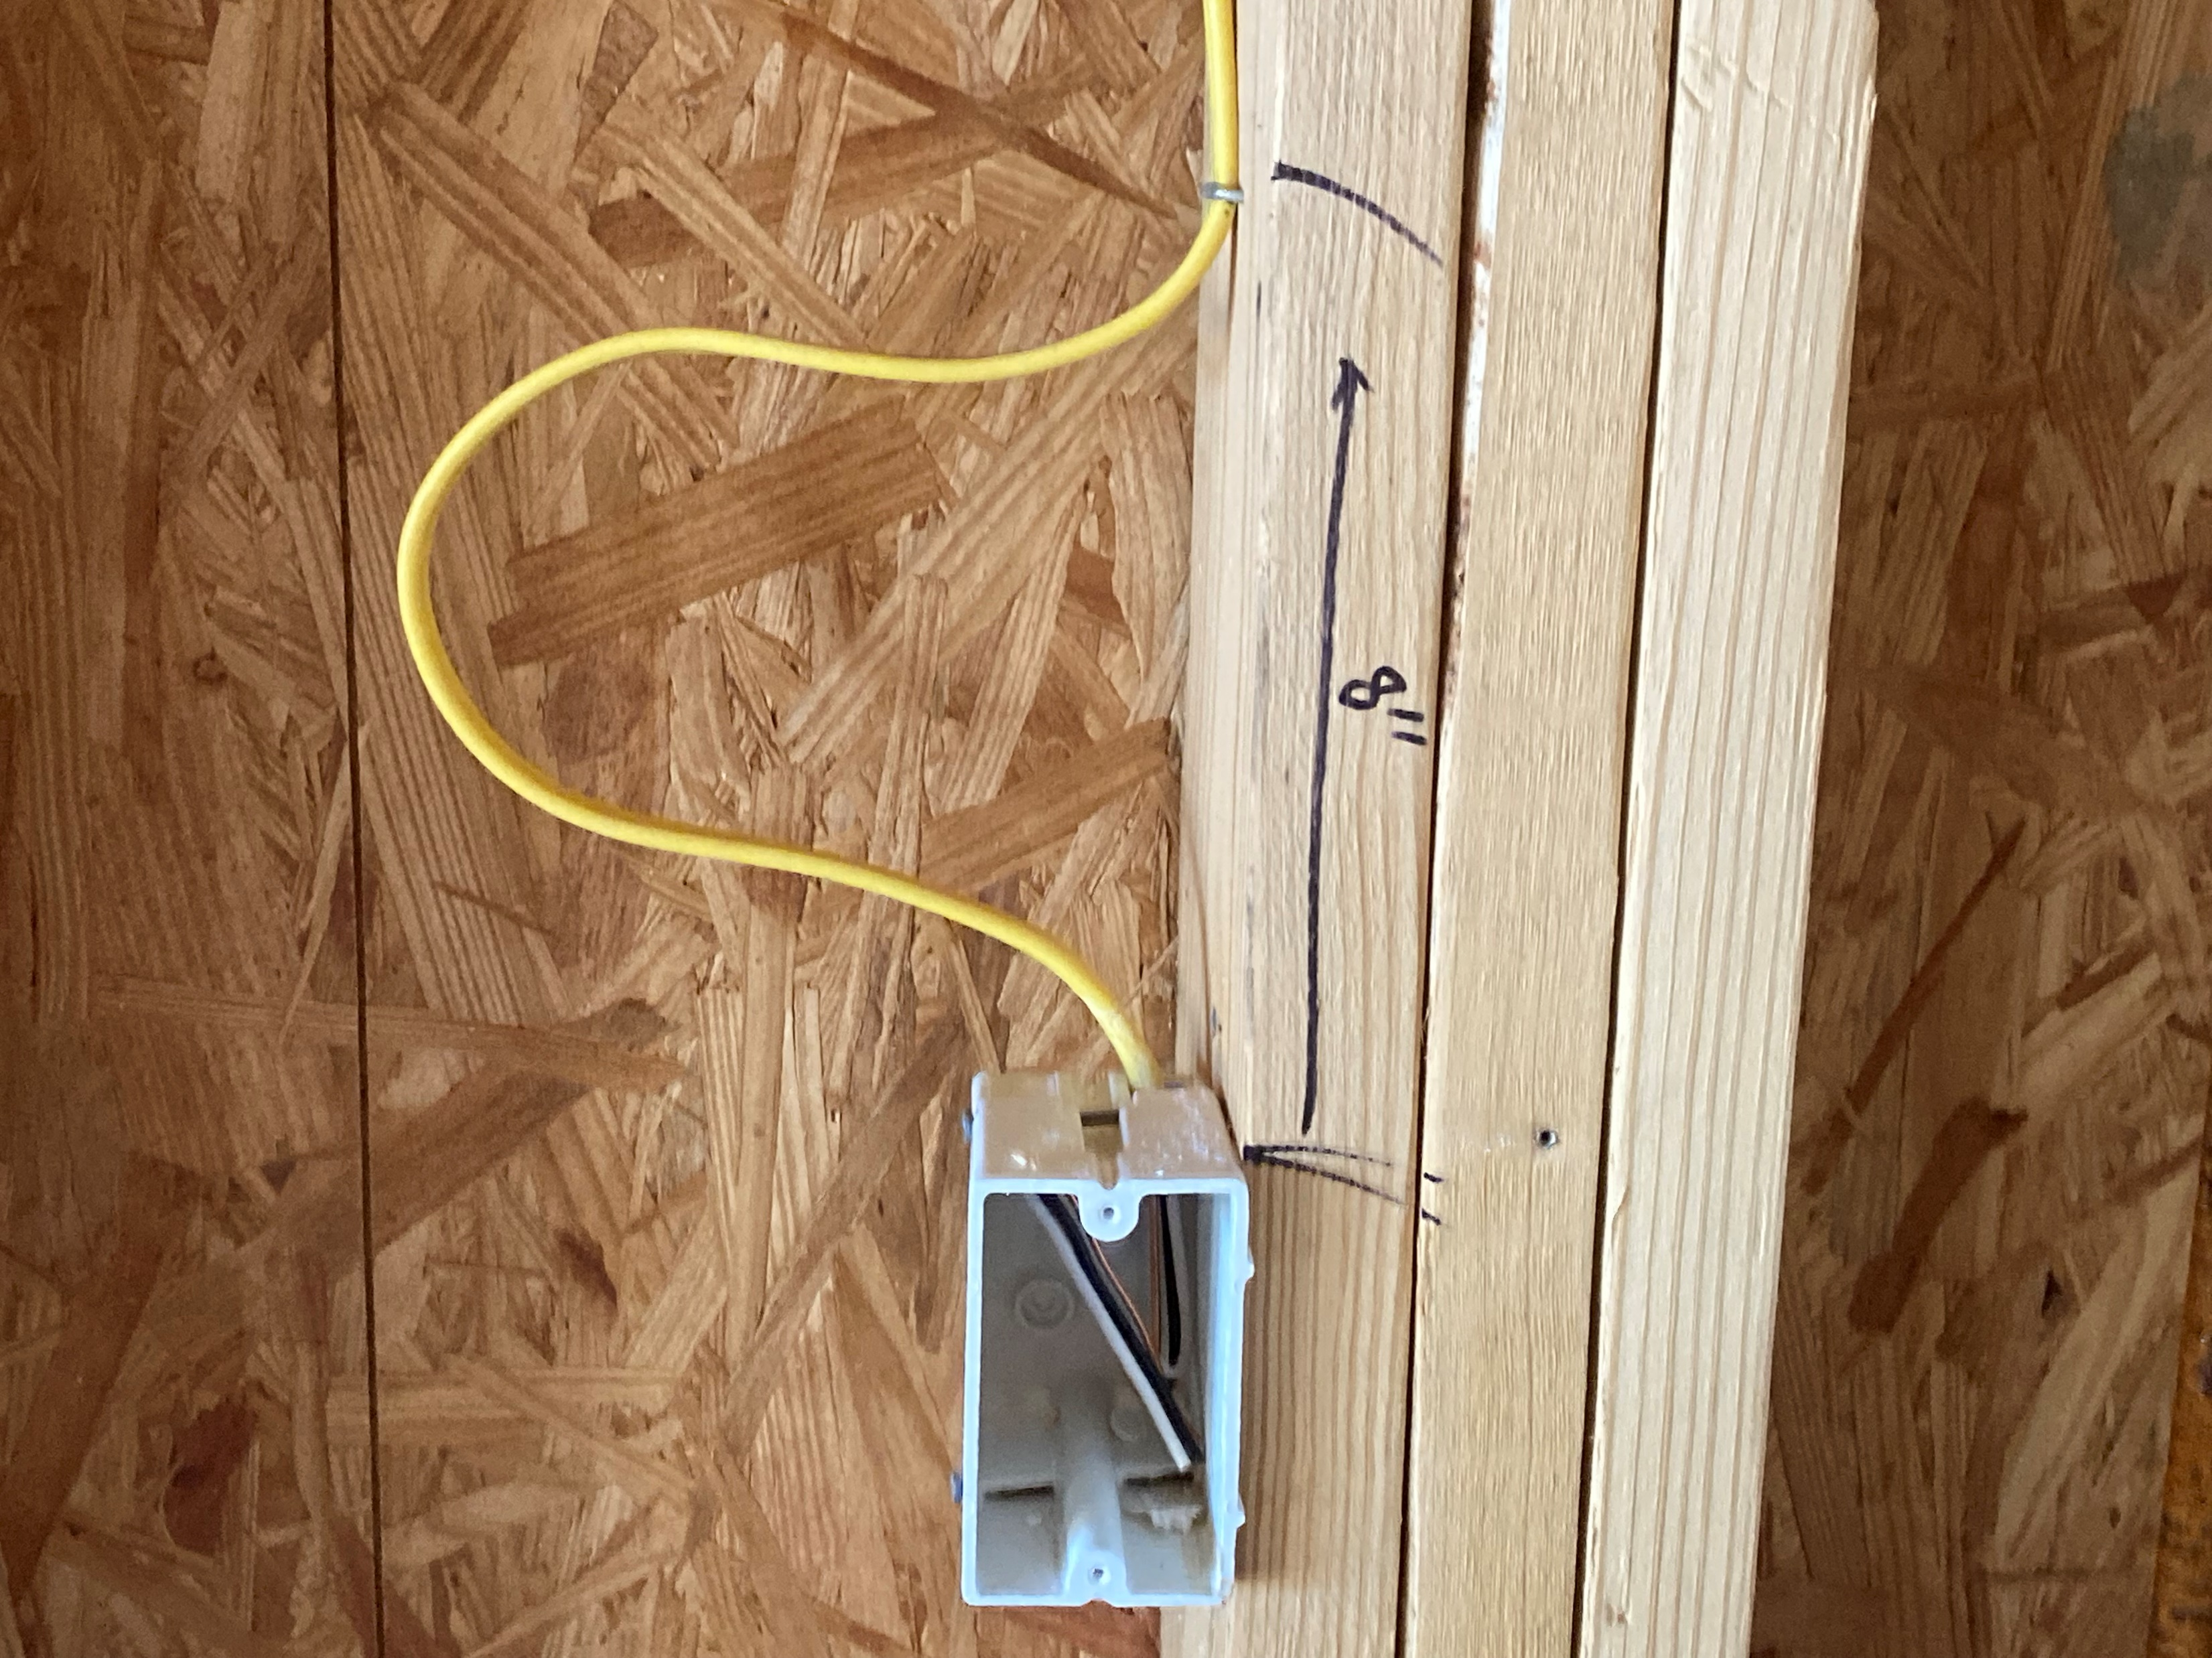

Slide 31
406.5(G)(2) – Face-up receptacles under sinks
Receptacles shall not be installed in a face-up position in the area below a sink.

Slide 32
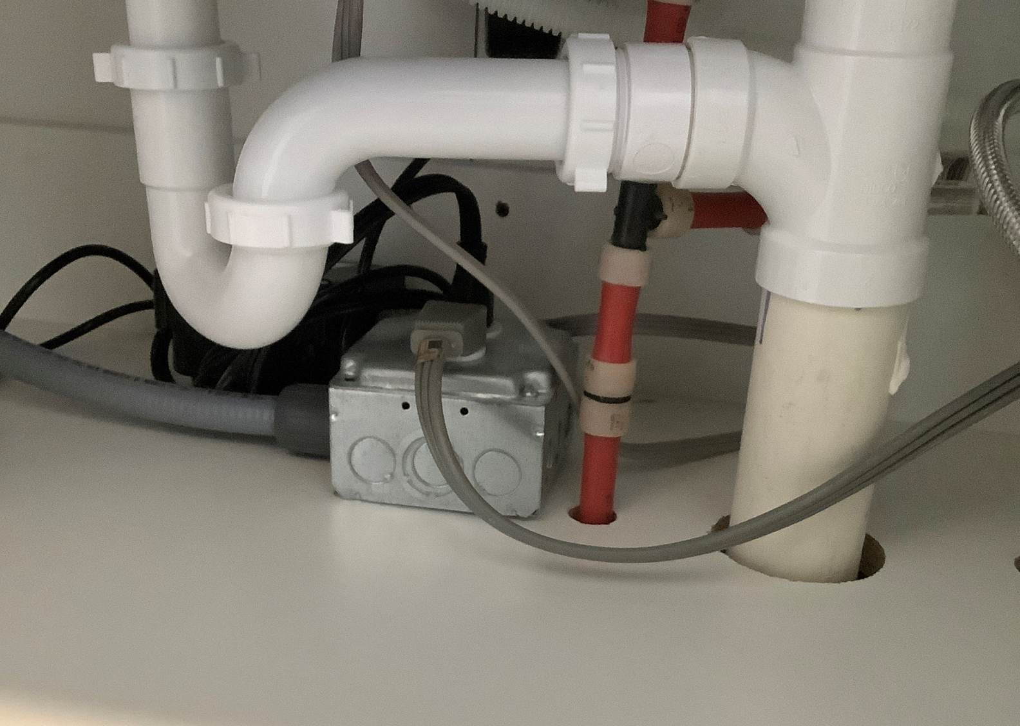

Slide 33
406.9(C) – Bathtub and shower space
Receptacles shall not be installed within a zone measured 3’ horizontally and 8’ vertically from the top of the bathtub rim or shower stall threshold. The identified zone is all-encompassing and shall include the space directly over the tub or shower stall.

Slide 34
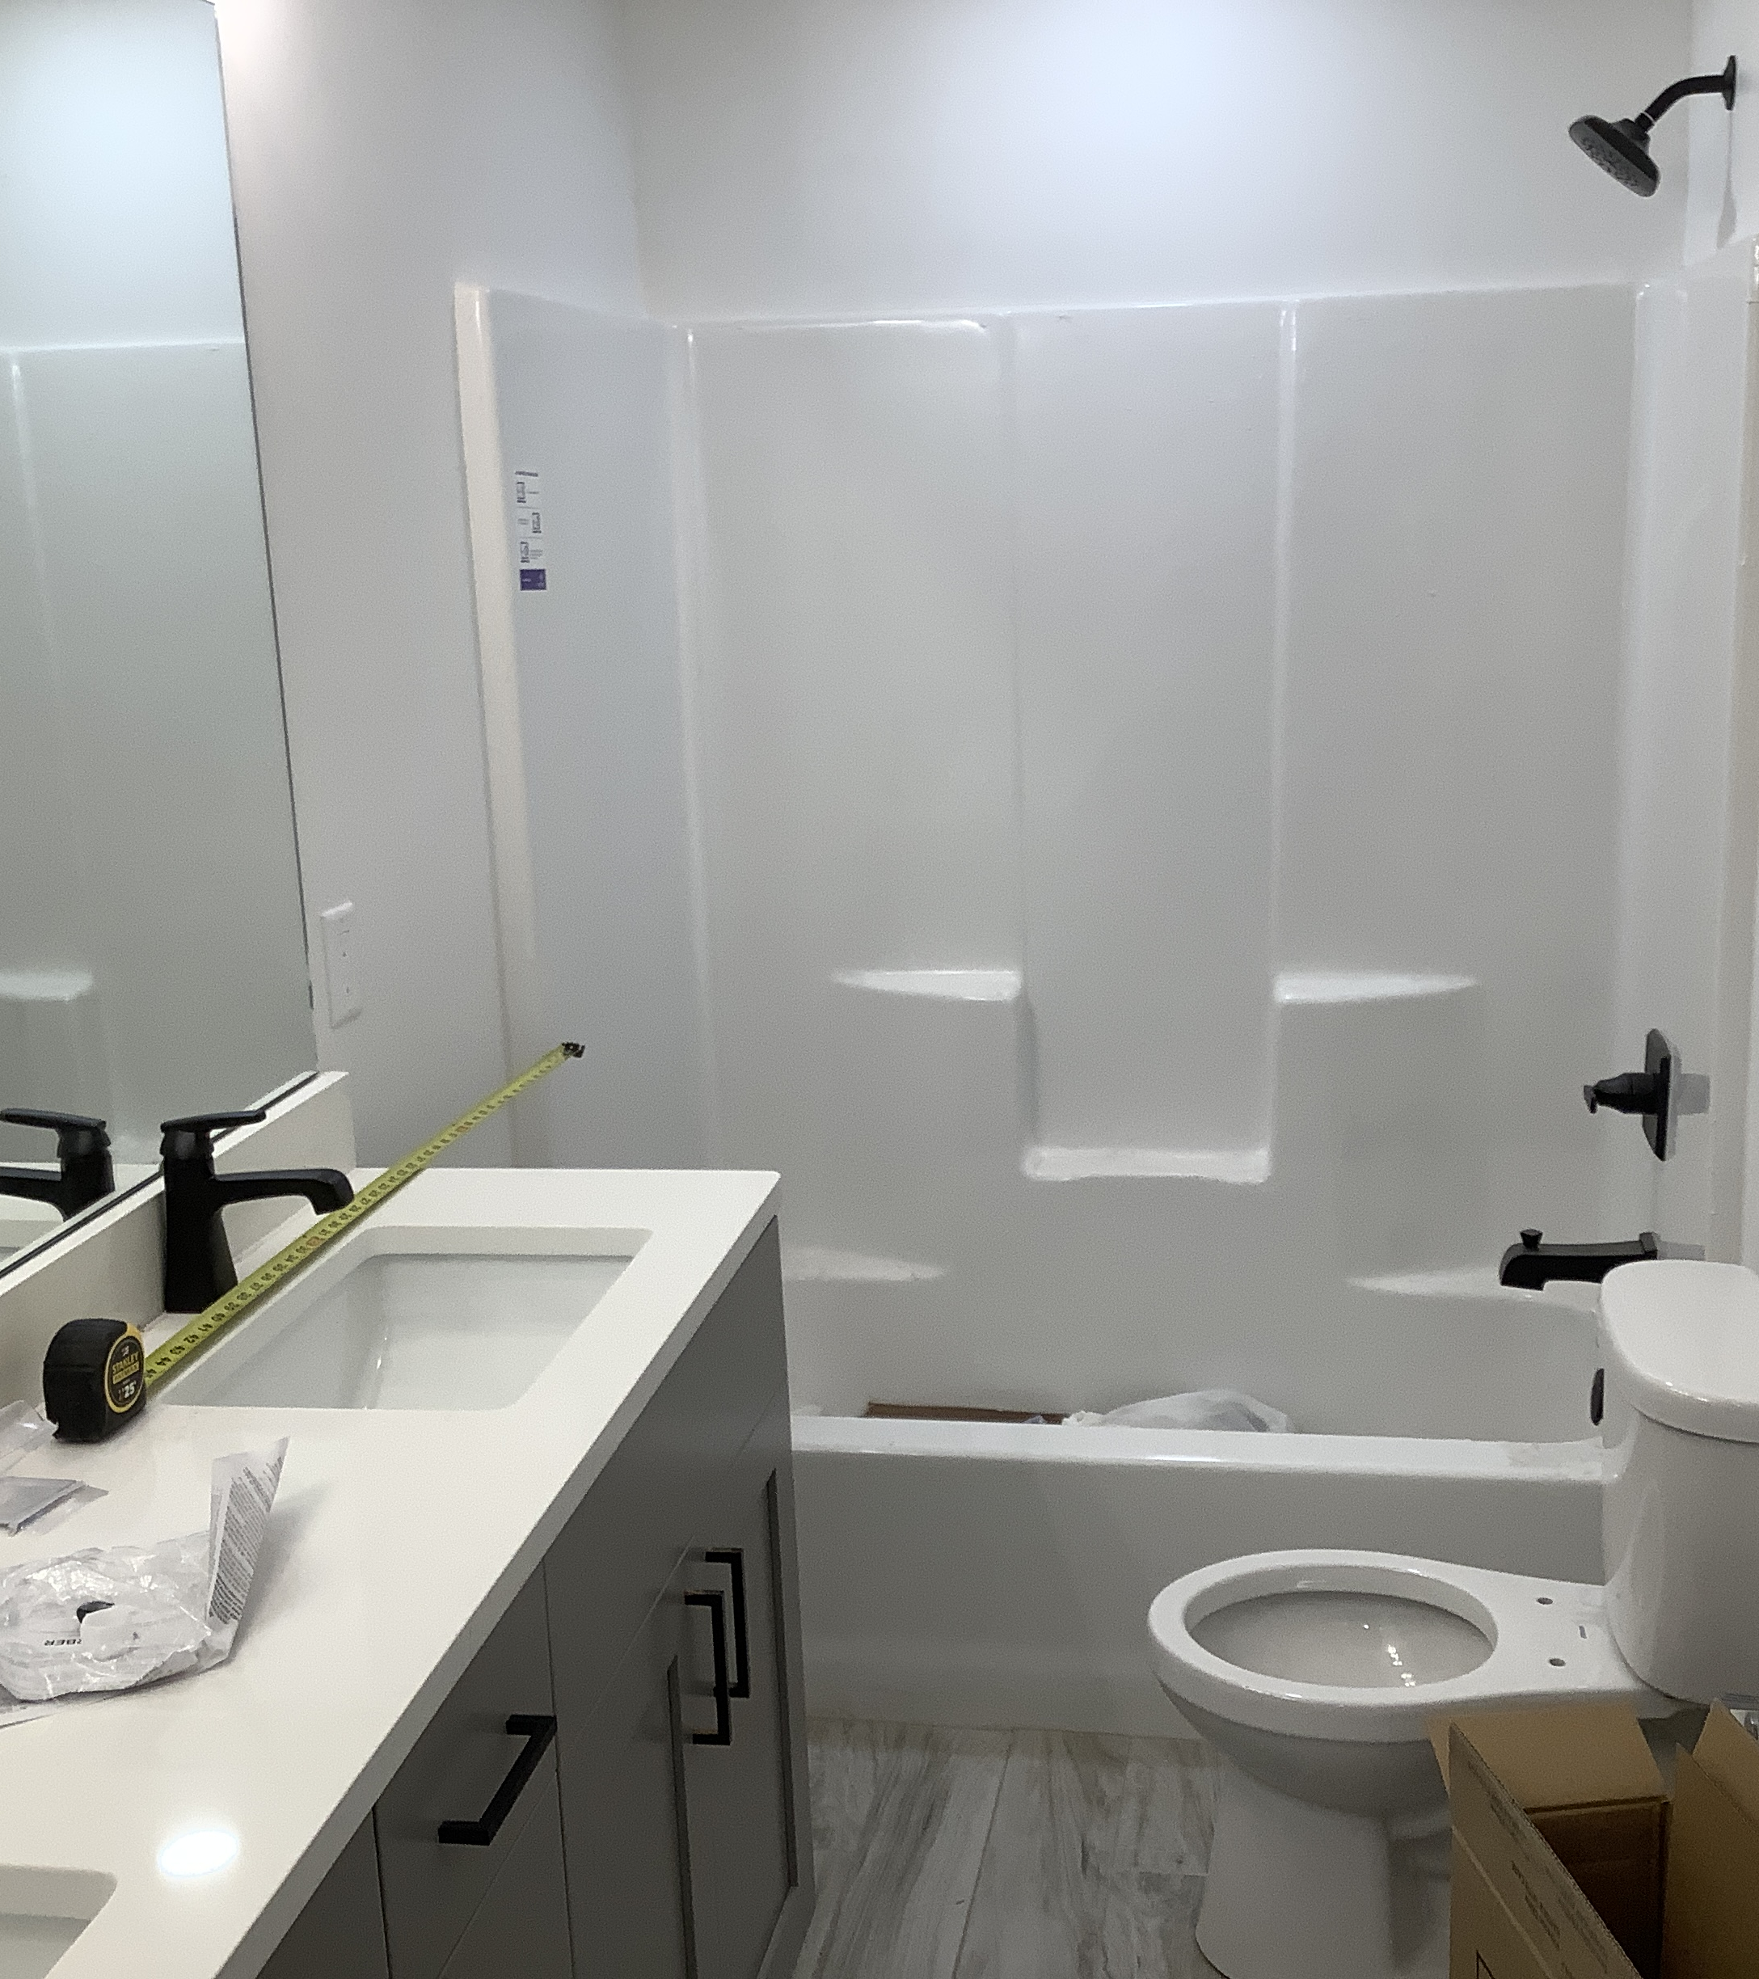

Slide 35
406.12 - Tamper Resistant Receptacles
All 15- and 20-ampere 125- and 250-volt nonlocking type receptacles in the areas specified… shall be listed tamper-resistant receptacles.
(1) Dwelling units, including attached or detached garages or accessory buildings.

Slide 36
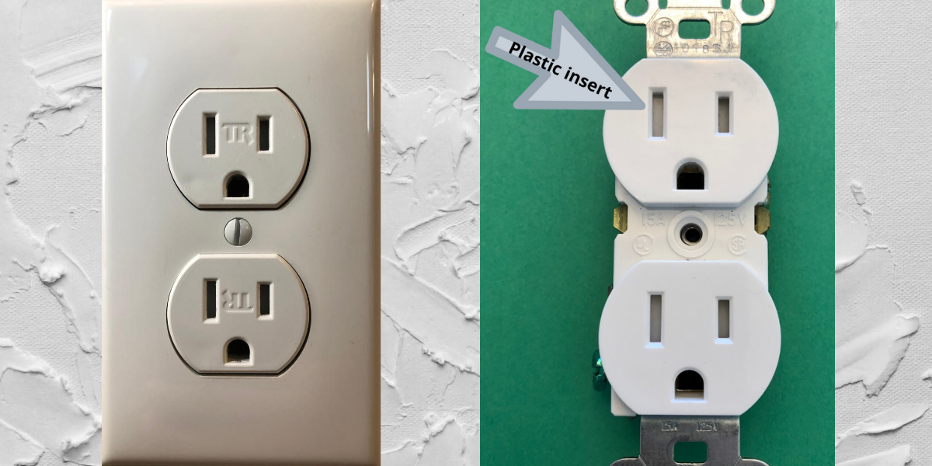
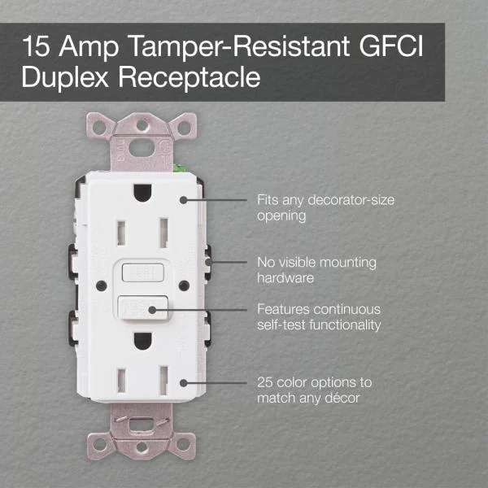
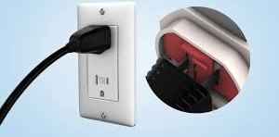

Slide 37
408.4(A) – Circuit Directory
Circuits still must be identified and included in a circuit directory, but the circuit directory is now also allowed to be located adjacent to the panel in an approved location, if the electrician doesn’t want to keep it inside the panelboard cabinet.

Slide 38
408.6 – Short Circuit Current Rating
In other than one– and two-family dwelling units, the available fault current and the date the calculation was performed shall be field marked on the enclosure at the point of supply.

Slide 39
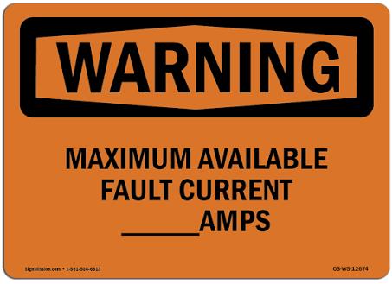
Date of Calculation:

Slide 40
422.16(B)(2) – Built-in Dishwashers
Where the flexible cord passes through an opening, it shall be protected against physical damage by a bushing, grommet, or other approved means.

Slide 41
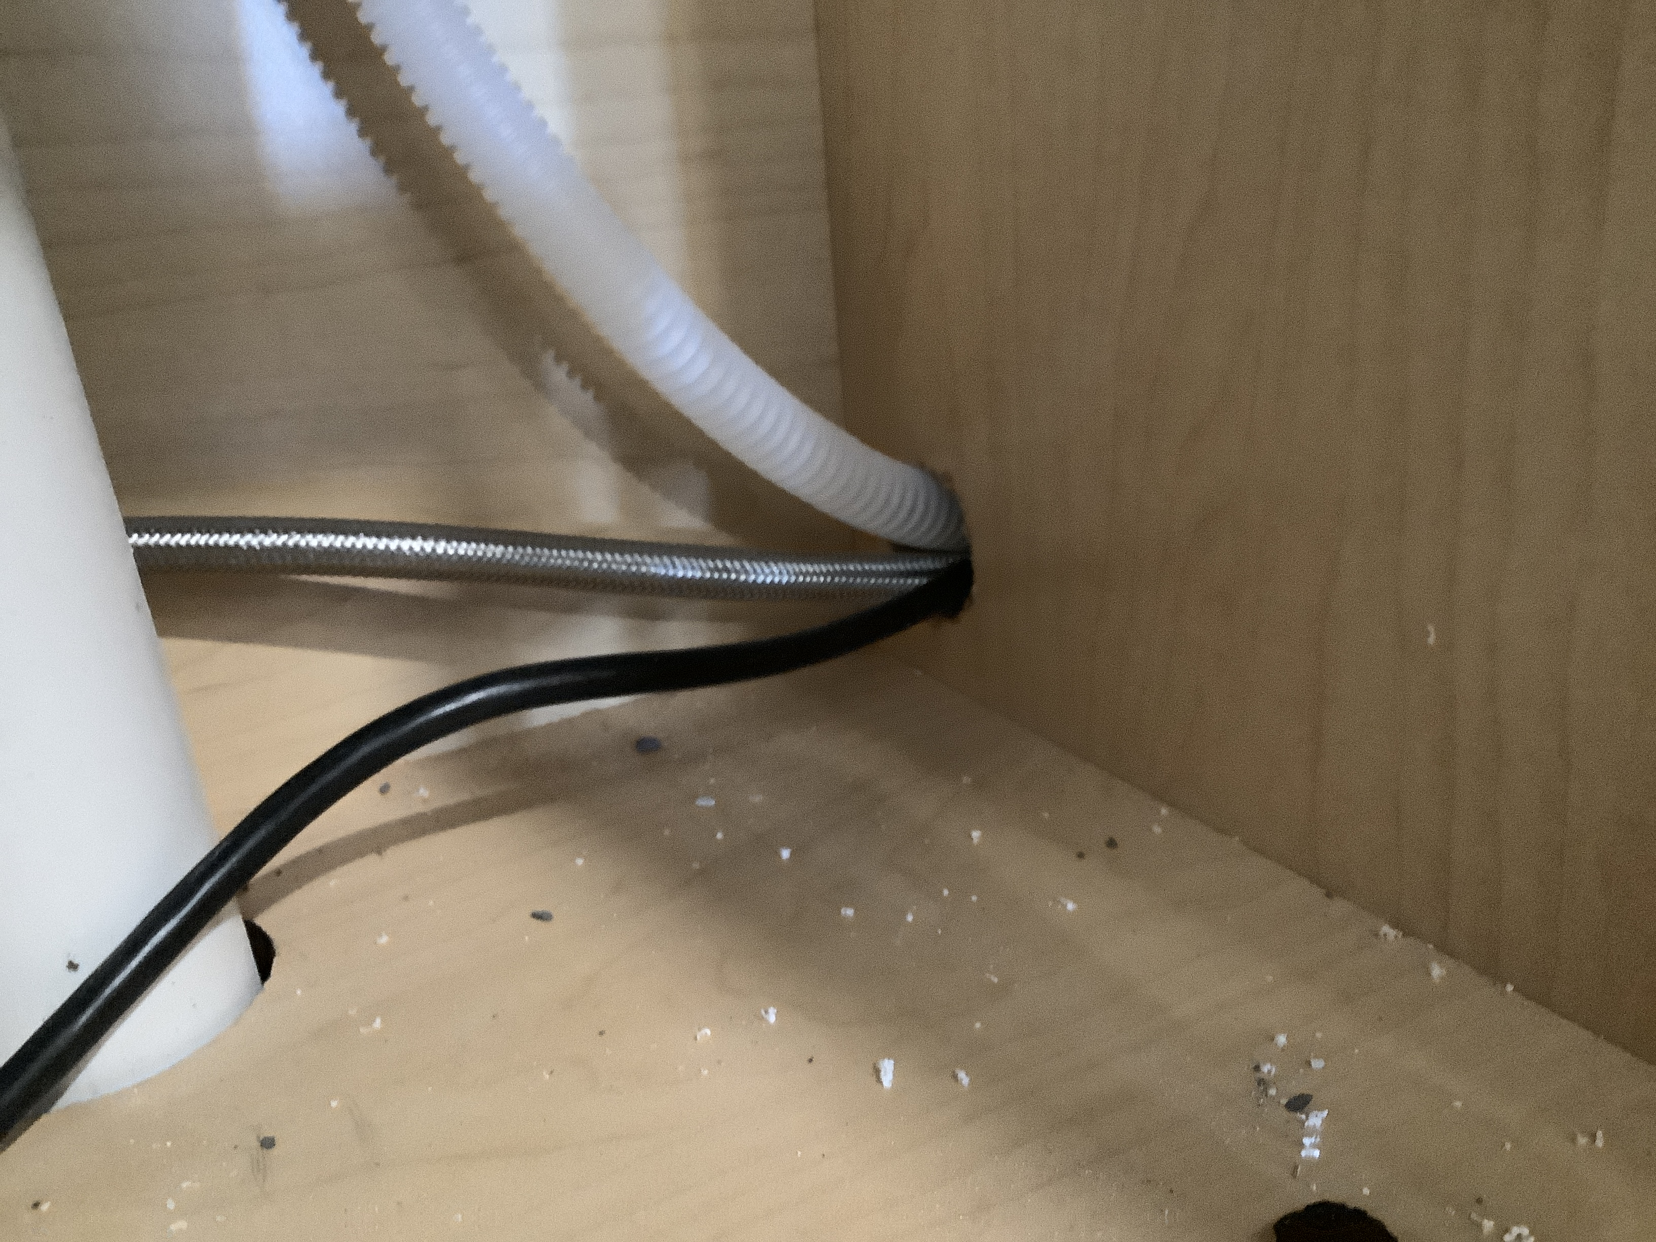

Slide 42
445.6 – Listing of Generators
Stationary generators of 600 volts or less shall be listed.

Slide 43
445.6, 480.7, 694.22, 706.15A
Emergency shut-off for secondary power
One- and two-family dwelling units need to have a readily accessible emergency shut-down device on the exterior of the house to shut off generators, storage batteries, wind powered electric systems, and energy storage systems.

Slide 44
450.9 – Labeling of transformers
Transformer top surfaces that are horizontal and readily accessible shall be marked to prohibit storage.

Slide 45
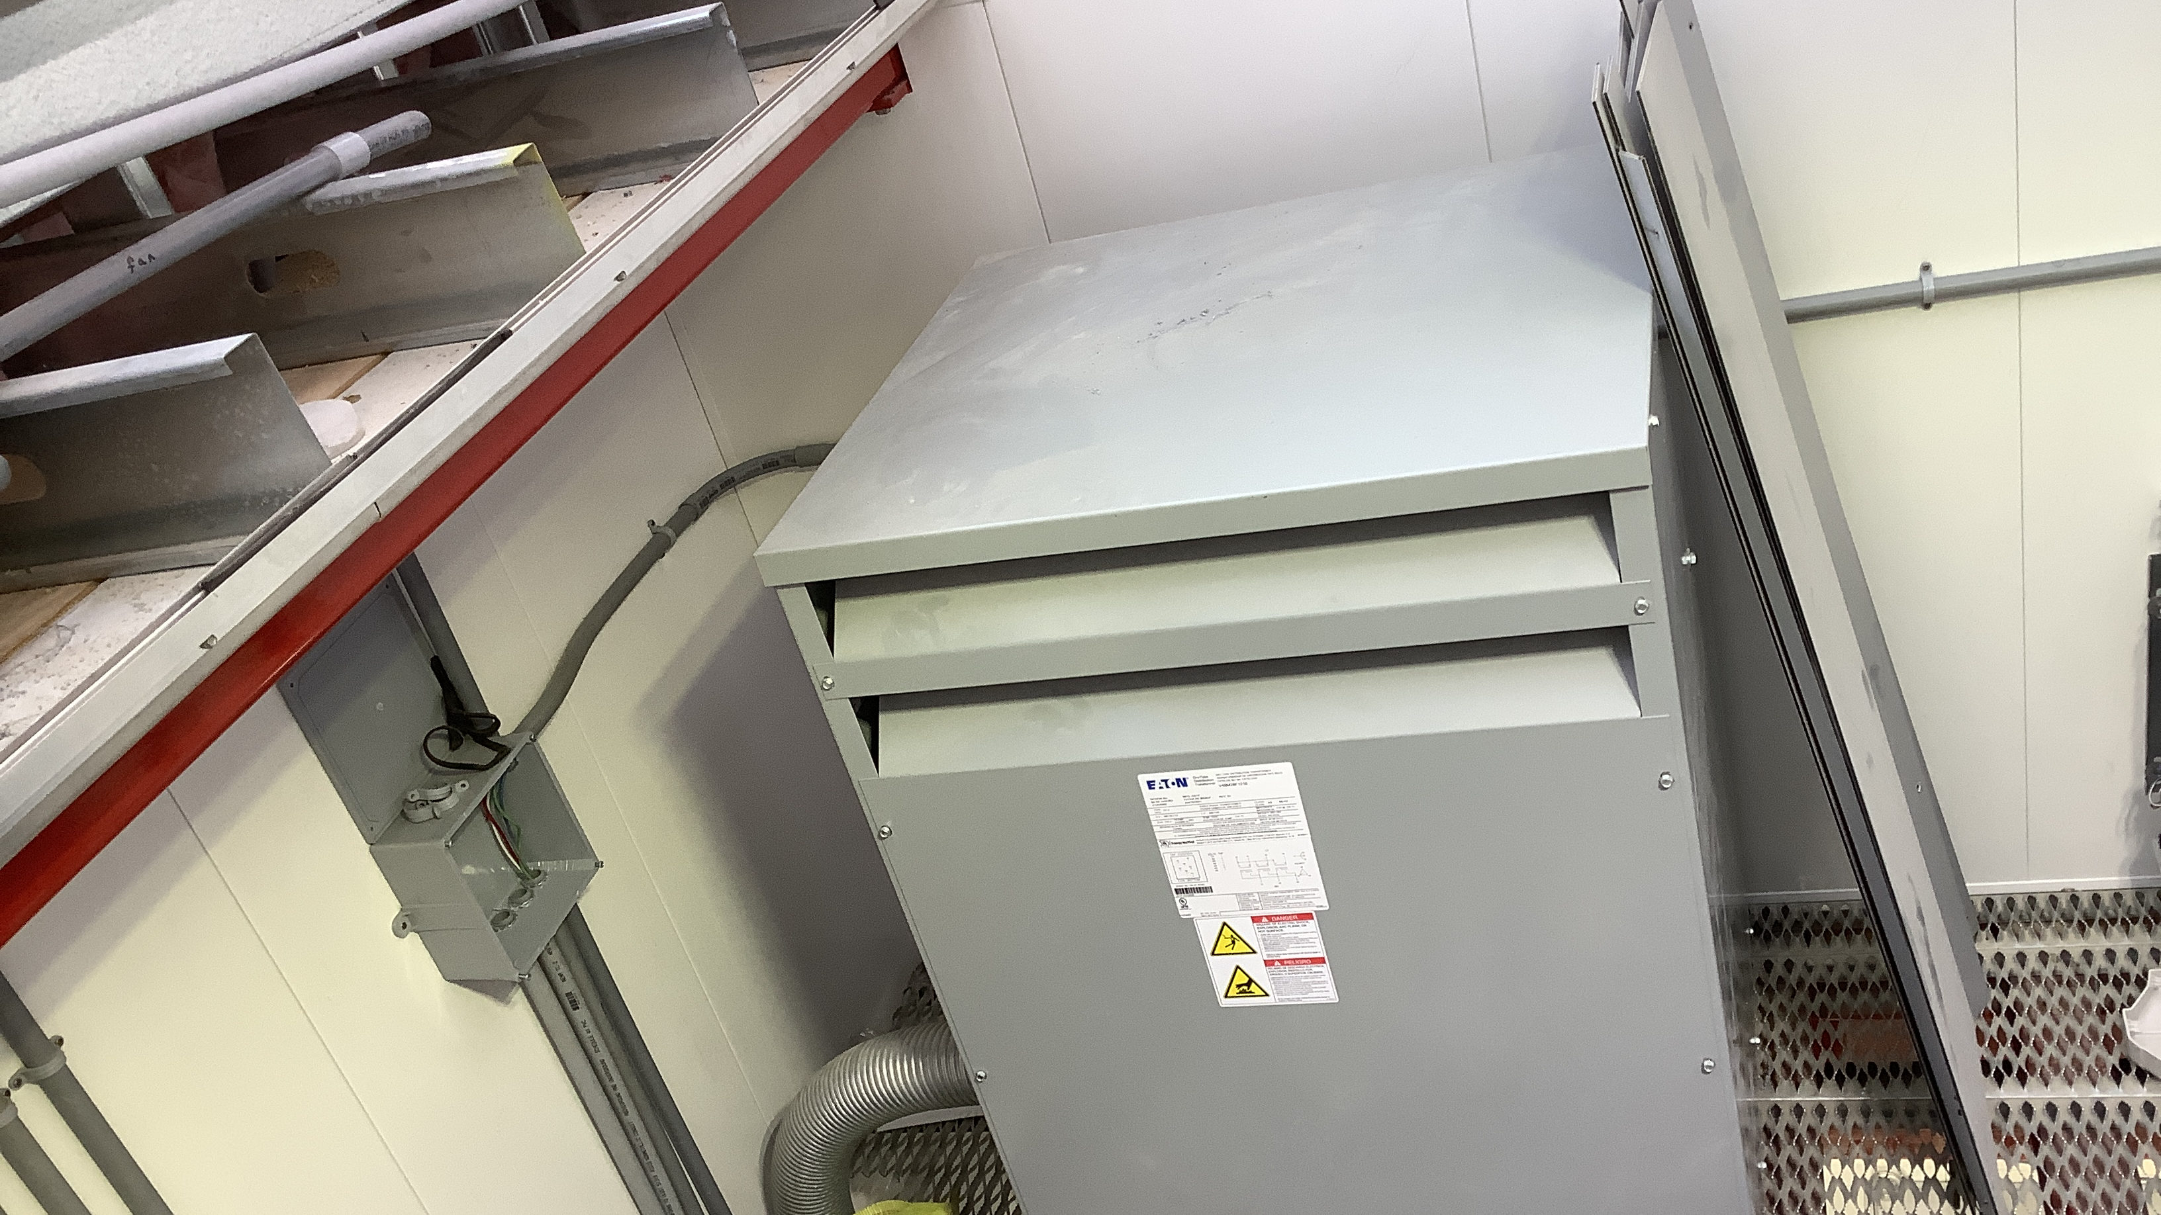

Not a Shelf – Do not store stuff here!

Slide 46
518.6 – Outdoor equipment Illumination
Assembly Occupancies: Illumination shall be provided for outdoor electrical equipment. Control by automatic means shall not be permitted.

Slide 47
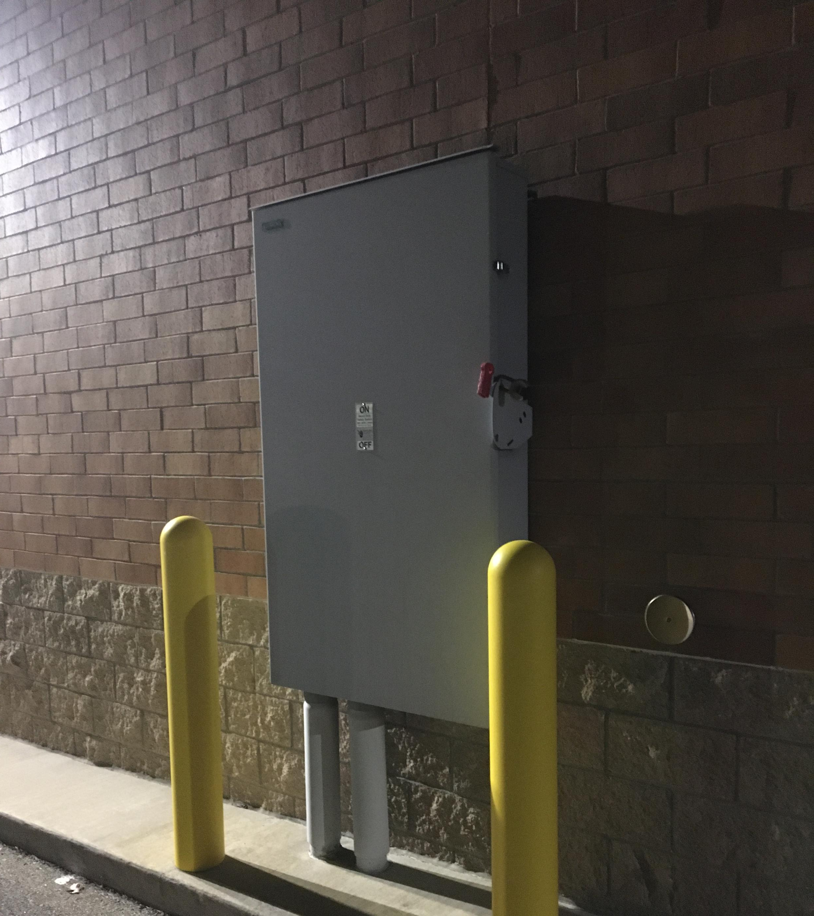
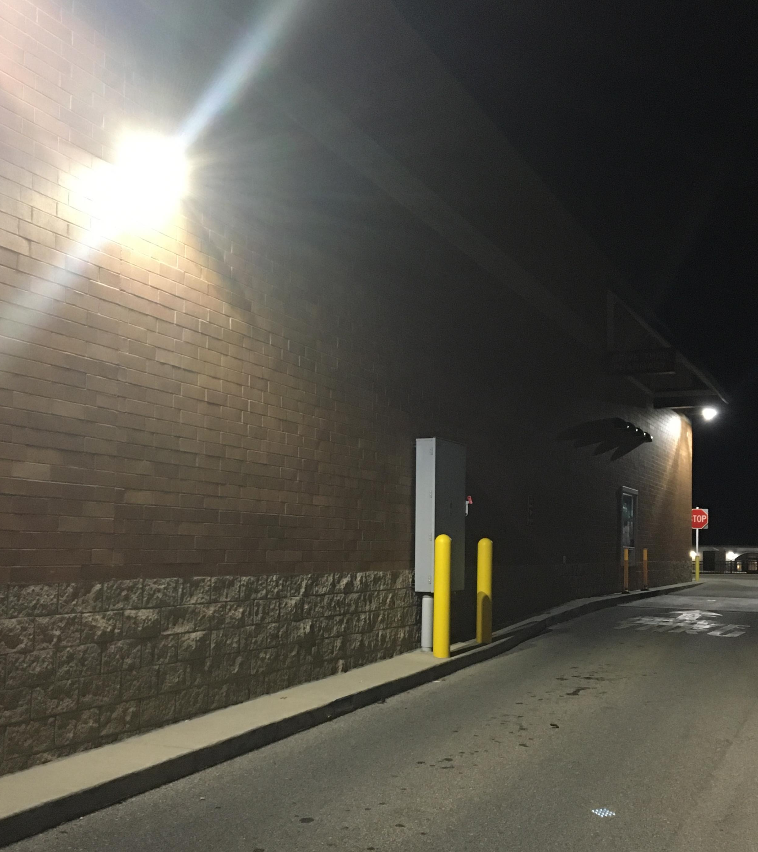

Slide 48
680.4 – Inspections after installation
Inspections After Installation.
The authority having jurisdiction shall be permitted to require periodic inspection and testing.

Slide 49
680.22(A)(5) – Pool equipment Rooms
Pool equipment rooms are required to have at least one GFCI protected 15- or 20-amp 120v receptacle installed. Additionally, any other receptacles that are less than 150v to ground shall be GFCI protected.

Slide 50
680.26(B)(5) – Equipotential bonding
Metal anchors for pool safety covers are no longer required to be bonded, if they are less than 1” wide and less than 2” long.

Slide 51
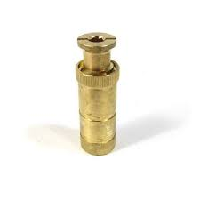
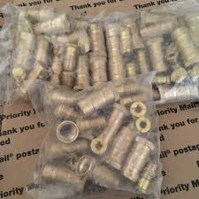
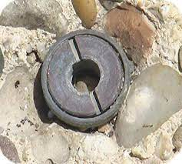

Slide 52
References
2020 NEC
Analysis of Changes to the 2020 NEC

Slide 53
The End

