Slide 1
2021 International Existing Building Code
Significant Changes

Slide 2
Application of fire code
Added a reference to tie the IEBC to chapter 11 of the IFC
New section
101.2.1 Application of fire code
  Where work regulated by this code is also regulated by the construction requirements for existing buildings in Chapter 11 of the International Fire Code, such work shall comply with the applicable requirements in both codes.
Minimal impact, but serves as a reminder that there are minimum requirements for existing buildings in the IFC that must be addressed.

Slide 3
Definitions
Change of Occupancy definition
  Modification
  CHANGE OF OCCUPANCY. Any of the following shall be considered as a change of occupancy where the current International Building Code requires a greater degree of safety, accessibility, structural strength, fire protection, means of egress, ventilation or sanitation than is existing in the current building or structure:
    Any change in the occupancy classification of a building or structure.
    Any change in the purpose of, or a change in the level of activity within, a building or structure.
    A change of use.
  Clarifies what shall be considered a change of occupancy.
Notes:
Definitions revised and new one added to clarify what a change of occupancy is.

Slide 4
Definitions
Change of Use
  New definition
  CHANGE OF USE. A change in the use of a building or a portion of a building, within the same group classification, for which there is a change in application of the code requirements.
  Defines “Change of Use” which is one of the items in the Change of Occupancy definition.
New definitions for the 2021 IEBC
  Emergency Escape and Rescue Opening
  Exterior Wall Covering
  Exterior Wall Envelope

Slide 5
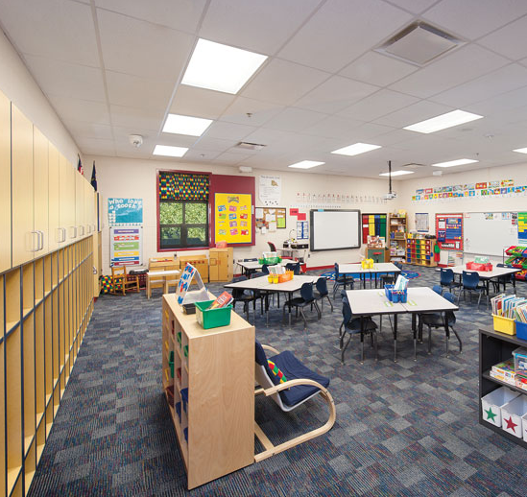
303 – Storm Shelters
Modification/relocation
Storm shelter requirements have been moved from the prescriptive and work area methods and relocated to Chapter 3 to apply generally to all compliance methods.
New Section 303.1 requires that the storm shelter comply with the International Code Council’s standard ICC 500. This language is now consistent with International Building Code (IBC) Section 423.
The required occupant capacity is now limited to the total occupant load of the classrooms, vocational rooms and offices in the school while the maximum distance of travel has been deleted.
Notes:
Modification. Moved from various sections to the general compliance Chapter 3 and references ICC 500

Slide 6
303 – Storm Shelters
303.2 Addition to a Group E occupancy.
  Where an addition is added to an existing Group E occupancy located in an area where the shelter design wind speed for tornados is 250 mph (402.3 km/h) in accordance with Figure 304.2(1) of ICC 500 and the occupant load in the addition is 50 or more, the addition shall have a storm shelter constructed in accordance with ICC 500.
    Exceptions:
      1.Group E day care facilities.
      2.Group E occupancies accessory to places of religious worship.
      3.Additions meeting the requirements for shelter design in ICC 500.
Notes:
Modification. Moved from various sections to the general compliance Chapter 3 and references ICC 500

Slide 7
303 – Storm Shelters
303.2.1 Required occupant capacity.
  The required occupant capacity of the storm shelter shall include all buildings on the site, and shall be the total occupant load of the classrooms, vocational rooms and offices in the Group E occupancy.
    Exceptions:
      1.Where an addition is being added on an existing Group E site, and where the addition is not of sufficient size to accommodate the required occupant capacity of the storm shelter for all of the buildings on-site, the storm shelter shall at a minimum accommodate the required capacity for the addition.
      2.Where approved by the code official, the required occupant capacity of the shelter shall be permitted to be reduced by the occupant capacity of any existing storm shelters on the site.
Notes:
Modification. Moved from various sections to the general compliance Chapter 3 and references ICC 500

Slide 8
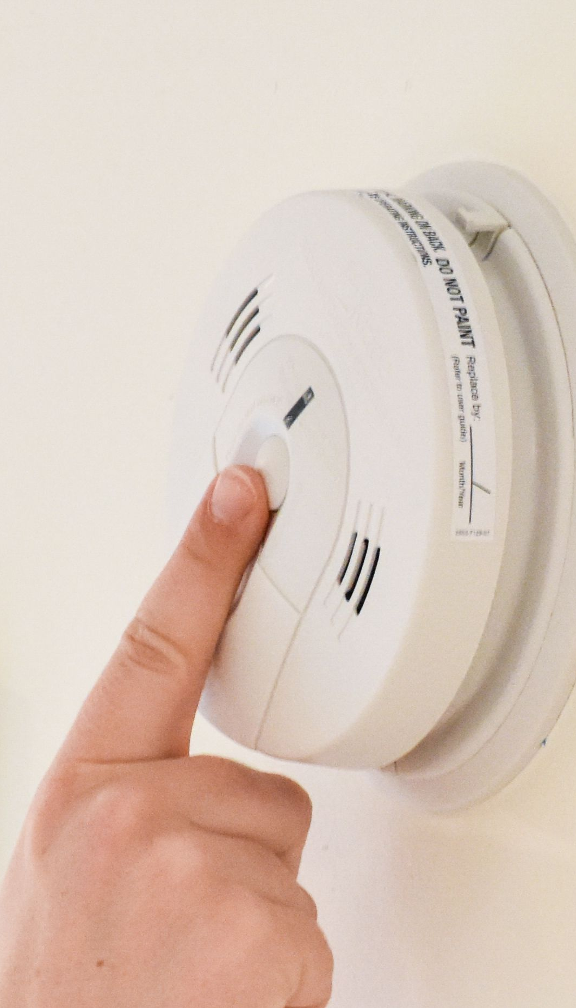
307 & 308 – Smoke Alarms & Carbon Monoxide Detection
The requirements for smoke alarms and CO alarms have been relocated to Chapter 3 to apply to all three compliance methods.
CO requirements have been revised to recognize the use of both CO alarms and CO detection systems.
Group E classrooms have also been added to the locations requiring CO detection to provide consistency with the requirements for existing buildings in Chapter 11 of the International Fire Code (IFC).
Notes:
Moved from various sections to the general compliance section to make the requirements equal across the board

Slide 9
307 & 308 – Smoke Alarms & Carbon Monoxide Detection
307.1 Smoke alarms.
  Where an alteration, addition, change of occupancy or relocation of a building is made to an existing building or structure of a Group R and I-1 occupancy, the existing building shall be provided with smoke alarms in accordance with the International Fire Code or Section R314 of the International Residential Code.
    Exception: Work classified as Level 1 Alterations in accordance with Chapter 7.
308.1 Carbon monoxide detection.
  Where an addition, alteration, change of occupancy or relocation of a building is made to Group I-1, I-2, I-4 and R occupancies and classrooms of Group E occupancies, the existing building shall be provided with carbon monoxide detection in accordance with the International Fire Code or Section R315 of the International Residential Code.
    Exceptions:
      1.Work involving the exterior surfaces of buildings, such as the replacement of roofing or siding, the addition or replacement of windows or doors, or the addition of porches or decks.
      2.Installation, alteration or repairs of plumbing or mechanical systems, other than fuel-burning appliances.
      3.Work classified as Level 1 Alterations in accordance with Chapter 7.
Notes:
Moved from various sections to the general compliance section to make the requirements equal across the board

Slide 10
307 & 308 – Smoke Alarms & Carbon Monoxide Detection
Intended to provide consistent requirements between methods, these requirements will also apply when the performance method is chosen.
  The CO requirements have been revised to reflect “detection” versus “alarm” considerations to recognize that either CO alarms or a CO detection system may be used.
  Two new exceptions clarify that these provisions are only intended to apply to Level 2 and 3 alterations, changes of occupancy and additions mirroring the application of requirements in the 2018 IEBC.
Notes:
Moved from various sections to the general compliance section to make the requirements equal across the board

Slide 11
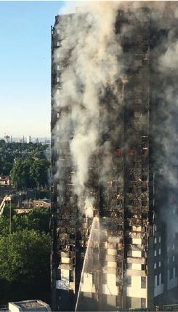
Exterior Wall Coverings & Envelopes
Addition
When significant portions of a building’s exterior wall coverings or exterior wall envelopes are added or replaced, they must comply with the requirements of Chapters 14 and 26 of the IBC.
Added in response to large fires related to exterior wall envelope or exterior wall covering.
Requirements will ensure the safety of existing buildings when replacement of the exterior wall covering or envelope is performed. Existing buildings, which may not have the same life safety features as a new building, are more at risk from non-code-compliant exterior wall envelopes and exterior wall coverings.
Notes:
New section
Where either replacing an exterior wall covering or envelope, or where an exterior wall assembly or an exterior wall envelope is added, materials and systems must now meet the minimum performance and safety requirements in IBC Chapters 14 and 26 as applicable. This provision applies when the building owner voluntarily makes changes or when replacement is necessary due to damage or failure of the exterior wall covering or envelope.
Two or more contiguous stories and more than 15% of the total wall area on any side of the building
Grenfell Fire – June 2017
72 fatalities – Started in a dwelling unit on the 4th floor
combustible cladding with an air gap lead to rapid exterior fire spread
Issues – We do not issue permits for exterior siding/finish work that does not involve any additions, alterations, etc.

Slide 12
Exterior Wall Coverings & Envelopes
309.1 General.
  The provisions of Section 309 apply to all alterations, repairs, additions, relocations of structures and changes of occupancy regardless of compliance method.
309.2 Additions and replacements.
  Where an exterior wall covering or exterior wall envelope is added or replaced, the materials and methods used shall comply with the requirements for new construction in Chapter 14 and Chapter 26 of the International Building Code if the added or replaced exterior wall covering or exterior wall envelope involves two or more contiguous stories and comprises more than 15 percent of the total wall area on any side of the building.
Notes:
New section
Where either replacing an exterior wall covering or envelope, or where an exterior wall assembly or an exterior wall envelope is added, materials and systems must now meet the minimum performance and safety requirements in IBC Chapters 14 and 26 as applicable. This provision applies when the building owner voluntarily makes changes or when replacement is necessary due to damage or failure of the exterior wall covering or envelope.
Two or more contiguous stories and more than 15% of the total wall area on any side of the building
Grenfell Fire – June 2017
72 fatalities – Started in a dwelling unit on the 4th floor
combustible cladding with an air gap lead to rapid exterior fire spread
Issues – We do not issue permits for exterior siding/finish work that does not involve any additions, alterations, etc.

Slide 13
Changes not likely to have impact
405.2.4 – Snow loads
  Must address snow loads during the repair of substantial structural damage
  Only applies to repairs after substantial structural damage
502.6, 503.16, 506.6 & 903.4, 1011.4, 1101.4 – Classroom Acoustics
  Additions, Level 3 alterations and changes of occupancy in educational occupancies are now required to meet the enhanced classroom acoustic requirements of Section 808 of ICC A117.1.
  Not likely to have any school alterations/additions for many years
503.4 – Rooftop Equipment Dead Load
  The addition of equipment to the roof without a full structural analysis is now permitted when the equipment weighs less than 400 pounds and is less than 10 percent of the total roof dead load.
  Only applies to prescriptive compliance method
  Gives us a hard number to draw the line for when structural evaluation is required for new rooftop equipment

Slide 14
Changes not likely to have impact
Change of occupancy from Group S or U to any other occupancy
  Seismic upgrade required but allows use of reduced seismic loads if the risk category doesn’t change
Seating in Nursing Home Corridors
  Allows furniture to be added to corridor in a nursing home. Change to mirror the IBC
803.2.2 – Sprinkler requirements for Level 2 alterations
  Requires work areas in I-2 occupancies to be equipped with fire sprinkler system
  All I-2 occupancies are already sprinklered throughout
803.2.5 – Sprinkler requirements in buildings and special uses
  Only applies to uses/buildings in IBC table 903.2.11.6

Slide 15
Locking Arrangements in Educational Occupancies
Requirements in the IBC have been referenced to provide special allowances for educational occupancies with regard to door lock mechanisms.
The new provisions within the prescriptive method and the work area method are intended to correlate with provisions found within the IBC and IEBC regarding locking arrangements in educational spaces. It is especially important to place these requirements in the IEBC to make sure where alterations are made that the locking arrangements are safe.
Notes:
Addition
Will ensure locking arrangements are compliant in alterations

Slide 16
Locking Arrangements in Educational Occupancies
503.17 & 704.3 Locking arrangements in educational occupancies.
  In Group E occupancies, Group B educational occupancies and Group I-4 occupancies, egress doors with locking arrangements designed to keep intruders from entering the room shall comply with Section 1010.2.8 of the International Building Code.
Existing buildings are more likely to make use of unapproved devices that do not meet egress requirements. Oftentimes, locks or devices are added to doors to provide security, but they do not allow free egress or comply with the single operation requirement. The new provisions within the IEBC are consistent with Section 1010.2.8 of the IBC and IFC to provide guidance for combining security while maintaining safe egress capabilities.
Notes:
Addition
Will ensure locking arrangements are compliant in alterations

Slide 17
Emergency Escape & Rescue Openings
Added allowances during a change of occupancy to use replacement window requirements for the installation of emergency escape and rescue openings.
New provisions allow the use of existing and smaller replacement windows for emergency escape and rescue openings (EEROs) within a change of occupancy when applying both the prescriptive and work area methods, providing flexibility while still maintaining the level of safety for occupants and emergency responders.
Notes:
New addition to the IEBC
Previously, Sections 505 and 702 were not applicable to Change of Occupancy; therefore, provisions have been added to Section 506 and updated in Chapter 10 to provide this same allowance for a change of occupancy. The new provisions address occupancies that are converted to a Group R-3, R-4 or single exit R-2 occupancy. EEROs are required by IBC Section 1031 in Group R-3 and R-4 dwellings and for Group R-2 apartments in a single exit building (4 units per story, 3 stories above grade plane maximum).

Slide 18
Emergency Escape & Rescue Openings
1011.5.6 Existing emergency escape and rescue openings.
  Where a change of occupancy would require an emergency escape and rescue opening in accordance with Section 1031 of the International Building Code, operable windows serving as the emergency escape and rescue opening shall comply with the following:
    1. An existing operable window shall provide a minimum net clear opening of 4 square feet (0.38 m2) with a minimum net clear opening width and height of 18 inches (457 mm) and a maximum sill height above floor level of 48 inches (1219 mm). Permanently installed step(s) may be used to attain maximum sill height. Such step(s) must have a minimum tread of 12 inches and a maximum riser height of 16 inches.
    2. A replacement window where such window complies with both of the following:
      2.1. The replacement window meets the size requirements in Item 1.
      2.2. The replacement window is the manufacturer’s largest standard size window that will fit within the existing frame or existing rough opening. The replacement window shall be permitted to be of the same operating style as the existing window or a style that provides for an equal or greater window opening area than the existing window.
Notes:
New addition to the IEBC

Slide 19
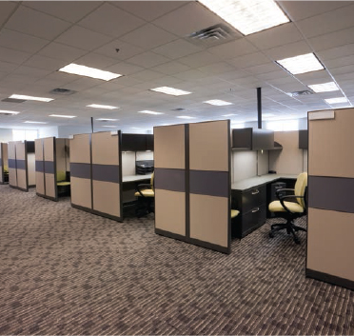
Furniture & Casework
Furniture, such as office cubicles, reception desks and small bookcases, are exempt from a permit and not intended to be a Level 2 alteration nor contribute to work area.
Clarification has occurred by recognizing that cubicle walls are considered furniture when they are no more than 5 feet 9 inches in height, and where they do not create a work area.
Notes:
Modification and new section

Slide 20
Furniture & Casework
603.1Scope.
  Level 2 alterations include the addition or elimination of any door or window, the reconfiguration or extension of any system, or the installation of any additional equipment, and shall apply where the work area is equal to or less than 50 percent of the building area.
    Exception: The movement or addition of nonfixed and movable fixtures, cases, racks, counters and partitions not over 5 feet 9 inches (1753 mm) in height shall not be considered a Level 2 alteration.
704.2Casework.
  Addition, alteration or reconfiguration of nonfixed and movable cases, counters and partitions not over 5 feet 9 inches (1753 mm) in height shall maintain the required means of egress path.
Notes:
Modification and new section

Slide 21
Level 2 Alterations
603.1Scope.
  Level 2 alterations include the addition or elimination of any door or window, the reconfiguration or extension of any system, or the installation of any additional equipment, and shall apply where the work area is equal to or less than 50 percent of the building area.
    Exception: The movement or addition of nonfixed and movable fixtures, cases, racks, counters and partitions not over 5 feet 9 inches (1753 mm) in height shall not be considered a Level 2 alteration.
801.3 System installations. Requirements related to work area are not applicable where the Level 2 alterations are limited solely to one or more of the following:
  1.Mechanical systems, electrical systems, fire protection systems and abatement of hazardous materials.
  2.Windows, hardware, operating controls, electrical outlets and signs.
  3.Alterations undertaken for the primary purpose of increasing the accessibility of a facility.
It has been clarified that the work area has limited applicability and does not include building systems, windows and alterations for the purpose of increasing accessibility.
Additionally, a project can be a Level 2 alteration without an assigned work area. Level 2 alterations, as defined in IEBC Chapter 6, include the addition or extension of any system.
Notes:
New section
Have to look at the definition of alteration - ALTERATION. Any construction or renovation to an existing structure other than a repair or addition.
Sections 802 – Building Elements and Materials, 803 – Fire Protection, & 804 – Means of Egress are not applicable if there is no “work area”
Alterations to mechanical, electrical, plumbing, fire protection are considered a level 2 alteration but they do not constitute a “work area”

Slide 22
Sprinklers and Level 3 Alterations
Sprinkler requirements for Level 3 alterations have been modified to clarify required systems based on the specific occupancy and location of the work area.
904.1.4 Groups A, B, E, F-1, H, I-1, I-3, I-4, M, R-1, R-2, R-4, S-1 and S-2.
  In buildings with occupancies in Groups A, B, E, F-1, H, I-1, I-3, I-4, M, R-1, R-2, R-4, S-1 and S-2 work areas shall be provided with automatic sprinkler protection where all of the following conditions occur:
    1.The work area is required to be provided with automatic sprinkler protection in accordance with the International Building Code as applicable to new construction.
    2.The building site has sufficient municipal water supply for design and installation of an automatic sprinkler system.
Nearly all existing buildings have sufficient municipal water supply available at the site
Notes:
Addition to make the package of requirements more complete for level 3 alterations.
Section 904.1.7 was modified to recognize that once a project becomes a Level 3 alteration, the provisions should not be limited to more than one tenant or a minimum occupant load of 30 people. Level 3 also does not limit the application of sprinkler requirements to situations where a fire pump is not required, but rather the requirements focus on whether sufficient water is available at the building site.

Slide 23
Sprinklers and Level 3 Alterations
904.1.4 Groups A, B, E, F-1, H, I-1, I-3, I-4, M, R-1, R-2, R-4, S-1 and S-2.
  In buildings with occupancies in Groups A, B, E, F-1, H, I-1, I-3, I-4, M, R-1, R-2, R-4, S-1 and S-2 work areas shall be provided with automatic sprinkler protection where all of the following conditions occur:
    1.The work area is required to be provided with automatic sprinkler protection in accordance with the International Building Code as applicable to new construction.
    2.The building site has sufficient municipal water supply for design and installation of an automatic sprinkler system.
    Exception: If the building site does not have sufficient municipal water supply for design of an automatic sprinkler system, work areas shall be protected by an automatic smoke detection system throughout all occupiable spaces other than sleeping units or individual dwelling units that activates the occupant notification system in accordance with Sections 907.4 , 907.5 and 907.6 of the International Building Code.
Notes:
Addition to make the package of requirements more complete for level 3 alterations.

Slide 24
Sprinklers and Level 3 Alterations
904.1.6 Windowless stories.
  Work located in a windowless story, as determined in accordance with the International Building Code, shall be sprinklered where the work area is required to be sprinklered under the provisions of the International Building Code for newly constructed buildings and the building site has a sufficient municipal water supply for the design and installation of an automatic sprinkler system.
Notes:
Addition to make the package of requirements more complete for level 3 alterations.

Slide 25
Special and Incidental Uses
Section 1002 has been revised to provide a general reference to IBC Chapter 4 for special uses, to require compliance with incidental uses in accordance with the IBC
1002.1 Compliance with the building code.
  Where an existing building or part of an existing building undergoes a change of occupancy to one of the special use or occupancy categories as described in Chapter 4 in the International Building Code, the building shall comply with all of the requirements of Chapter 4 of the International Building Code applicable to the special use or occupancy.
1002.2 Incidental uses.
  Where a portion of a building undergoes a change of occupancy to one of the incidental uses listed in Table 509.1 of the International Building Code, the incidental use shall comply with Section 509 of the International Building Code applicable to the incidental use.
Provides general reference back to Chapter 4 of the IBC instead of listing all the special uses and incidental uses in the IEBC.
Notes:
Modification/expansion

Slide 26
Plumbing requirements in a change of occupancy
New exception for increased plumbing system demand
1009.1 Increased demand.
  Where the occupancy of an existing building or part of an existing building is changed such that the new occupancy is subject to increased or different plumbing fixture requirements or to increased water supply requirements in accordance with the International Plumbing Code, the new occupancy shall comply with the intent of the respective International Plumbing Code provisions.
  Exception: Only where the occupant load of the story is increased by more than 20 percent, plumbing fixtures for the story shall be provided in quantities specified in the International Plumbing Code based on the increased occupant load.
Plumbing fixtures only need added if the occupant load of a story increases by > 20%

Slide 27
Change of Occupancy
A change of occupancy without alterations need not comply with all IEBC Level 1, 2 and 3 Alteration requirements for the work area method
1011.1 General.
  The provisions of this section shall apply to buildings or portions thereof undergoing a change of occupancy classification. This includes a change of occupancy classification within a group as well as a change of occupancy classification from one group to a different group or where there is a change of occupancy within a space where there is a different fire protection system threshold requirement in Chapter 9 of the International Building Code. Such buildings shall also comply with Sections 1002 through 1010 of this code.
The revisions to Section 1011.1 are intended to clarify that the provisions for alterations are only applicable to a change of occupancy classification where an alteration occurs. If there is an alteration, it is addressed by Chapters 7 through 9.
The provisions in Section 1011 address the minimal requirements that must be met for a change of occupancy without an alteration.
Notes:
Modification
1011 is only applicable when there is a change of occupancy classification without any associated alterations.

Slide 28
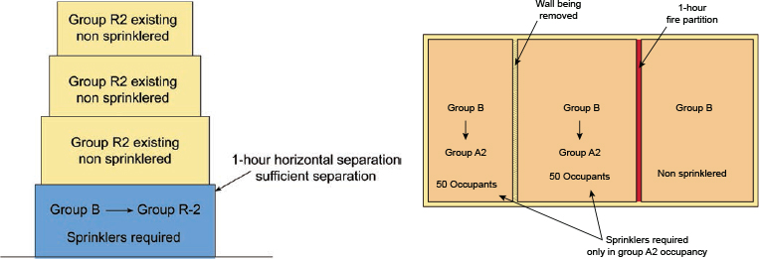
Extent of fire sprinkler system in change of occupancy
Extent of the automatic sprinkler installation has been clarified.
Clarity has been added by focusing on how extensive the system should be and what sort of physical separations are needed to get optimal performance.

Slide 29
Extent of fire sprinkler system in change of occupancy
1011.2.1 Fire sprinkler system. Where a change in occupancy classification occurs or where there is a change of occupancy within a space where there is a different fire protection system threshold requirement in Chapter 9 of the International Building Code that requires an automatic fire sprinkler system to be provided based on the new occupancy in accordance with Chapter 9 of the International Building Code. The installation of the automatic sprinkler system shall be required within the area of the change of occupancy and areas of the building not separated horizontally and vertically from the change of occupancy by one of the following:
1.Nonrated permanent partition and horizontal assemblies.
2.Fire partition.
3.Smoke partition.
4.Smoke barrier.
5.Fire barrier.
6.Fire wall.
Notes:
Section 1011.2.1 has been revised to clarify that the automatic sprinkler system is only intended in the location of the change of occupancy and, in some cases, may extend farther based on the separations provided. There has been confusion in the past as to how extensive the installation of an automatic sprinkler system required by the IBC should be in an existing building. The IBC often requires installation throughout the fire area, or in the case of residential occupancies, throughout the building. In many cases, installation throughout an existing building is viewed as excessive and not within the intent of the change of occupancy classification requirements. The result, while not confined to separated occupancies or fire areas, should lead to the installation of automatic sprinkler systems throughout the building over time.

