Slide 1
2021 International Fire Code
Significant Changes

Slide 2
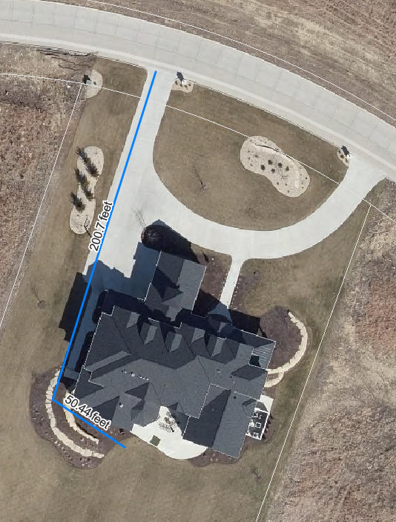
Proposed Ordinance Changes
Fire apparatus access to 1 & 2 family dwellings
Allow an increase from 150’ to 250’ from the edge of the road to all portions of the exterior of the structure

Slide 3
Changes not likely to have an impact
Fire Command Center
Not likely to have an occupancy in MHK that requires one
Fuel Oil Storage Tanks
Most fixed appliances run on natural gas
Maintenance of Fire Resistance Rated Construction
Added provisions for inspecting protection for mass timber buildings
Mechanical Access Parking Garages
Sprinkler system must be provided in enclosed mechanical access parking garages

Slide 4
Changes not likely to have an impact
Standpipes in parking garages
Removed the exceptions that allow manual and dry standpipes in parking garages
Dry standpipes are still allowed
NFPA 14 and IFC committee interpretation does not require automatic standpipes unless the building is a high rise
Portable fire extinguishers
Fire extinguishers not required in unoccupied Group U communications structures.
Fixed fire extinguishers not required in portions of S-1 occupancies where forklift operators are primary occupants.
Manual fire alarm in self storage facilities
Required in facilities 3 stories or greater in height

Slide 5
Changes not likely to have an impact
Water supply to fire pumps
2 water supply connections are required for Type IVA & IVB buildings over 120’ in height
Restricted Materials in College Labs
Clarification on the MAQ
Extraction Equipment
References a new UL standard

Slide 6
Minor Changes
Sound pressure level for audible alarms
Total sound pressure level of ambient noise and audible notification appliances not to exceed 110 dBA.
Increases ambient noise threshold from 95 to 105 dBA for omission of audible alarm appliances
Emergency Voice/Alarm Communications Systems
Now only require standby power instead of emergency power
Correlated requirements between IFC and NFPA 72
Expansion capability for fire alarms in Group R-2
Recognizes wireless and wired equipment
Allows 3 methods for wired equipment to comply with future capability requirements

Slide 7
Minor Changes
Electrical Working Space
Minimum did not change, added reference to NFPA 70 for required working space
Monitor It Yourself (MIY) monitoring
Direct transmission of alarms associated with MIY systems to the Public Safety Answering Point is prohibited
Emergency alarm and fire alarm interface
Emergency alarms shall initiate a supervisory signal at the building fire alarm system if the systems are connected
Smoke control system response time
Must be in proper operating state within 90 seconds
Smoke and Heat Vent Operation
Manual release now required
Fusible links in heat vents where sprinkler system is provided shall be 360° F

Slide 8
Minor Changes
Protection of circuits for electric fire pumps
Recognizes a minimum of 2” concrete cover to provide protection in case of fire
Fuel line piping protection for emergency and standby generators
Adds options for protecting fuel lines for generators inside buildings
Group R-1 Hotel and Motel Fire Alarm System
Requires manual fire alarm system in existing Group R-1 hotels/motels if more than one story or with more than 20 sleeping units
Portable Generators
New section and definition added to IFC to regulate portable generators
Minimum of 5’ from building openings

Slide 9
Minor Changes
Smoke ventilation with Solar PV
Clarified the requirements for ventilation options between array sections
Toxic solids in retail occupancies
MAQ can be increased under certain conditions
Outdoor Control Areas
Clarification and correlation of language
Storage of Oxidizers
Simplified the tables and clarified the requirements for storage of oxidizers
Appendix H – Chemical Facility Anti-Terrorism Standards
New appendix for security of chemical facilities

Slide 10

Additive Manufacturing – 3D Printing
Requirements for 3D printing operations are added to the code
Addition
Divides processes into industrial and nonindustrial
Nonindustrial printers are generally going to be allowed in offices, schools, etc. with no permit or other requirements other than using a listed and labeled printer.
Industrial printers will only be allowed in manufacturing occupancies and are required to meet much stricter requirements.

Slide 11
Additive Manufacturing – 3D Printing
320.2 Nonindustrial additive manufacturing. Nonindustrial additive manufacturing equipment and operations shall comply with Sections 320.2.1 and 320.2.2. Additive manufacturing equipment and operations that do not comply with Section 320.2 shall comply with Section 320.3.
320.2.1 Listing. 3D printers used in nonindustrial additive manufacturing shall be listed and labeled in accordance with ​ UL 2011, UL 60950-1 or UL 62368-1.
The listing shall also verify:
1. The 3D printers are self-contained and utilize maximum 30-liter prepackaged production materials.
2. The operation of the 3D printers shall not create a hazardous (classified) electrical area or zone outside the unit.
3. If any hazardous (classified) electrical area or zone exists inside the unit's outer enclosure, the area shall be protected by intrinsically safe electrical construction or other acceptable protection methods.
4. The 3D printers shall not utilize inert gas or an external combustible dust collection system.
320.2.2 Occupancies. Nonindustrial additive manufacturing shall be permitted in all occupancy groups.

Slide 12
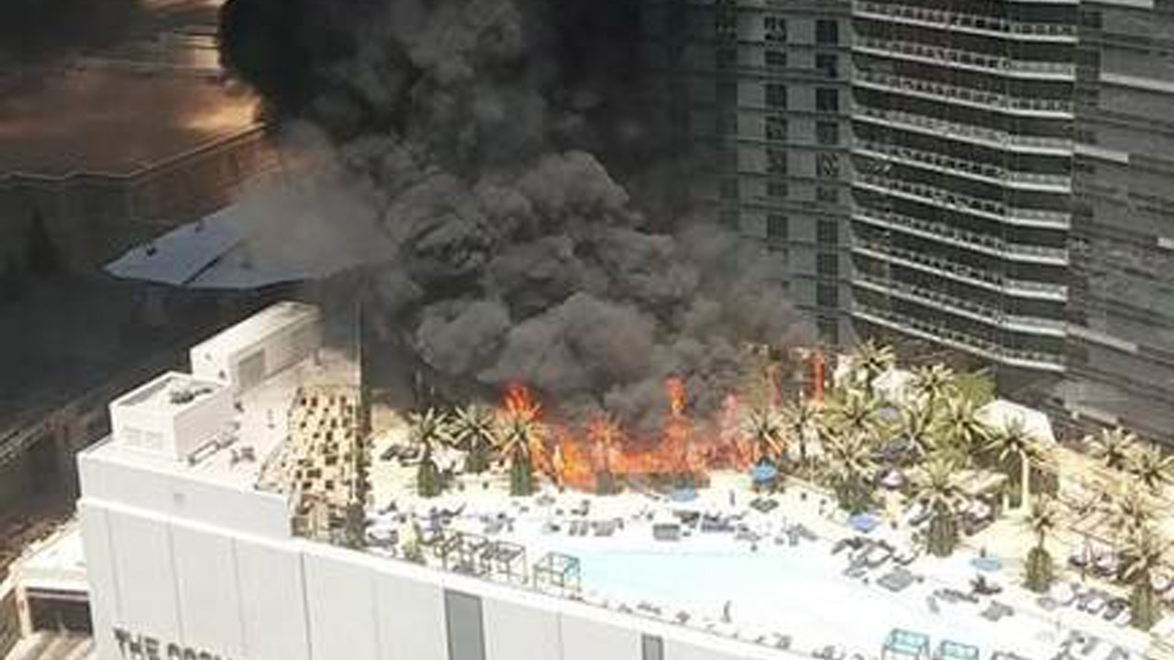
Exterior Artificial Combustible Vegetation
Artificial combustible vegetation is regulated when it is located on a roof or within close proximity to a building
Addition
321.1 Artificial combustible vegetation on roofs and near buildings. Artificial combustible vegetation exceeding 6 feet (1829 mm) in height and permanently installed outdoors within 5 feet (1524 mm) of a building or on the roof of a building shall comply with Section 807.4.1. The placement of artificial combustible vegetation shall also comply with Sections 806.3 and 807.4.2.
Exception: Artificial decorative vegetation located more than 30 feet (9144 mm) from the exterior wall of a building.
Regulates permanent artificial vegetation over 6’ high and within 5’ of a building or on the roof. Will not apply to table top ornaments and small planters.
Las Vegas Cosmopolitan Hotel – July 2015

Slide 13
Emergency Drills
The frequency of training and participation in fire drills and evacuation drills are revised. The use of defend-in-place or staged evacuation strategies are included with specific criteria for each.
Modification
405.2 Occupant participation. Emergency fire and evacuation drills shall involve the actual evacuation of occupants to a selected assembly point and shall provide occupants with experience in exiting through required exits.
Exceptions:
1. In ambulatory care facilities and Group I-2 the movement of care recipients to a safe area or to the exterior of the building is not required.
2. In Group I-1, Condition 2 the assembly point for residents is permitted to be within an adjacent smoke compartment.
3. In Group R-4, actual exiting from emergency escape and rescue openings shall not be required. Opening the emergency escape and rescue opening and signaling for help shall be an acceptable alternative.
4. In Group I-3, Conditions 2 through 5 where a defend-in-place response is permitted, the assembly point for detainees is permitted to be within an adjacent smoke compartment.
5. In Group I-3, Conditions 2 through 5, movement of detainees is not required to an assembly point where there are security concerns.
Reorganized section 405 to coordinate the requirements of fire safety, evacuation and lockdown plans and to provide for defend in place and staged evacuation strategies. Clarified that all staff are required to participate.

Slide 14
Emergency Responder Radio Coverage
The testing criteria for in-building 2-way emergency responder coverage systems is enhanced by requiring 99 percent coverage in critical areas and by adding a second test criteria for inbound signals.
Modification
510.4.1 Emergency responder communication coverage system signal strength. The building shall be considered to have acceptable in-building, two-way emergency responder communication coverage where signal strength measurements in 95 percent of all areas and 99 percent of areas designated as critical areas by the fire code official on each floor of the building meet the signal strength requirements in Sections 510.4.1.1 through 510.4.1.3.
510.4.1.1 Minimum signal strength into the building. The minimum inbound signal strength shall be sufficient to provide usable voice communications throughout the coverage area as specified by the fire code official. The inbound signal level shall be a minimum of -95dBm throughout the coverage area and sufficient to provide not less than a Delivered Audio Quality (DAQ) of 3.0 or an equivalent Signal-to-Interference-Plus-Noise Ratio (SINR) applicable to the technology for either analog or digital signals.
CRITICAL AREAS. Areas that are designated for the highest level of emergency responder radio coverage including but not limited to areas such as exit stairs, exit passageways, elevator lobbies, fire protection equipment room and control valve locations, fire command centers.
New term “in building 2-way emergency responder communication coverage system (ERCCS) is now consistent across the IFC & IBC. New definition to define what is a “Critical Area”.

Slide 15
Emergency Responder Radio Coverage
New requirements for active RF systems to have built in oscillation detection and control
Has to be monitored by a listed FACP
Donor antenna must be permanently affixed or have a clearly visible sign that reads
“Movement or repositioning of this antenna is prohibited without approval from the fire code official”
Antenna density must be engineered to minimize the near-far effect
New testing requirement for subjective voice quality using two portable radios simultaneously

Slide 16
Storage in Elevator Lobbies
Addition
Storage is prohibited in elevator lobbies
604.5.3 Storage within elevator lobbies. Where hoistway opening protection is required by Section 3006.2 of the International Building Code, elevator lobbies shall be maintained free of storage.
Furniture and other combustibles are not allowed in elevator lobbies

Slide 17
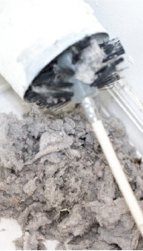
Clothes Dryer Exhaust Systems
Provisions are added to ensure the clothes dryer lint trap and exhaust ducts are cleaned and maintained properly
Addition
610.1 Clothes dryer exhaust ducts. Clothes dryer exhaust ducts shall be in accordance with Sections 610.1.1 and 610.1.2.
610.1.1 Installation. Clothes dryer vent ducts shall be installed and maintained in accordance with the International Mechanical Code or the International Fuel Gas Code and the manufacturer’s installation instructions.
610.1.2 Maintenance. The lint trap, mechanical and heating components, and the exhaust duct system of a clothes dryer shall be maintained in accordance with the manufacturer’s operating installation instructions to prevent the accumulation of lint or debris that prevents the exhaust of air and products of combustion.
Requires clothes dryers and their exhaust ducts to be cleaned and maintained according to the dryer manufacturers instructions
Will be a significant cost to apartment building owners.

Slide 18
Repair of Penetrations and Voids in Fire Resistance Rated Construction
Specific requirements have been added to the code for repair or replacement of penetrations, joints and voids in fire-resistance-rated construction.
Addition
703.2 Repair of Penetrations. Where damaged, materials used to protect membrane and through-penetrations shall be replaced or restored with materials or systems that meet or exceed the code requirements applicable at the time when the assembly was constructed, remodeled or altered.
704.2 Repair of Joints and Voids. Where damaged, materials used to protect joints and voids shall be replaced or restored with materials or systems that meet or exceed the code requirements applicable at the time when the assembly was constructed, remodeled or altered.
Allows the continued use of previously approved methods of protection

Slide 19
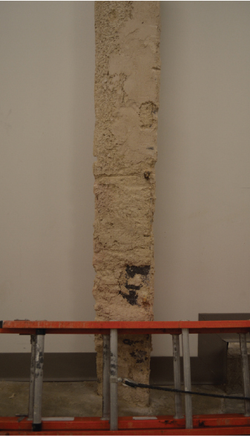
Maintenance of Spray Fire Resistant Materials
Maintenance requirements for spray fire-resistant materials and intumescent fire-resistant materials are added to the code
Addition
708.1 Maintaining protection. Where required when the building was originally permitted and constructed, spray fire-resistant materials and intumescent fire-resistant materials shall be visually inspected to verify that the materials do not exhibit exposure to the substrate.

Slide 20
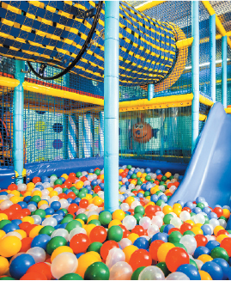
Play Structures
Play structures added to existing buildings must comply with the requirements in the International Building Code (IBC)
Addition
808.5 Play structures added to existing buildings. Where play structures that exceed 10 feet (3048 mm) in height or 150 square feet (14 m2) in area are added inside an existing building they shall comply with Section 424 of the International Building Code.
Requires materials used in the play structure to meet limits for heat release rate found in Section 424 of the IBC.

Slide 21
Life Safety Systems
A definition for life safety systems is added and sections modified to address provisions in Chapter 9 that address life safety systems in addition to fire protection systems.
Modification
202 LIFE SAFETY SYSTEMS. Systems, devices and equipment that enhance or facilitate evacuation, smoke control, compartmentation or isolation.
901.4 Fire Protection and life safety systems. Fire protection and life safety systems shall be installed, repaired, operated and maintained in accordance with this code and the International Building Code.
901.4.3 Alterations in buildings and structures. For any alteration within a building or structure, the fire protection and life safety systems shall be extended, altered or augmented to maintain and continue protection within the building or structure. Persons shall not remove or modify any fire protection or life safety system installed or maintained under the provisions of this code or the International Building Code without approval from the fire code official .
The inclusion of life safety systems acknowledges that Chapter 9 addresses fire protection systems and other systems which are life safety systems rather than fire protection systems. These systems include emergency alarms, carbon monoxide detection, mass notification and gas detection.

Slide 22
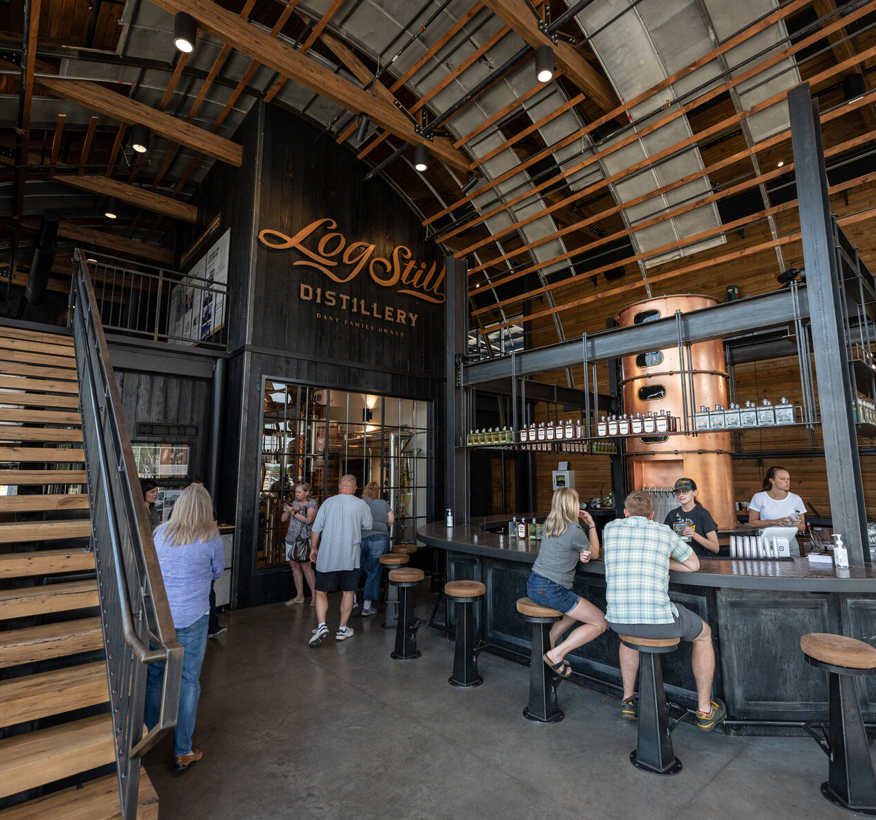
Fire sprinkler systems for Distilled Spirits
Fire areas containing Group F-1 occupancies used for the manufacturing of distilled spirits or Group S-1 occupancies used for the storage of distilled spirits or wine are required to be equipped with an automatic sprinkler system.
Addition
903.2.4.2 Group F-1 distilled spirits. An automatic sprinkler system shall be provided throughout a Group F-1 fire area used for the manufacture of distilled spirits.
903.2.9.3 Group S-1 distilled spirits or wine. An automatic sprinkler system shall be provided throughout a Group S-1 fire area used for the bulk storage of distilled spirits or wine.
ALL fire areas containing a distillery operation and the bulk storage of beverages over 16% alcohol content are required to be equipped with an automatic sprinkler system

Slide 23
Upholstered Furniture and Mattresses
Requirements for the installation of an automatic sprinkler system in facilities manufacturing, storing or selling upholstered furniture and mattresses have been revised.
Modification
Since the fire sprinkler requirements for upholstered furniture and mattresses were first added into the code there has been debate and discussion on exactly how the provisions should be applied. Because the language could be interpreted in several ways, it has led to inconsistent application and in some situations to sprinklers being required although many felt there was not a great enough hazard to justify the need for the protection. This code change modifies the sprinkler requirements for these special hazard items in Groups F-1, M and S-1 occupancies to clarify not only when the sprinkler requirements apply, but also what portions of the building require fire sprinkler systems.

Slide 24
Upholstered Furniture and Mattresses
903.2.4 Group F-1. An automatic sprinkler system shall be provided throughout all buildings containing a Group F-1 occupancy where one of the following conditions exists:
1. A Group F-1 fire area exceeds 12,000 square feet (1115 m2).
2. A Group F-1 fire area is located more than three stories above grade plane.
3. The combined area of all Group F-1 fire areas on all floors, including any mezzanines, exceeds 24,000 square feet (2230 m2).
4. A Group F-1 occupancy used for the manufacture of upholstered furniture or mattresses exceeds 2,500 square feet (232 m2).
903.2.4.3 Group F-1 upholstered furniture or mattresses. An automatic sprinkler system shall be provided throughout a Group F-1 fire area that exceeds 2,500 square feet (232 m2) used for the manufacture of upholstered furniture or mattresses.

Slide 25
Upholstered Furniture and Mattresses
903.2.7 Group M. An automatic sprinkler system shall be provided throughout buildings containing a Group M occupancy where one of the following conditions exists:
1.A Group M fire area exceeds 12,000 square feet (1115 m2).
2.A Group M fire area is located more than three stories above grade plane.
3.The combined area of all Group M fire areas on all floors, including any mezzanines, exceeds 24,000 square feet (2230 m2).
4.A Group M occupancy used for the display and sale of upholstered furniture or mattresses exceeds 5,000 square feet (464 m2).
903.2.7.2 Group M upholstered furniture or mattresses. An automatic sprinkler system shall be provided throughout a Group M fire area where the area used for the display and sale of upholstered furniture or mattresses exceeds 5,000 square feet (464 m2).

Slide 26
Upholstered Furniture and Mattresses
903.2.9 Group S-1. An automatic sprinkler system shall be provided throughout all buildings containing a Group S-1 occupancy where one of the following conditions exists:
1.A Group S-1 fire area exceeds 12,000 square feet (1115 m2).
2.A Group S-1 fire area is located more than three stories above grade plane.
3.The combined area of all Group S-1 fire areas on all floors, including any mezzanines, exceeds 24,000 square feet (2230 m2).
4.A Group S-1 fire area used for the storage of commercial motor vehicles where the fire area exceeds 5,000 square feet (464 m2).
5.A Group S-1 occupancy used for the storage of upholstered furniture or mattresses exceeds 2,500 square feet (232 m2).
903.2.9.4 Group S-1 upholstered furniture and mattresses. An automatic sprinkler system shall be provided throughout a Group S-1 fire area where the area used for the storage of upholstered furniture or mattresses exceeds 2,500 square feet (232 m2).
Exception: Self-service storage facilities not greater than one story above grade plane where all storage spaces can be accessed directly from the exterior.

Slide 27
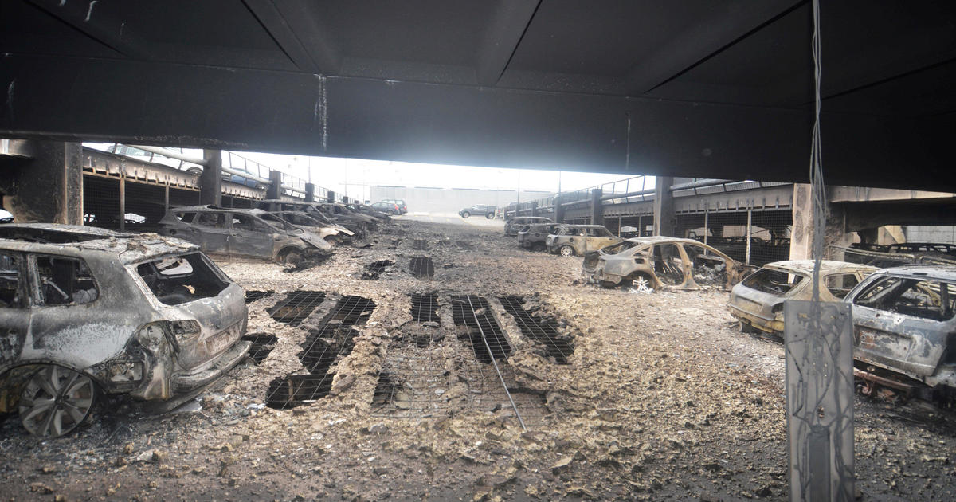
Group S-2 Parking Garages
Open parking garages are required to be equipped with an automatic sprinkler system when the fire area exceeds 48,000 square feet.
Modification
Open parking garages were previously considered a low fire risk
Legacy vehicles contained much less plastic and synthetic materials
New vehicles are a significant fire load

Slide 28
Group S-2 Parking Garages
903.2.10 Group S-2 parking garages. An automatic sprinkler system shall be provided throughout buildings classified as parking garages where any of the following conditions exists:
1. Where the fire area of the enclosed parking garage, in accordance with Section 406.6 of the International Building Code, exceeds 12,000 square feet (1115 m2).
2. Where the enclosed parking garage, in accordance with Section 406.6 of the International Building Code, is located beneath other groups.
Exception: Enclosed parking garages located beneath Group R-3 occupancies.
3. Where the fire area of the open parking garage, in accordance with Section 406.5 of the International Building Code, exceeds 48,000 square feet (4460 m2).

Slide 29
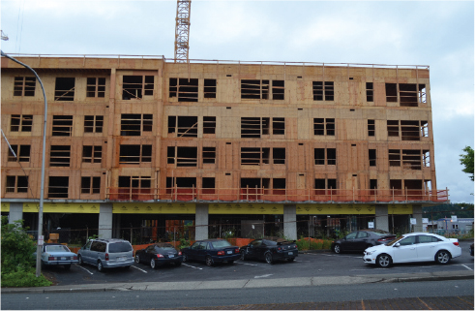
NFPA 13R Sprinkler Systems
The allowable use of NFPA 13R sprinkler systems in Group R occupancies is reduced, especially those built with the podium concept, which increases the fire protection in these buildings.
Modification
Limits the height of buildings where NFPA 13R sprinkler system can be used.
Generally, large podium buildings require NFPA 13 sprinkler system anyway due to the allowable area increases afforded with an NFPA 13 system

Slide 30
NFPA 13R Sprinkler Systems
903.3.1.2 NFPA 13R sprinkler systems. Automatic sprinkler systems in Group R occupancies shall be permitted to be installed throughout in accordance with NFPA 13R where the Group R occupancy meets all of the following conditions:
1.Four stories or less above grade plane.
2.The floor level of the highest story is 30 feet (9114 mm) or less above the lowest level of fire department vehicle access.
3.The floor level of the lowest story is 30 feet (9114 mm) or less below the lowest level of fire department vehicle access.
The number of stories of Group R occupancies constructed in accordance with Sections 510.2 and 510.4 shall be measured from the horizontal assembly creating separate buildings grade plane.

Slide 31
Sprinklers in Means of Egress Balconies
This revision modifies the requirements in NFPA 13R and specifies that sprinklers are required to protect corridors and egress balconies that are not adequately open to the exterior to provide for heat and smoke to escape.
Modification
903.3.1.2.2 Corridors and balconies in the means of egress. Sprinkler protection shall be provided in corridors and for balconies in the means of egress where any of the following conditions apply:
1. Corridors with combustible floor or walls.
2. Corridors with an interior change of direction exceeding 45 degrees (0.79 rad).
3. Corridors that are less than 50 percent open to the outside atmosphere at the ends.
4. Open-ended corridors and associated exterior stairways and ramps as specified in Section 1027.6, Exception 3.
5. Egress balconies not complying with Sections 1021.2 and 1021.3.
More strict requirements must be met for exempting sprinkler coverage for exterior means of egress in residential occupancies.

Slide 32
Low Frequency Alarms in Sleeping Rooms
Audible fire alarm notification with a 520 Hz low frequency signal is designed to enhance the waking effectiveness of high-risk segments of the population and is required in Group R-1 and R-2 occupancies when a fire alarm system is required.
Modification
907.5.2.1.3.1 Fire alarm system signal. In sleeping rooms of Group R-1 and R-2 occupancies, the audible alarm activated by a fire alarm system shall be a 520 Hz low-frequency signal complying NFPA 72.
907.5.2.1.3.2 Smoke alarm signal in sleeping rooms. In sleeping rooms of Group R-1 and R-2 occupancies that are required by Sections 907.2.8 or 907.2.9 to have a fire alarm system, the audible alarm signal activated by single or multiple-station smoke alarms in the dwelling unit or sleeping unit shall be a 520 Hz signal complying NFPA 72. Where a sleeping room smoke alarm is unable to produce a 520 Hz signal, the 520 Hz alarm signal shall be provided by a listed notification appliance or a smoke detector with an integral 520 Hz sounder.
This revision in the IFC requires the 520 Hz low-frequency signal in the sleeping rooms regardless of whether smoke alarms are installed in the sleeping room or if smoke detectors are installed as part of a fire alarm system.
Only applicable if the building is required to have a fire alarm system.

Slide 33
Puzzle Rooms and Special Amusement Areas
Specific provisions are added to the code to address puzzle rooms.
Modification
PUZZLE ROOM. A puzzle room is a type of special amusement area in which occupants are encouraged to solve a challenge to escape from a room or series of rooms.
SPECIAL AMUSEMENT AREA. A special amusement area is any temporary or permanent building or portion thereof that is occupied for amusement, entertainment or educational purposes and is arranged in a manner that:
1.Makes the means of egress path not readily apparent due to visual or audio distractions.
2.Intentionally confounds identification of the means of egress path.
3.Otherwise makes the means of egress path not readily available because of the nature of the attraction or mode of conveyance through the building or structure.
Added definition for “Puzzle Room” and clarified the definition of “Special Amusement Area”.

Slide 34
Chapter 10 – Means of Egress
Exit access stairways in atriums
Egress from occupied roofs
Single exit – exit access vs. common path
Elevator serving occupied roof
Size of doors
Locks and Latches
Locking arrangements in educational occupancies
Panic Hardware
Dead end corridors in Group I-2
Handrails at Social Stairs

Slide 35
Carbon Monoxide Detection in Existing Buildings
Carbon monoxide detection is required in existing Group I-1, I-3, I-4 and R occupancies and in existing classrooms in Group E.
Modification
1103.9 Carbon monoxide detection. Carbon monoxide detection shall be installed in Group I-1, I-2, I-4 and R occupancies and in classrooms in Group E occupancies where those units include any of the conditions identified in Sections 915.1.2 through 915.1.6. The carbon monoxide alarms shall be installed in the locations specified in Section 915.2 and the installation shall be in accordance with Section 915.4.
Existing classrooms in buildings containing fuel fired appliances required to have CO detection.
Recognizes either CO alarms or CO detection systems

Slide 36
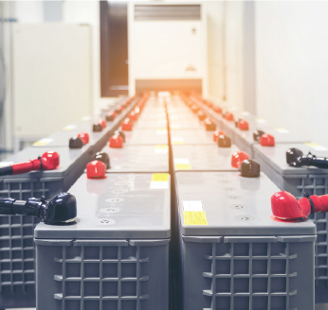
Electrical Energy Storage Systems
The requirements for energy storage systems have been reformatted and revised to better address this growing and changing technology.
Modification
Revisions to address new technology and safety requirements for Energy Storage Systems
Retains the basic principles of the 2018 IFC
Provides specific guidance for different types of ESS

Slide 37
Special Occupancies and Operations
Combustible dust producing operations
Revisions and additional guidelines to mitigate dust accumulation, control ignition sources, and provide guidance for fire inspectors
CNG vehicle fueling
New provision to differentiate between residential and non residential fueling
Repair of Lighter than air fueled vehicles
Clarification and expansion to ensure safe operations in repair garages
Size of spray booths
No longer restricted to a maximum size of 1500 square feet

Slide 38
Special Occupancies and Operations
Water-Reactive solids in semiconductor fabrication areas
Quantity limits of water reactive class 3 materials increased
Size of piles and stacks of organic materials
Additional provisions for stacked products and allowances for fire code official to approve increases.
High piled storage of lithium ion batteries
Now considered a high hazard commodity
Will be classified as high piled storage if storage height is > 6’
Shutdown of automated rack storage
Automatic shutdown now required upon sprinkler system water flow or fire detection system activation
Previously, only manual shutdown was required

Slide 39
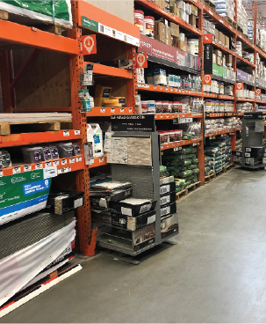
Special Occupancies and Operations
Aisle Maintenance in high piled storage
New exception to allow 48” displays in aisles
clear width of aisle is maintained
Area protected by K-25.2 extended coverage sprinklers
Recognizes what is already occurring in box stores

Slide 40
Fire Safety During Construction and Demolition
Several provisions added to Chapter 33 to increase fire safety on construction sites
Additions
The number of fires during building construction have increased in recent years. These fires are normally quite destructive. Combustible framing is not yet protected by sheetrock and fire spreads quickly.

Slide 41
Daily Fire Safety Inspection
3303.3 Daily fire safety inspection. The site safety director shall be responsible for completion of a daily fire safety inspection at the project site. Each day, all building and outdoor areas shall be inspected to ensure compliance with the inspection list in this section. The results of each inspection shall be documented and maintained on-site until a certificate of occupancy has been issued. Documentation shall be immediately available on-site for presentation to the fire code official upon request.
1.Any contractors entering the site to perform hot work each day have been instructed in hot work safety requirements in Chapter 35 and hot work is only performed in areas approved by the site safety director.
2.Temporary heating equipment is maintained away from combustible materials in accordance with the equipment manufacturer’s instructions.
3.Combustible debris, rubbish and waste material is removed from the building in areas where work is not being performed.
4.Temporary wiring does not have exposed conductors.
5.Flammable liquids and other hazardous materials are stored in locations that have been approved by the site safety director when not involved in work that is being performed.
6.Fire apparatus access roads required by Section 3311 are maintained clear of obstructions that reduce the width of the usable roadway to less than 20 feet.
7.Fire hydrants are clearly visible from access roads and are not obstructed.
8.The location of fire department connections to standpipe and inservice sprinkler systems are clearly identifiable from the access road and such connections are not obstructed.
9.Standpipe systems are in service and continuous to the highest work floor, as specified in Section 3313.1.
10.Portable fire extinguishers are available in locations required by Section 3316 and 3318.3.
This code provision is intended to serve as an accountability measure to ensure that there is motivation to adhere to basic fire safety requirements. By requiring daily inspections and documentation, any fire or building official can request to see documentation of daily inspections when at the site for any reason, and a clear enforcement path is specified when noncompliance is encountered.

Slide 42
Fire Watch
3305.5 Fire watch. Where required by the fire code official or the site safety plan established in accordance with Section 3303.1, a fire watch shall be provided for building demolition and for building construction.
3305.5.1 Fire watch during construction. Where required by the fire code official, A fire watch shall be provided during nonworking hours for new combustible construction that exceeds 40 feet (12 192 mm) in height above the lowest adjacent grade at any point along the building perimeter, any new multistory construction with an aggregate area exceeding 50,000 square feet per story or as required by the fire code official.
Modified the language in these two sections to now require fire watch anytime construction exceeds 40’ at any point or 50,000 square feet per story. Also added sections on duties, training, means of notification, and recordkeeping for fire watch personnel.

Slide 43
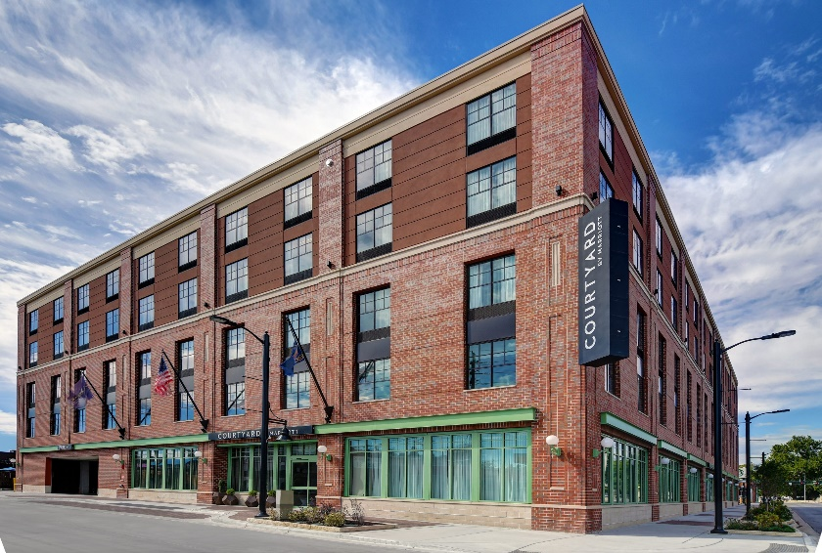
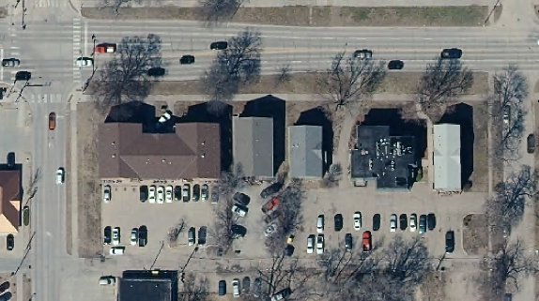
Fire Watch
Examples of buildings that would require fire watch during non working hours
Aggieville Marriott
4+ story apartment buildings
11b & 12b Lofts
Strasser Village
Solheim Condos
For perspective, half a city ward block is approximately 60,000 sq. ft.

Slide 44
Separation of Construction Areas
In Type I and II buildings, barriers installed to separate construction areas from the remainder of a building must be noncombustible, flame retardant or have a limited heat release rate.
Addition
3305.9 Separations between construction areas. Separations used in Type I and Type II construction to separate construction areas from occupied portions of the building, shall be constructed of materials that comply with one of the following:
1.Non-combustible materials.
2.Materials that exhibit a flame spread index not exceeding 25 when tested in accordance with ASTM E84 or UL 723.
3.Materials exhibiting a heat peak release rate not exceeding 300kW/m2when tested in accordance with ASTM E1354 at an incident heat flux of 50 kW/m2in the horizontal orientation on specimens at the thickness intended for use.
This new section requires that the barrier separating the construction zone from the remainder of the building meet a minimum level of fire resistance. In Type I and II buildings, the barrier must be noncombustible, or it must meet the flame spread requirements. The material can have a Class A flame spread rating or demonstrate that when it burns, it produces limited amounts of heat.

Slide 45
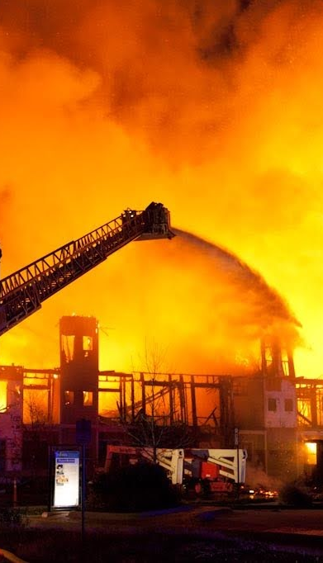
Water Supply During Construction
New requirements for minimum water supply during construction specify minimum fire flow and distance from the structure.
Addition
One of the issues with construction is that water supply infrastructure is not always completed prior to vertical construction of the building. The lack of a reliable and sufficient water supply has resulted in many of these fires causing more damage than may otherwise have occurred. The fire service cannot fight a fire of any significant size without a reliable water supply. These changes provide minimum criteria for the water supply available during construction.

Slide 46
Water Supply During Construction
3313.2 Combustible building materials. When combustible building materials of the building under construction are delivered to a site, a minimum fire flow of 500 gallons per minute (gpm) (1893 L/min) shall be provided. The fire hydrant used to provide this fire flow supply shall be within 500 feet (152 m) of the combustible building materials, as measured along an approved fire apparatus access lane. Where the site configuration is such that one fire hydrant cannot be located within 500 feet (152 m) of all combustible building materials, additional fire hydrants shall be required to provide coverage in accordance with this section.
3313.3 Vertical construction of Types III, IV and V construction. Prior to commencement of vertical construction of Type III, IV or V buildings that utilize any combustible building materials, the fire flow required by Sections 3313.3.1 through 3313.3.3 shall be provided, accompanied by fire hydrants in sufficient quantity to deliver the required fire flow and proper coverage.
3313.3.1 Fire separation up to 30 feet. Where a building of Type III, IV or V construction has a fire separation distance of less than 30 feet (914 mm) from property lot lines, and an adjacent property has an existing structure or otherwise can be built on, the water supply shall provide either a minimum of 500 gallons per minute (1893 L/min) or the entire fire flow required for the building when constructed, whichever is greater.
3313.3.2 Fire separation of 30 feet up to 60 feet. Where a building of Type III, IV or V construction has a fire separation distance of 30 feet up to 60 feet from property lot lines, and an adjacent property has an existing structure or otherwise can be built on, the water supply shall provide a minimum of 500 gallons per minute (1893 L/min) or 50 percent of the fire flow required for the building when constructed, whichever is greater.
3313.3.3 Fire separation of 60 feet or greater. Where a building of Type III, IV or V construction has a fire separation of 60 feet (18 288 mm) or greater from a property lot line, a water supply of 500 gallons per minute (1893 L/min) shall be provided.
3313.4 Vertical construction, Type I and II construction. If combustible building materials are delivered to the construction site, water supply in accordance with Section 3313.2 shall be provided. Additional water supply for fire flow is not required prior to commencing vertical construction of Type I and II buildings.
3313.5 Standpipe supply. Regardless of the presence of combustible building materials, the construction type or the fire separation distance, where a standpipe is required in accordance with Section 3314, a water supply providing a minimum flow of 500 gallons per minute (1893 L/min) shall be provided. The fire hydrant used for this water supply shall be located within 100 feet (3048 mm) of the fire department connection supplying the standpipe.

Slide 47
Chapter 40 – Storage of Distilled Spirits and Wine
Provisions have been added to address storage of distilled spirits and wines in barrels and casks
Addition
Several changes to the IFC & IBC to clarify that storage of distilled spirits and wine over 16% alcohol in barrels and casks is not a Group H occupancy but an S-1.
Ensures the STORAGE of spirits and wines is safe. Does not apply to the distillation (Group F-1)
Change recognizes the hazard of distilled spirits and wine >16% alcohol but exempts them from following the Haz-Mat requirements and classification as a group H occupancy.

Slide 48
Hazardous Material Exemptions
Exceptions to Chapters 50 and 57 are correlated to eliminate confusion and misapplication.
Modifications
Hazardous materials can be found in nearly all occupancies. Chapter 50 provides general requirements for hazardous materials, and Chapter 57 provides requirements specific to flammable and combustible liquids. Both chapters address hazardous materials, however the exceptions do not correlate.

Slide 49
Hazardous Material Exemptions
5001.1 Scope
Exceptions:
12. Specific provisions for flammable liquids in motor fuel-dispensing facilities, repair garages, airports and marinas in Chapter 23.
13. Storage and use of fuel oil in tanks and containers connected to oil-burning equipment. Such storage and use shall be in accordance with Section 603. For abandonment of fuel oil tanks, Chapter 57 applies.
14. Storage and display of aerosol products complying with Chapter 51.
15. Storage and use of flammable or combustible liquids that do not have a fire point when tested in accordance with ASTM D92, not otherwise regulated by this code.
16. Flammable or combustible liquids with a flash point greater than 95°F (35°C) in a water-miscible solution or dispersion with a water and inert (noncombustible) solids content of more than 80 percent by weight, which do not sustain combustion, not otherwise regulated by this code.
17. Commercial cooking oil storage tank systems located within a building and designed and installed in accordance with Section 607 and NFPA 30.
5701.2 Nonapplicability
12. Application and release of pesticide and agricultural products and materials intended for use in weed abatement, erosion control, soil amendment or similar applications where applied in accordance with the manufacturers’ instructions and label directions.
13. The off-site transportation of hazardous materials where in accordance with Department of Transportation (DOTn) regulations.

Slide 50
Number of Control Areas
Portions of buildings separated by fire walls can be treated as separate buildings when evaluating control areas.
Modification
The application of fire walls changed in the 2018 International Building Code (IBC). That change no longer allowed portions of a building to be considered separately when separated by a fire wall. Previously the IBC stated that fire walls created separate buildings and the number of control areas in each building was counted independently on each side of a fire wall. The IBC now states that fire walls only create separate buildings for the application of height, area and type of construction requirements. This resulted in an unintended consequence in its application to control areas. Based on the 2018 IBC change, quantities in these control areas now must be aggregated, which has the potential to place many facilities out of compliance. This code change allows a fire wall to create separate buildings when determining the allowable number of control areas in a building.

Slide 51
Retail of Consumer Use Fireworks
The referenced NFPA standard for fireworks sale and storage is specified as the 2006 edition of NFPA 1124.
Modification
The most recent edition of NFPA 1124 no longer contains requirements for retail sales and storage of consumer fireworks. This code change therefore specifies the 2006 edition of NFPA 1124 as the referenced document.
Section 7.3.1.2 of NFPA 1124 correlates with Footnote l in International Fire Code (IFC) Table 5003.1.1(1) which states to use 25 percent of the product weight to determine the quantity of pyrotechnic composition.

Slide 52
Ammunition Reloading in Commercial Operations
Requirements for ammunition reloading in commercial operations are added to the code.
Modification/Addition
These new requirements in the code regulate reloading of ammunition in commercial operations. These requirements do not apply to personal reloading operations.
Add safety provisions to reduce the hazard of commercial ammunition manufacturing

Slide 53
On-Demand Mobile Fueling
On-demand mobile fueling operations are enhanced and fueling vehicles are now identified as one of three classifications based on the quantity of fuel carried.
Modification
Adds 3 tiers of mobile fueling vehicles and requirements for each
On-demand mobile fueling is the operation where any vehicle owner can contact a fueling service to bring fuel to their private vehicle. This fueling operation is not limited to commercial, industrial, governmental or manufacturing establishments. This section regulates on-demand mobile fueling.

Slide 54
Code section - Title
Summary
Additions
New Text
Impact

