Slide 1
2021 Significant Changes
International Fuel Gas Code

Slide 2
Formatting
Normal Italic – No change to the code section
Bold Italic – Add to the code section
Strikethrough Italic – Delete from the code section

Slide 3

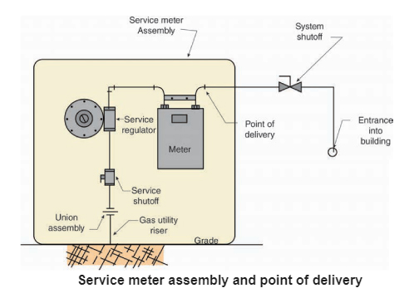
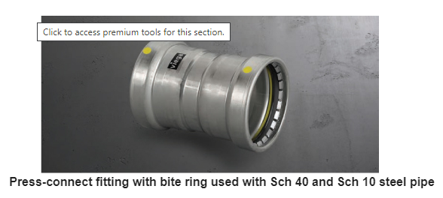
Section 202 Definitions
Added new definitions:
  Service Meter Assembly: The meter, valve, regulator, piping, fittings and equipment installed by the service gas supplier before the point of delivery.
  System Shutoff: A valve installed after the point of delivery to shut off the entire piping system.
  Press-connect Joint: A permanent mechanical joint incorporating an elastomeric seal or an elastomeric seal and corrosion-resistant grip or bite ring. The joint is made with a pressing tool and jaw or ring approved by the fitting manufacturer.

Slide 4
Section 307.2 Fuel-burning Appliances
Modified section to include permanent markings on the terminations of concealed condensate drain lines where it is not apparent which drain is the normal condensate drain and which is the secondary (backup) drain. The required marking is intended to be permanent (duct tape or marker is not sufficient).
  Liquid combustion byproducts of condensing appliances shall be collected and discharged to an approved plumbing fixture or disposal area in accordance with the manufacturer’s instructions. Condensate piping shall be of approved corrosion-resistant material and shall be not smaller than the drain connection on the appliance. Such piping shall maintain a minimum slope in the direction of discharge of not less than ¹/₈ unit vertical in 12 units horizontal (1-percent slope). The termination of concealed condensate piping shall be marked to indicate whether the piping is connected to the primary drain or to the secondary drain.

Slide 5
Section 402.7 Maximum operating pressure
Press-connect fittings are now suitable for high pressure (+5 psig) applications indoors. Modified Item 2; Items 1, 3-8 are unchanged.
  The maximum operating pressure for piping systems located inside buildings shall not exceed 5 pounds per square inch gauge (psig) (34 kPa gauge) except where one or more of the following conditions are met:
    2. The piping is joined by fittings listed to ASNI LC-4/CSA6.32 and installed in accordance with the manufacturer’s instructions.

Slide 6
Section 403.8.3 Threaded joint sealing
Modified to require the use of thread joint sealants (i.e. joint compounds, pipe dope, pipe tape)
  Threaded joints shall be made using a thread joint sealing material. Thread joint sealing materials shall be nonhardening and shall be resistant to the chemical constituents of the gasses to be conducted through the piping. Thread joint sealing materials shall be compatible with the pipe and fitting materials on which the sealing materials are used.

Slide 7
Section 404.5 Fittings in concealed locations
Modified to allow plugs and caps to be used in concealed locations. Modified Item 1; Items 2-4 are unchanged.
  Fittings installed in concealed locations shall be limited to the following types:
  1. Threaded elbows, tees, couplings, plugs and caps.

Slide 8
Section 503.5.6.1 Chimney lining
Exception was removed that allowed an existing unlined chimney to vent replacement appliances, where such a replacement was similar in type, BTU/h input rating and thermal efficiency.
  Chimneys shall be lined in accordance with NFPA 211.

Slide 9
Section 503.8 Venting system terminal clearances
Modified to remove Items 1-5. Items 1-5 reformatted into a new table, Table 503.8, and a new figure, Figure 503.8. No technical changes were made.
  The clearances for through-the-wall direct-vent and non-direct-vent terminals shall be in accordance with Table 503.8 and Figure 503.8. Exception: The clearances in Table 503.8 shall not apply to the combustion air intake of a direct-vent appliance.

Slide 10
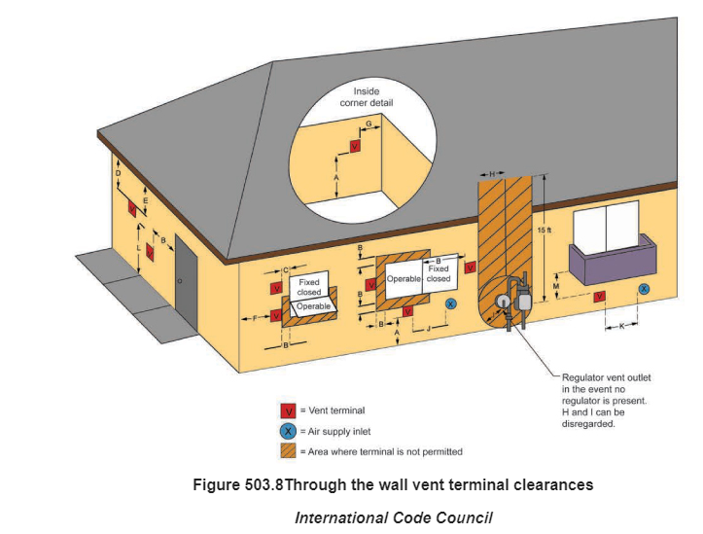
Section 503.8 Venting system terminal clearances

Slide 11
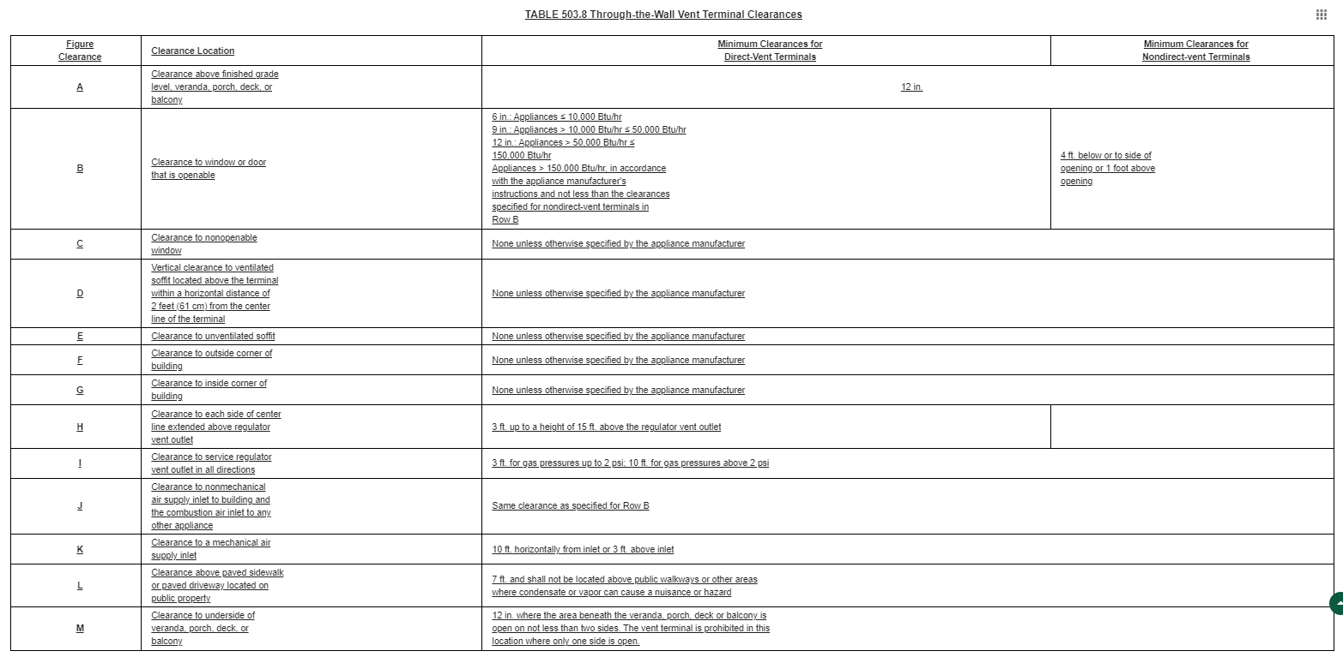
Section 503.8 Venting system terminal clearances

Slide 12
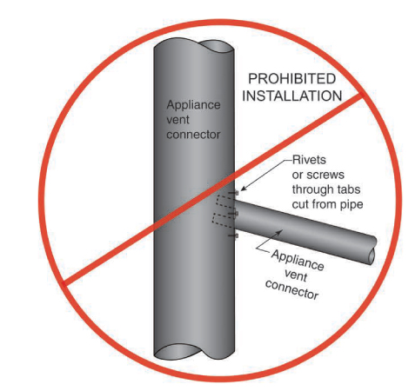
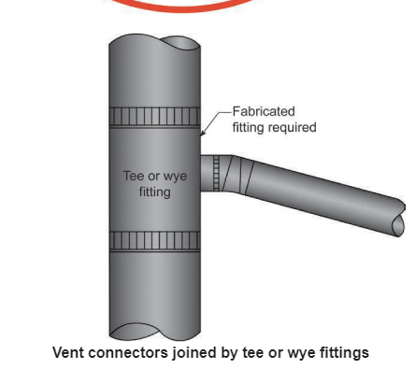
Section 503.10.7 Connector junctions
Section added primarily to address single-wall vent connectors that are joined together before connecting to a chimney, B-vent or Type L vent.
  Where vent connectors are joined together, the connection shall be made with a tee or wye fitting.

Slide 13
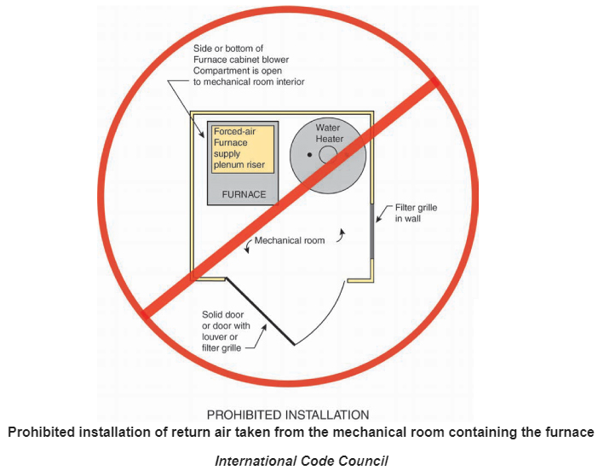
Section 618.6 Furnace plenums and air ducts.
Modified to clarify the intent of prohibiting pulling return air from the mechanical room.
  Where a furnace is installed so that supply ducts carry air circulated by the furnace to areas outside of the space containing the furnace, the return air shall be handled by a duct(s) sealed to the furnace casing and terminating outside of the space containing the furnace. Return air shall not be taken from the mechanical room containing the furnace.

Slide 14
Section 623.2 Prohibited location
Exception 2 for commercial cooking appliances within dwelling units has been deleted. Exception 1 remains. Appliance manufacturers currently offer many commercial-style appliances that are dual listed as both commercial and household appliances; exception 2 is no longer needed.
  Cooking appliances designed, tested, listed and labeled for use in commercial occupancies shall not be installed within dwelling units or within any area where domestic cooking operations occur.
    Exception: Appliances that are also listed as domestic cooking appliances.
    Exception 2: Where the installation is designed by a license Professional Engineer, in compliance with the manufacturer’s installation instructions.

