Slide 1
2021 Significant Changes International Mechanical Code

Slide 2
Section 307.2.1.1 Condensate Discharge
Modified section to address the locations of where the point of disposal of condensate can be discharged.
Condensate drains shall not directly connect to any plumbing drain, waste, or vent pipe. Condensate drains shall not discharge into a plumbing fixture other than a floor sink, floor drain, trench drain, mop sink, hub drain, standpipe, utility sink or laundry sink. Condensate drains connections to a lavatory wye branch tailpiece or to a bathtub overflow pipe shall not be considered as discharging to a plumbing fixture. Except where discharging to grade outdoors, the point of discharge of condensate drains shall be located within the same occupancy, tenant space or dwelling unit as the source of the condensate.

Slide 3

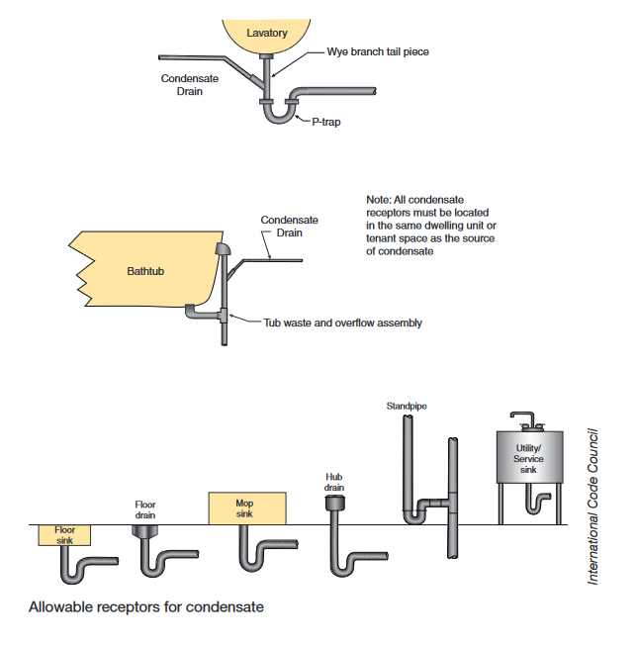
Section 307.2.1.1 Condensate Discharge

Slide 4
Section 401.2 Mechanical Ventilation required for Dwelling Units
Change clarifies where mechanical ventilation is required for R-2 dwelling units.
Every occupied space shall be ventilated by natural means in accordance with Section 402 or by mechanical means in accordance with Section 403. Where the air infiltration rate in a dwelling unit is less than 5 air changes per hour when tested with a blower door at a pressure of 0.2-inch water column (50 Pa) in accordance with Section R402.4.1.2 of the International Energy Conservation Code, the dwelling unit shall be ventilated by Dwelling units complying with the air leakage requirements of the International Energy Conservation Code or ASHRAE 90.1 shall be ventilated by mechanical means in accordance with Section 403. Ambulatory care facilities and Group I-2 occupancies shall be ventilated by mechanical means in accordance with Section 407.

Slide 5
Section 403.1 Mechanical Ventilation system for Dwelling Units
Text clarifying that there is no distinction between R-2 buildings of 3 stories or less and R-2 buildings over 3 stories.
Mechanical ventilation shall be provided by a method of supply air and return or exhaust air except that mechanical ventilation air requirements for Group R-2, R-3 and R-4 occupancies three stories and less in height above grade plane shall be provided by an exhaust system, supply system of combination thereof. The amount of supply air shall be approximately equal to the amount of return and exhaust air. The system shall not be prohibited from producing negative or positive pressure. The system to convey ventilation air shall be designed and installed in accordance with Chapter 6.

Slide 6
Section 401.4 Intake opening locations
New type of factory-built combination intake/exhaust air fitting is introduced that does not require separation between the two openings.
3. Intake openings shall be located not less than 3 feet below contaminant sources where such sources are located within 10 feet of the opening. Separation is not required between intake air openings and living space exhaust air openings of an individual dwelling unit or sleeping unit where an approved factory-built intake/exhaust combination termination fitting is used to separate the air streams in accordance with the manufacturer’s instructions.
No changes to text on 1. 2. and 4.

Slide 7
Section 501.3.1 Exhaust Outlet locations
New type of factory-built combination intake/exhaust air fitting is introduced that does not require separation between the two openings.
3. For all environmental air exhaust: 3 feet from property lines; 3 feet from operable openings into buildings for all occupancies other than Group U; and 10 feet from mechanical air intakes. Such exhaust shall not be considered hazardous or noxious. Separation is not required between intake air openings and living space exhaust air openings of an individual dwelling unit or sleeping unit where an approved factory-built intake/exhaust combination termination fitting is used to separate the air streams in accordance with the manufacturer’s instructions.
No changes to text on 1. 2. 4. and 5.

Slide 8
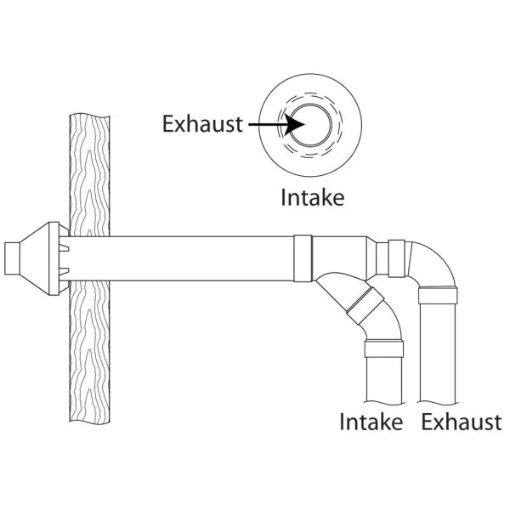
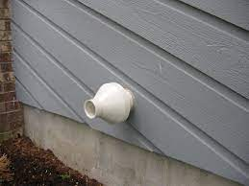
Section 401.4 Intake opening locations

Slide 9
Table 403.3.1.1 Recirculation of Mechanical Exhaust Prohibited
Table 403.3.1.1 note g was rewritten to lessen the negative impact of recirculated exhaust air
G. Mechanical exhaust is required and recirculation from such spaces is prohibited except that recirculation shall be permitted where the resulting supply airstream consists of not more than 10 percent air recirculated from these spaces. prohibited. For occupancies other than science laboratories, where there is a wheel-type energy recovery ventilation (ERV) unit in the exhaust system design, the volume of air leaked from the exhaust airstream into the outdoor airstream within the ERV shall be less than 10 percent of the outdoor air volume. Recirculation of air that is contained completely within such spaces shall not prohibited (see Section 403.2.1, Items 2 and 4).

Slide 10
Section 403.3.1.3 Demand Controlled Ventilation
Clarifies that demand control ventilation schemes cannot eliminate all ventilation in a space while the space is expected to be occupied.
The minimum flow rate of outdoor air that the ventilation system must be capable of supplying during its operation shall be permitted to be based on the rate per person indicated in Table 403.3.1.1 and the actual number of occupants present. Where demand-controlled ventilation is employed to adjust the outdoor airflow rate based on the actual number of occupants present, the minimum quantity of outdoor air shall not fall below that determined from the area outdoor airflow rate column of Table 403.3.1.1 during periods when the building is expected to be occupied.

Slide 11
Section 403.3.2.1 Outdoor Air for Dwelling Units
Recognizing the higher efficiency of balanced ventilation systems, the code will grant a reduction in the ventilation rate.
2. The minimum mechanical ventilation rate determined in accordance with Equation 4-9 shall be reduced by 30 percent provided that both of the following apply:
2.1 A ducted system supplies ventilation air directly to each bedroom and to one of the following rooms:
2.1.1. Living room
2.1.2. Dining room
2.1.3. Kitchen
2.2 The whole-house ventilation system is a balanced system.

Slide 12
Section 202 General Definitions
Added new definition:
Balanced Ventilation: Any combination of concurrently operating mechanical exhaust and mechanical supply whereby the total mechanical exhaust airflow rate is within 10 percent of the total mechanical supply airflow rate.

Slide 13
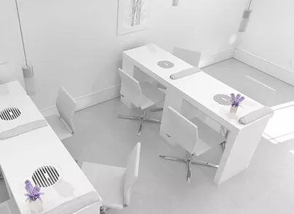
Section 502.20 Manicure and pedicure stations
Modified section to now require the continuous operation of nail salon exhaust systems during business hours.
502.20.1 Operation. The exhaust system for manicure and pedicure stations shall have controls that operate the system continuously when the space is occupied.

Slide 14
Section 504.4.1 Termination location for Dryer Exhaust
Modification to address the possibility of dryer exhaust air being reintroduced into the building's interior.
Exhaust duct terminations shall be in accordance with the dryer manufacturer’s installation instructions. Where the manufacturer’s instructions do not specify a termination location, the exhaust duct shall terminate not less than 3 feet in any direction from openings into the buildings including openings in ventilated soffits.

Slide 15
Section 506.3.7 Factory-Built Grease Duct Slope
Modification – A new exception exempts factory-built grease ducts from the duct slope prescriptions of the code and relying instead on the slope requirements stated in the product listing and manufacturer’s installation instructions.
Exception: Factory-built grease ducts shall be installed at a slope that is in accordance with the listing and manufacturer’s installation instructions.

Slide 16
Section 507.1 Smoker Ovens with Integral Exhaust
Modification the exempts smoker ovens from the requirement for a Type I hood where the ovens have an integral exhaust system and are listed for installation without a Type I hood.
Exceptions: 4. Smoker ovens with integral exhaust systems, provided that the appliance is installed in accordance with the manufacturer’s installation instructions, is listed and tested for the application and complies with Chapter 5.

Slide 17
Section 514.2 Energy Recovery Ventilation Systems
Modification – The prohibition of some types of energy recovery ventilation (EVR) equipment for use with Type II kitchen exhaust hoods has been lifted.
Prohibited applications. Energy recovery ventilation systems shall not be used in the following systems:
1. Hazardous exhaust control systems covered in Section 510.
2. Dust, stock and refuse systems that convey explosive of flammable vapors, fumes or dust.
3. Smoke control systems covered in Section 513.
4. Commercial kitchen exhaust systems serving Type I or Type II hoods.
5. Clothes dryer exhaust systems covered in Section 504.

Slide 18
Section 602.2.1.8 Pipe and Duct Insulation Within Plenums
Modification that addresses protecting piping that does not meet the required fire performance requirements.
Pipe and duct insulation contained within plenums, including insulation adhesives, shall have a flame spread index of not more than 25 and a smoke developed index of not more than 50 when tested in accordance with ASTM E84 or UL 723, using the specimen preparation and mounting procedures of ASTM E2231. Pipe and duct insulation shall not flame, glow, smolder or smoke when tested in accordance with ASTM C411 at the temperature to which they are exposed in service. The test temperature shall not fall below 250°F. Pipe and duct insulation shall be listed and labeled. Pipe and duct insulation shall not be used to reduce the maximum flame spread and smoke-developed indices except where the pipe or duct and its related insulation, coatings and adhesives are tested as a composite assembly in accordance with Section 602.2.1.7.

Slide 19
Section 608.1 Balancing
403.3.1.5 Balancing Removed.
Modified section that relocates text that requires verification of the required ventilation airflow rates by means of balancing he system and adds a requirement for airflow adjustments means for air distribution and exhaust systems, in addition to the previous requirement for ventilation air systems..
608.1 Balancing. Air distribution, ventilation and exhaust systems shall be provided with means to adjust the system to achieve the design airflow rates and shall be balanced by an approved method. Ventilation air distribution shall be balanced by an approved method and such balancing shall verify that the air distribution system is capable of supplying and exhausting the airflow rates required by Chapter 4.

Slide 20
Section 1105.9 Machinery Room Means of Egress
Egress requirements for machinery rooms from the IBC were added to the IMC to prevent such requirements from being overlooked.
Machinery rooms larger than 1000 sq. ft. in area shall have not less than two exits or exit access doorways. Where two exit access doorways are required, one such doorway is permitted to be served by a fixed ladder or an alternating tread device. Exit access doorways shall be separated by a horizontal distance equal to or greater than one-half of the largest horizontal dimension of the room. All portions of machinery rooms shall be within 150 ft. of an exit or exit access doorway. An increase in exit access travel distance is permitted where in accordance with Section 1017.1 of the International Building Code. Exit and exit access doorways shall swing in the direction of egress travel and shall be equipped with panic hardware, regardless of the occupant load served. Exit and exit access doorways shall be tight-fitting and self-closing.

