Slide 1
2021 Significant Changes
International Plumbing Code

Slide 2
Formatting
Normal Italic – No change to the code section
Bold Italic – Add to the code section
Strikethrough Italic – Delete from the code section

Slide 3

Section 202 Definitions
Added new definition:
  Copper Alloy: A metal alloy where the principle component is copper.
    Reason for the addition: Historically, “brass” was used as a term for alloys of copper in plumbing systems. Brasses are only one group of a wider array of copper alloys that manufacturers might wish to use for products. The definition was added to provide simple clarification.

Slide 4
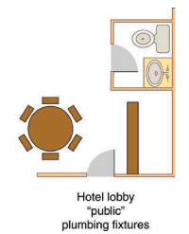
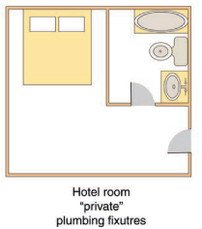
Section 202 Definitions
Modified definitions:
  Public or Private Utilization: In the classification of plumbing fixtures, “public” applies to fixtures with unrestricted exposure to walk-in traffic.
  Private: In the classification of plumbing fixtures, “private” applies to fixtures that are not public.
  Reason for the modification: The definitions are simplified to make a clearer distinction as to which fixtures are intended to be configured for public use.

Slide 5
Section 202 Definitions
Modified definition:
  Water Dispenser: A plumbing fixture that is manually controlled by the user for the purpose of dispensing potable drinking water into a receptacle such as a cup, glass or bottle. Such fixture is connected to the potable water distribution system of the premise.
  Reason for modification: Eliminating bottled water units and other self-contained potable water dispensing apparatus as an alternative to some drinking fountains

Slide 6
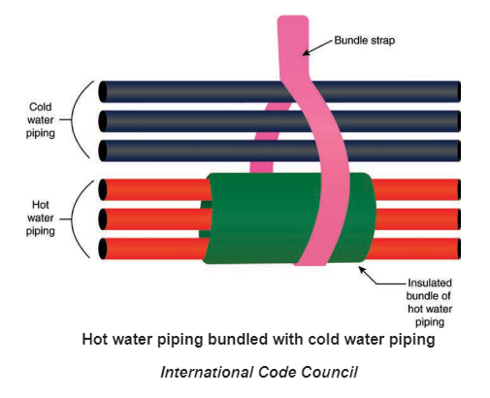
Section 308.9 Parallel water distribution systems
Modified section to allow hot water piping for a manifold system to be bundled with cold water piping. Hot water piping is required to be insulated but not necessarily individually insulated.
  Piping bundles for manifold systems shall be supported in accordance with Table 308.5. Support at changes in direction shall be in accordance with the manufacturer’s instructions. Where hot water piping is bundled with cold or hot water piping, each hot water pipe piping shall be insulated in accordance with Section 607.5.

Slide 7
Section 403.1.1 Fixture Calculations
Modified section to calculate the minimum fixture quantities for multiple-user toilet facilities that are designed to serve all genders must be calculated 100 percent based on total occupant loads.
  Exceptions:
  The total occupant load shall not be required to be divided in half where approve statistical data indicate a distribution of sexes of other than 50 percent of each sex.
  Where multiple-user facilities are designed to serve all genders, the minimum fixture count shall be calculated 100 percent, based on total occupant load. In such multiple-user facilities, each fixture type shall be in accordance with ICC A117.1 and each urinal that is provided shall be located in a stall.
  Distribution of the sexes is not required where single-user water closets and bathing room fixtures are provided in accordance with Section 403.1.2.

Slide 8
Section 403.1.2 Single-user toilet and bathing room fixtures
Section clarified to allow the numbers of plumbing fixtures in all single-user toilet rooms and bathing rooms to count towards the total number required for a building.
  The plumbing fixtures located in single-user toilet and bathing rooms, including family or assisted-use toilet and bathing rooms that are required by Section 1109.2.1 of the International Building Code, shall contribute toward the total number of required plumbing fixtures for a building or tenant space. Single-user toilet and bathing rooms, and family or assisted-use toilet rooms and bathing rooms shall be identified as being available for use by all persons regardless of their sex.
  The total number of fixtures shall be permitted to be based on the required number of separate facilities or based on the aggregate of any combination of single-user or separate facilities.

Slide 9
Section 403.2 Separate facilities
Modified section to allow designs for multiple-user facilities serving both sexes.
  Where plumbing fixtures are required, separate facilities shall be provided for each sex.
  Exceptions:
  1. Through 4. remain unchanged.
  5. Separate facilities shall not be required to be designated by sex where single-user toilets rooms are provided in accordance with Section 403.1.2.
  6. Separate facilities shall not be required where rooms having both water closets and lavatory fixtures are designed for use by both sexes and privacy for water closets is provided in accordance with Section 405.3.4. Urinals shall be located in an area visually separated from the remainder of the facility or each urinal that is provided shall be located in a stall.

Slide 10
Section 403.3.3 Location of toilet facilities in occupancies other than malls
Section modified to allow the location of toilet facilities in Group S occupancies to exceed the location and maximum distance limitations provided that the arrangement is approved. Example: large, multiple-level self-storage facility with an office at the facility entrance allowing the only employee and public facility to be at the office.
  In occupancies other than covered and open mall buildings, the required public and employee toilet facilities shall be located not more than one story above or below the space required to be provided with toilet facilities, and the path of travel to such facilities shall not exceed a distance of 500 feet.
  Exceptions:
  1. The location and maximum distance of travel to required employee facilities in factory and industrial occupancies shall be permitted to exceed that required by this section, provided that the location and maximum distances are approved.
  2. The location and maximum distances of travel to required public and employee facilities in Group S occupancies shall be permitted to exceed that required by this section, provided that the location and maximum distances of travel are approved.

Slide 11
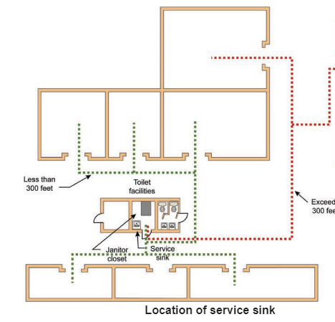
Section 403.6 Service sink location
Section added to provide travel distance requirements for service sinks in covered malls.
  Service sinks shall not be required to be located in individual tenant spaces in a covered mall provided that service sinks are located within a distance of travel of 300 feet (91 m) of the most remote location in the tenant space and not more than one story above or below the tenant space. Service sinks shall be located on an accessible route.

Slide 12
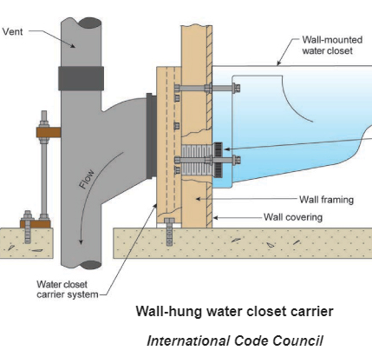
Section 405.4.3 Securing wall-hung water closet bowls
Section modified to add a new standard for water closet carriers.
Wall-hung water closet bowls shall be supported by a concealed metal carrier that is attached to the building structural members so that strain is not transmitted to the fixture connector or any other part of the plumbing system. The carrier shall conform to ASME A112.6.1M or ASME A112.6.2.

Slide 13
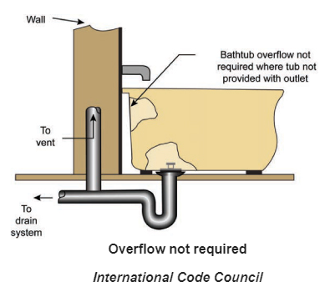
Section 407.2 Bathtub waste outlets and overflow
Section modified to remove the requirement for bathtub overflow outlets. Bathtub overflow outlets are not designed to prevent overflows of a bathtub.
Bathtubs shall be equipped with a waste outlet and an overflow outlet. The outlets shall be connected to the waste tubing or piping that is not less than 1 ½ inches in diameter. The waste outlet shall be equipped with a watertight stopper. Where an overflow is installed, the overflow shall be not less than 1 ½ inches in diameter.

Slide 14
Section 410.3.2 More than the minimum number
Section added to match to the IBC. 50% of the required number of drinking fountains must be for standing persons and the other 50% for persons who use wheelchairs.
  Where more than the minimum number of drinking fountains specified in Section 410.3.1 is provided, 50 percent of the total number of drinking fountains provided shall comply with the requirements for person who use a wheelchair and 50 percent of the total number of drinking fountains provided shall comply with the requirements for standing persons.
  Exceptions:
  1. Where 50 percent of the drinking fountains yields a fraction, 50 percent shall be permitted to be rounded up or down, provided that the total number of drinking fountains complying with this section equals 100 percent of the drinking fountains.
  2. Where drinking fountains are primarily for children’s use, drinking fountains for people using wheelchairs shall be permitted to comply with the children’s provisions in ICC A117.1 and drinking fountains for standing children shall be permitted to provide the spout at 30 inches (762 mm) minimum above the floor.

Slide 15
Section 410.4 Substitution
Section clarified to state that at least three required drinking fountains must be installed before 50% of the additional required drinking fountains can be substituted with water dispensers. The substitution of water dispensers for drinking fountains cannot be applied to the first two drinking fountains but only to the drinking fountains that are in excess of the first two.
  Where restaurants provide drinking water in a container free of charge, drinking fountains shall not be required in those restaurants. In other occupancies where three or more drinking fountains are required, water dispensers shall be permitted to be substituted for not more than 50 percent of the required number of drinking fountains.

Slide 16
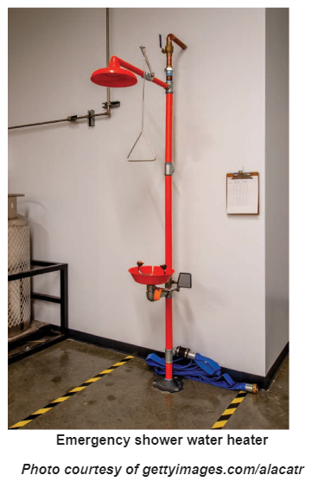
Section 411.3 Water Supply
Section modified to allow a new type of water heater for emergency showers and eyewash stations that doe not require a temperature-actuated mixing valve.
Where hot and cold water is supplied to an emergency shower or eyewash station, the temperature o the water supply shall only be controlled by a temperature-actuated mixing valve complying with ASSE 1071. Where water is supplied directly to an emergency shower or eyewash station from a water heater, the water heater shall comply with ASSE 1085.

Slide 17
Section 412.3 Individual shower valves
Section modified to require compatibility between lower flow shower heads and shower control (mixing valves).
  Individual shower and tub-shower combination valves shall be balanced-pressure, thermostatic or combination balanced-pressure/thermostatic valves that conform to the requirements of ASSE 1016/ASME A112.106/CSA B125.16 or ASME A112.18.1/CSA B125.1. Such valves shall be installed that the point of use. Shower control valves shall be rated for the flow rate of the installed shower head. Shower and tub-shower combination valves required by this section shall be equipped with a means to limit the maximum setting of the valved to 120º F (49ºC), which shall be field adjusted in accordance with the manufacturer’s instructions to provide water at a temperature not to exceed 120ºF (49ºC). In-line thermostatic valves shall not be utilized for compliance with this section.

Slide 18
Section 412.4 Multiple (gang) showers
Section modified to require compatibility between lower flow shower heads and shower control (mixing valves).
  Multiple (gang) showers supplied with a single, tempered water supply pipe shall have the water supply for such showers controlled by an approved automatic temperature control mixing valve that conforms to ASSE 1069 or CSA 125.3, or each shower head shall be individually controlled by a balanced-pressure, thermostatic or combination balanced-pressure/thermostatic valve that conforms to ASSE 1016/ASME A112.1016/CSA B125.16 or ASME A112.18.1/CSA B125.1 and is installed at the point of use. Where a shower head is individually controlled, shower control valves shall be rated for the flow rate of the installed shower head. Such valves shall be equipped with a means to limit the maximum setting of the valve to 120ºF (49ºC), which shall be field adjusted in accordance with the manufacturer’s instructions to provide water at a temperature not to exceed 120ºF (49ºC). Access shall be provided to an ASSE 1069 or CSA B125.3 valve.

Slide 19
Section 412.5 Bathtub and whirlpool bathtub valves
Section modified to allow for new types of water heaters and a new design for tub faucets as additional methods to control water temperatures for bathtubs. Where integral temperature limiting devices comply with the standard of ASSE 1070/ASME A112.1070/CSA B125.70, external temperature limiting devices are not required.
  Bathtubs and whirlpool bathtub valves shall have or be supplied by a water-temperature-limiting device that conforms to ASSE 1070/ASME A112.1070/CSA B125.70 or by a water heater complying with {ASSE 1082} or {ASSE 1084}, except where such valves are combination tub/shower valves in accordance with Section 412.3. The water-temperature-limiting device required by this section shall be equipped with a means to limit the maximum setting of the device to 120ºF (49ºC), and, where adjustable, shall be field adjusted in accordance with the manufacturer’s instructions to provide hot water at a temperature not to exceed 120ºF (49ºC). Access shall be provided to water-temperature-limiting devices that conform to ASSE 1070/ASME A112.1070/CSA B125.70.
  Exception: Access shall not be required for nonadjustable water-temperature-limiting devices that conform to ASSE 1070/ASME A112.1070/CSA B125.70 and are integral with a fixture fitting, provided that the fixture fitting itself can be accessed for replacement.

Slide 20
Section 412.10 Head shampoo sink faucets
Section modified to allow for two additional methods to limit the water temperature discharged from a head shampoo sink.
  Head shampoo sink faucets shall be supplied with hot water that is limited to not more than 120ºF (49ºC). Each faucet shall have integral check valves to prevent crossover flow between the hot and cold water supply connections. The means for regulating the maximum temperature shall be one of the following:
  1. A limiting device conforming to ASSE 1070/ASME A112.1070/CSA B125.70.
  2. A water heater conforming to ASSE 1082.
  3. A temperature-actuated, flow-reduction device conforming to ASSE 1062.

Slide 21
Section 419.5 Tempered water for public hand-washing facilities
Section modified to removed the standard CSA B125.3 as an acceptable water-temperature-limiting device for public hand-washing lavatories.
  Tempered water shall be delivered from lavatories and group wash fixtures located in public toilet facilities provided for customers, patrons and visitors. Tempered water shall be delivered through an approved water-temperature-limited device that conforms to ASSE 1070/ASME A112.70/CSA B225.70 or CSA B125.3.

Slide 22
Section 421.3.1 Waste fittings
Section added to provide standards for shower drains, including linear shower drains.
  Waste fittings shall conform to ASME A112.18.2/CSA B125.2.

Slide 23
Section 423.3 Footbaths and pedicure baths
Section modified to allow for a water heater complying with ASSE 1082 to be used as an additional method to limit the water temperature discharge at footbaths and pedicure baths.
  The water supplied to specialty plumbing fixtures, such as pedicure chairs having an integral foot bathtub and footbaths, shall be limited to not greater than 120ºF (49ºC) by a water-temperature-limiting device that conforms to ASSE 1070/ASME A112.1070/CSA B125.70 or by a water heater complying with ASSE 1082.

Slide 24
Section 501.2 Water heater as space heater
Section modified to align the title of the standard, ASSE 1017 Temperature Actuated Mixing Valve, to the code language. The standard also indicates the acceptable location where such mixing valves are intended at the source of hot water and not at the point-of-use.
  Where a combination potable water heating and space heating system requires water for space heating at temperatures greater than 140ºF (60ºC), a temperature-actuated mixing valve complying with ASSE 1017 shall be provided to limit the water supplied to the potable hot water distribution system to a temperature of 140ºF (60ºC) or less. The potability of the water shall be maintained throughout the system. Requirements for combination potable water heating and space heating systems shall be in accordance with the International Mechanical Code.

Slide 25
Section 602.3.5 Pumps
Section modified to state that pumps that supply drinking water must conform to NSF61.
  Pumps shall be rated for the transport of potable water. Pumps in an individual water supply system shall be constructed and installed so as to prevent contamination from entering a potable water supply through the pump units. Pumps intended to supply drinking water shall conform to NSF 61.Pumps shall be sealed to the well casing or covered with a water-tight seal. Pumps shall be designed to maintain a prime and installed such that ready access is provided to the pump parts of the entire assembly for repairs.

Slide 26
Section 605.12.3, 605.13.6 Solder joints
Section modified to state that solder and flux used in making joints in pipes and tubing for drinking water systems must conform to NFS 61.
  Solder joints shall be made in accordance with ASTM B828. Cut tube ends shall be reamed to the full inside diameter of the tube end. Joint surfaces shall be cleaned. A flux conforming to ASTM B813 shall be applied. The joint shall be soldered with a solder conforming to ASTM B32. The joining of water supply piping shall be made with lead-free solder and fluxes. “Lead free” shall mean a chemical composition equal to or less than 0.2-percent lead. Solder and flux joining pipe or fittings intended to supply drinking water shall conform to NSF 61.

Slide 27
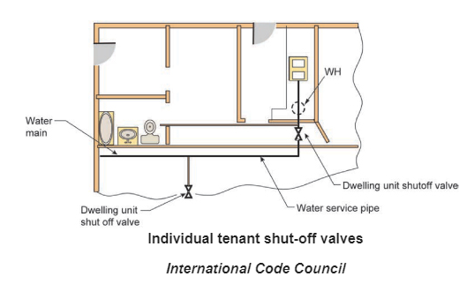
Section 606.1 Location of full-open valves
Section modified to require a main water shutoff valve for each tenant space in a multiple tenant building.
  Full-open valves shall be installed in the following locations:
  1. On the building water service pipe from the public water supply near the curb.
  2. On the water distribution supply pipe at the entrance into the structure.
  2.1 In multiple-tenant buildings, where a common water supply piping system is installed to supply other than one- and two- family dwellings, a main shutoff valve shall be provided for each tenant.
  3. through 8. remain unchanged

Slide 28
Section 607.1.1 Temperature limiting means
Section modified to recognize the advances in control technology for water heaters by allowing water heaters to serve as the temperature limiting device rather than needed an external mechanical water temperature limiting or control device.
  A thermostat control for a water heater shall not only serve as the temperature limiting means for the purpose of complying with the requirements of the code for maximum allowable hot or tempered water delivery temperature at fixtures where the water heater complies with ASSE 1082 or ASSE 1085.

Slide 29
Section 607.1.2 Tempered water temperature control
Section modified to recognize the advances in control technology for water heaters by allowing water heaters to serve as the temperature limiting device rather than needed an external mechanical water temperature limiting or control device.
  Tempered water shall be controlled by one of the following:
  1. A limiting device conforming to ASSE 1070/ASME A112.170/CSA B152.70 and set to a maximum of 110ºF (43ºC).
  2. A thermostatic mixing valve conforming to ASSE 1017.
  3. A water heater conforming to ASSE 1082.
  4. A water heater conforming to ASSE 1084.

Slide 30
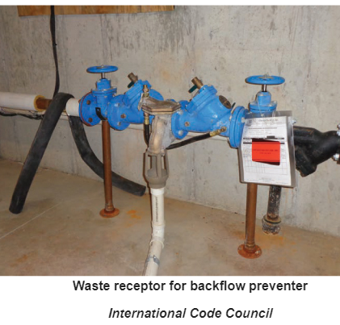
Section 608.15.2.1 Relief port piping
Section modified to require an adequately sized waste receptor where water discharged from backflow preventer relief ports discharges indoors to prevent flood damage to the structure or to building equipment.
  The termination of the piping from the relief port or air gap fitting of a backflow preventer shall discharge to an approved indirect waste receptor or to the outdoors where it will not cause damage or create a nuisance. The indirect waste receptor and drainage piping shall be sized to drain the maximum discharge flow rate from the relief port as published by the backflow preventer manufacturer.

Slide 31
Section 608.17.2 Connections to boilers
Section modified to add a recognized standard, ASSE 1081, for a combination pressure regulator/backflow preventer product for boilers. Potable water connections for boilers require both a pressure reducing valve and a backflow prevention device, the added standard now recognizes dual-purpose devices that satisfy both requirements.
  The potable supply to the boiler shall be equipped with a backflow preventer with an intermediate atmospheric vent complying with ASSE 1012, ASSE 1081, or CSA B64.3. Where conditioning chemicals are introduced into the system, the potable water connection shall be protected by an air gap or a reduced pressure principle backflow preventer, complying with ASSE 1013, CSA B64.4 or AWWA C511.

Slide 32
Section 609.2 Water service for Group I-2, Condition 2 facilities
Section modified to clarify that Group I-2, Condition 2 heath care facilities require 2 water service pipes. The term “hospital” was removed from the section and replaced with “Group I-2, Condition 2 facilities” to provide clarity as to which buildings require redundancy based on the occupancy classification.
  Group I-2, Condition 2 facilities shall have not fewer than two water service pipes sized such that with the loss of the largest service pipe, the remaining service pipes will meet the water demand for the entire facility. Each water service shall have a shutoff valve in the building and a shutoff valve at the utility-provided point of connection to the water main or other source of potable water.

Slide 33
Section 609.2.1 Tracer wire for nonmetallic piping
Section added requiring tracer wire on buried hospital water service piping to allow for easier locating to avoid pipe damage that would disrupt water service.
  An insulated tracer wire listed for the purpose or other approved conductor shall be installed adjacent to underground nonmetallic piping services as a water service for a hospital. Access shall be provided to the tracer wire or the tracer wire shall terminate above ground at each end of the nonmetallic piping. The tracer wire size shall be not less than 18 AWG and the wire insulation type shall be suitable for direct burial.

Slide 34
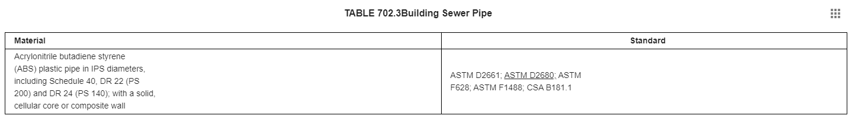
Section 702.3 Building Sewer Pipe
Section modified to add a standard, ASTM D2680, to the table for composite wall ABS pipe.

Slide 35
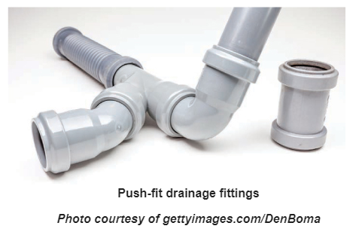
Section 705.2.4 Push-fit joints
Section 705.10.4 Push-fit joints
Sections added to allow push-fit DWV fittings for ABS and PVC pipe. The new standard has been added to Table 702.4, Pipe Fittings.
  705.2.4 Push-fit joints. Push-fit DWV fittings shall be listed and labeled to ASME A112.4.4 and shall be installed in accordance with the manufacturer’s instructions.
  705.10.4 Push-fit joints. Push-fit joints shall conform to ASME A112.4.4 and shall be installed in accordance with the manufacturer’s instructions.

Slide 36
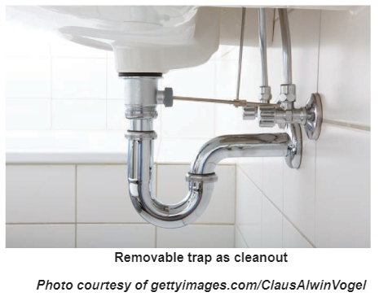
Section 708.1.6 Cleanout equivalent
Section added to allow removable traps and removable fixtures with integral traps as cleanout equivalents. Section 708.1.3 prohibits the removal of a water closet to serve as cleanout access to a building sewer. Section 708.1.2 (Exception 1) only allows cleanout access through a removable P-trap for the same or one size larger pipe size.
  A fixture trap or a fixture with an integral trap, removable without altering concealed piping, shall be acceptable as a cleanout equivalent.

Slide 37
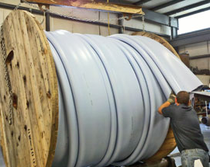
Section 717 Relining Building Sewers and Building Drains
Section added to recognize the “fold and form pipe (FFP)”method of pipe restoration for building sewer and building drain piping.
Fold and form pipe method basics :
  Spooled PVC liner, sized 4” to 30”
  PVC liner is heated with steam then pipe is pulled through existing pipe
  Ends are sealed with special plugs that fill the liner with steam and compressed air
  Remove plugs when liner is cool
  Reinstate service

Slide 38
Section 717 Relining Building Sewers and Building Drains
Section added to recognize the “fold and form pipe (FFP)”method of pipe restoration for building sewer and building drain piping.
  10 Sections added
  Method limited to gravity drainage piping 4” in diameter and larger.
  Existing pipe to be descaled and cleaned prior to relining. After cleaning, the piping shall be inspected internally by a recorded video camera survey.
  Prior to permit issuance, the code official is to review the camera survey to determine if the piping system is able to be relined in accordance with the manufacturer’s requirements.
  Installer shall provide a copy of the data report to the code official prior to approval. The data report is to include relining material type, amount of product used, and conditions of the installation.
  A post-installation recorded video camera survey is required to be submitted to the code official before final approval.
  A certificate in writing from the permit holder is required stating that the relining materials have been installed in accordance with manufacturer’s installation instructions, the applicable standards, and this code.

Slide 39
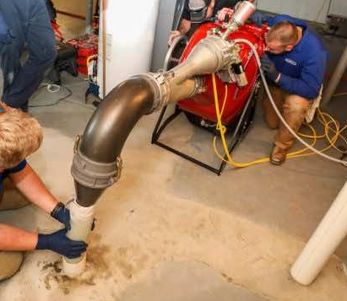
Section 718 Rehabilitation of Building Sewers and Building Drains
Section added to recognize the “cured-in-place pipe (CIPP)”method of pipe restoration for building sewer and building drain piping.
Cured-in-place pipe (CIPP) Method:
  Pipe liner is soaked in resin
  Liner is rolled into machine which inverts the liner
  Compressed air is introduced in the machine which
  pushes the inverted liner into the pipe to be lined
  The compressed air forms the liner to the existing pipe
  Reinstate service once resin has set

Slide 40
Section 718 Rehabilitation of Building Sewers and Building Drains
Section added to recognize the “cured-in-place pipe (CIPP)”method of pipe restoration for building sewer and building drain piping.
  Sectional cure-in-place rehabilitation of building sewer piping and sewer service lateral piping shall be in accordance with ASTM F2599. Main and lateral cure-in-place rehabilitation of building sewer and sewer service lateral pipe and their connections to the main sewer pipe shall be in accordance with ASTM F2561. Hydrophilic rings or gaskets in cure-in-place rehabilitation of building sewer piping and sewer service laterals shall be in accordance with ASTM F3240 to ensure water tightness and elimination of ground water penetration.

Slide 41
Section 903.1.3 Protected vent terminal
Section added to provide new requirements for roof vent terminals to accommodate solar panel and architectural roof feature installations.
  Where an open vent pipe terminates above a sloped room and is covered by either a roof-mounted panel (such as a solar collector or photovoltaic panel mounted over the vent opening) or a roof element (such as an architectural feature or a decorative shroud), the vent pipe shall terminate not less than 2 inches (51 mm) above the roof surface. Such roof elements shall be designed to prevent the adverse effects of snow accumulation and wind on the function of the vent. The placement of a panel over a vent pipe and the design of a roof element covering the vent pie shall provide for an open area for the vent pipe to the outdoors that is not less than the area of the pipe, as calculated from the inside diameter of the pipe. Such vent terminals shall be protected by a method that prevents birds and rodents from entering or blocking the vent pipe opening.

Slide 42
Section 915.1 Type of fixtures
Section modified to allow food waste disposers to discharge into a combination waste and vent system.
  A combination waste and vent system shall not serve fixtures other than floor drains, sinks, lavatories and drinking fountains. Combination waste and vent systems shall not receive the discharge from a food waste disposer or clinical sink.

Slide 43
Section 1002.1 Fixture traps
Section modified to require one, two or three-compartment sinks without traps to be directly connected to a hydromechanical grease interceptor provided that the grease interceptor is in close proximity and connects to a drainage branch that has an emergency floor drain connected immediately downstream of the interceptor.
  Exceptions:
  1. and 2. remain unchanged
  3. removed
  4. renumbered to 3.
  4. Where a hydromechanical grease interceptor serves a food utensil, dishes, pots-and-pans sink, in accordance with the manufacturer’s installation instructions. The branch drain serving the interceptor shall be provided with an emergency floor drain downstream of the interceptor connection, and the branch shall serve only the emergency floor drain and the interceptor. Where the interceptor serves a combination sink of not more than three compartments where the vertical discharge exceeds 30 inches (762 mm) and the developed length of the waste pipe from the most upstream fixture outlet to the inlet of the interceptor does not exceed 60 inches (1524 mm). The food utensil, dishes, pots and pans sink shall be required to connect directly with the interceptor.

Slide 44
Section 1002.4.1.5 Fixture drain connection for trap priming
Section added to allow waste from lavatories and hand sinks to be directed to floor drains, trench drains or floor sinks where such floor fixtures require a trap primer.
  A fixture drain from a lavatory or hand sink shall serve as a method of providing trap seal protection for an emergency floor drain, a trench drain, or a floor sink where such fixtures are located in the same room. A fixture drain for a drinking fountain shall serve as a method of providing trap seal protection for an emergency floor drain, a trench drain, or a floor sink where such fixtures are in the same room or in a room adjacent to the room having the drinking fountain. The fixture drain shall not be routed on or above the surface of the floor and shall connect to the floor drain, trench drain, or floor sink at a point that is below the flood level rim and above the inlet to the trap of the receiving fixture.

Slide 45
Section 1102.6 Roof drains
Section modified to require new referenced standards for flow testing and rating of roof drains. Requiring testing and rating of roof drains to standards will result in third party certified flow rate information that the roof drain manufacturers can use for publishing flow rate data.
  Roof drains shall conform to ASME A112.3.1 or ASME A112.6.4. Roof drains, other than siphonic roof drains, shall be tested and rated in accordance with ASME A112.6.4 or ASPE/IAPMO Z1034.

Slide 46
Section 1106.2.1 Rainfall rate conversion method
Section added to provide a conversion equation for rainfall from inches-per-hour to gallons per minute (gpm).
  The rainfall rate falling on a roof surface shall be converted to a gallon per minute (L/m) flow rate in accordance with Equation 11-1.
  GPM = R x A x 0.0104
  where:
  R = Rainfall intensity in inches (mm) per hour
  A = Roof area in square feet (m²)

Slide 47
Section 1202.1 Nonflammable medical gases
Section modified to be in line with NFPA 99. NFPA 99 covers installation, testing and labels for nonflammable medical gases, not design.
  Nonflammable medical gas systems, inhalation anesthetic systems and vacuum piping systems shall be designed installed, tested and installed labeled in accordance with NFPA 99.
  Exceptions are unchanged.

Slide 48
Section 1301.1 General
Section modified to add CSA B805/ICC 805, Rainwater Harvesting Systems, standard as an alternative method for providing a nonpotable water source.
  The provisions of Chapter 13 shall govern the materials, design, construction and installation of systems for the collection, storage, treatment and distribution of nonpotable water. For nonpotable rainwater systems, the provisions of CSA B805/ICC 805 shall be an alternative for regulating the materials, design, construction and installation of systems for rainwater collection, storage, treatment and distribution of nonpotable water. The use and application of nonpotable water shall comply with laws, rules and ordinances applicable in the jurisdiction.

