Slide 1
Significant Changes to the 2021 irc

Slide 2
Definitions
Chapter 2

Slide 3
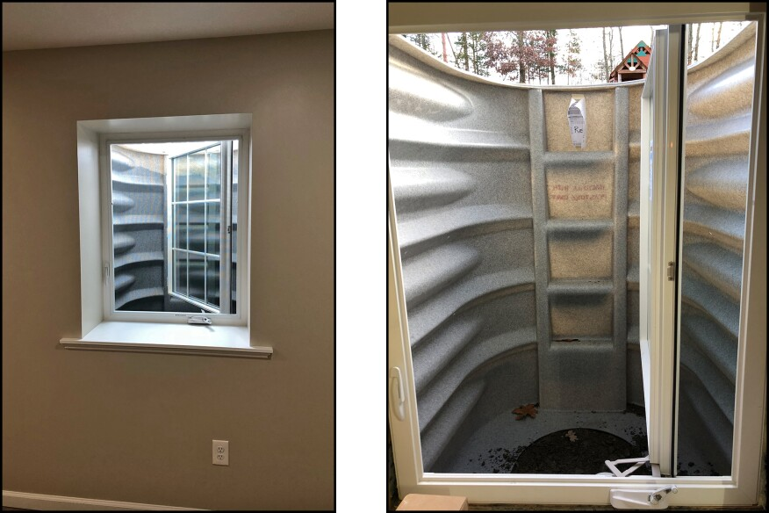
R202 Grade floor eero
Moot if we stick with the 5.7sq.ft for ALL EERO
Photo credit: JLConline.com

Slide 4
Building planning
Chapter 3

Slide 5
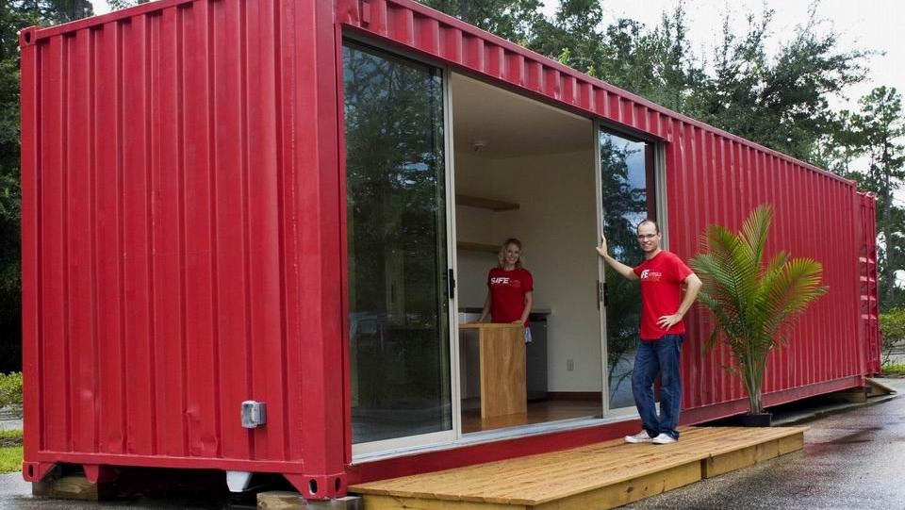
R301.1.4 Intermodal Shipping Containers
New Section
“Intermodal shipping containers that are repurposed for use as buildings or structures shall be designed in accordance with the structural provisions in Section 3115 of the International Building Code. ”
Shipping containers are now allowed as buildings in accordance with IBC 3115
The IBC requires an engineered design for the use of the containers. Must meet ISO 1496-1. (Also added to the definition section).
This Photo by Unknown Author is licensed under CC BY-SA-NC

Slide 6
R302.2.2 Common Walls
“Common walls separating townhouse units shall be assigned a fire-resistance rating in accordance with Item 1 or 2 and shall be rated for fire exposure from both sides. Common walls shall extend to and be tight against the exterior sheathing of the exterior walls, or the inside face of exterior walls without stud cavities, and the underside of the roof sheathing.”
“Exception: Common walls are permitted to extend to and be tight against the inside of the exterior walls if the cavity between the end of the common wall and the exterior sheathing is filled with a minimum of two 2-inch nominal thickness wood studs.”
Fire sprinkler piping is now allowed in this common wall.

Slide 7
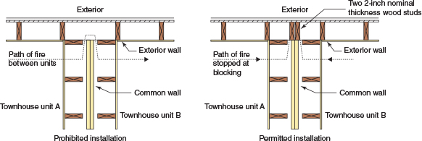

Slide 8
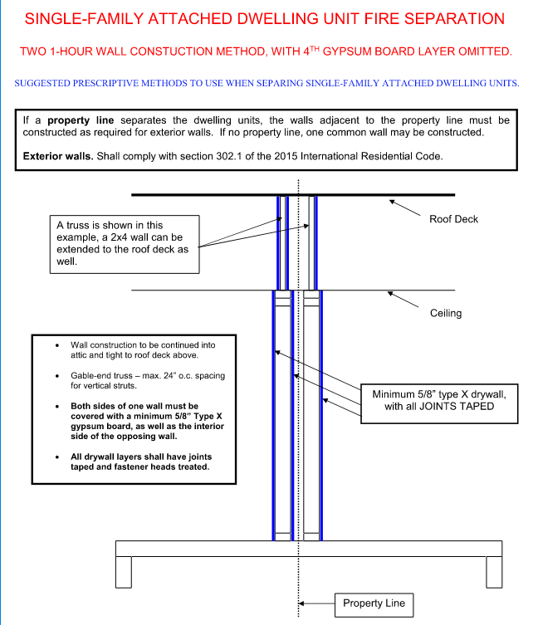
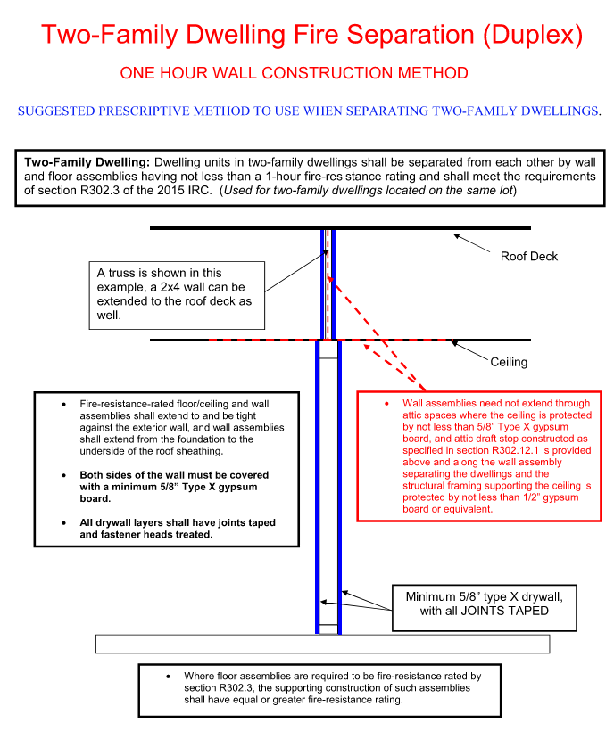
302.3 – Two family dwelling separation relaxation/clarification

Slide 9
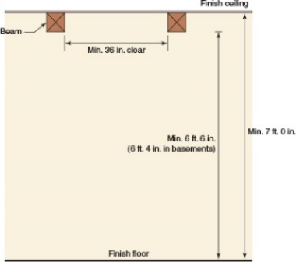
R305.1 minimum height
New Exception
“4. Beams and girders spaced apart not less than 36 inches in clear finished width shall project not more than 78 inches from the finished floor.”
This exception is NOT applicable to basements.

Slide 10
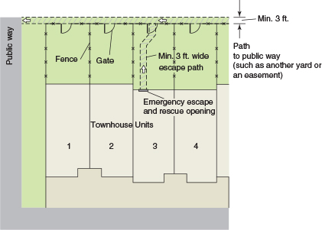
R310.1 emergency escape and rescue opening required
New Exception
“3. A yard shall not be required to open directly into a public way where the yard opens to an unobstructed path from the yard to the public way. Such a path shall have a width of not less than 36 inches.”

Slide 11
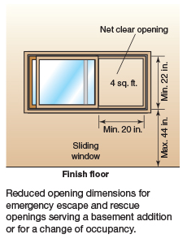
310.7.1
EERO in existing buildings
In alterations or repairs of existing basements, EERO requirements have been relaxed to more closely follow the Property Maintenance specifications.
This change reflects our current policy and practice.

Slide 12
R311.7 / 311.8 – stairs and ramps
Language added to clarify that the code does NOT apply to stairs outside the home, unless attached to a porch, deck, or building.
Also allows for non-compliant stairs to serve crawlspaces or non-habitable attics.

Slide 13
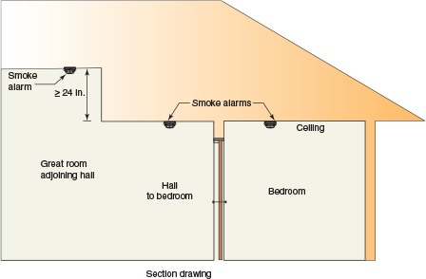
Smoke alarms
R314.3 location
New Location Requirement for Smoke Alarms
New location requirement
“5. In the hallway and in the room open to the hallway in dwelling units where the ceiling height of a room open to a hallway serving bedrooms exceeds that of the hallway by 24 inches or more.”

Slide 14
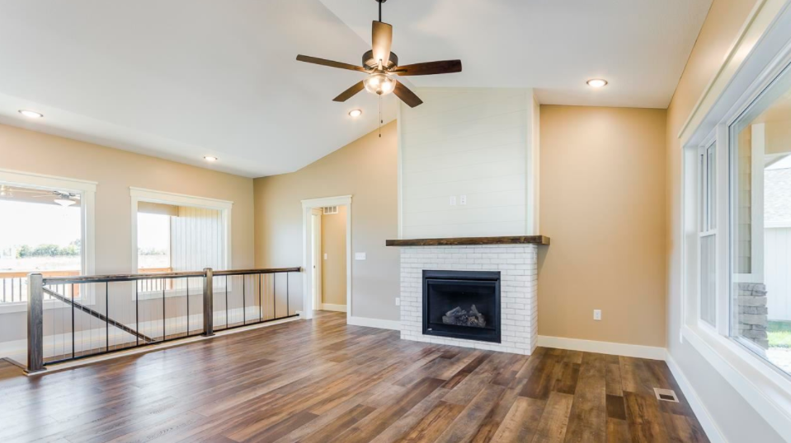

Slide 15
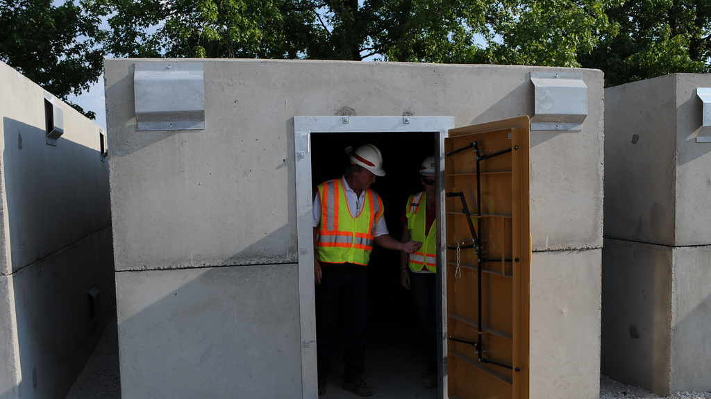
Storm shelters
R323.1.1 Sealed documentation
New Section
“The construction documents for all structural components and impact protective systems of the storm shelter shall be prepared and sealed by a registered design professional indicating that the design meets the criteria of ICC 500.”
“Exception: Storm shelters, structural components and impact-protective systems that are listed and labeled to indicate compliance with ICC 500.”
This Photo by Unknown Author is licensed under CC BY

Slide 16
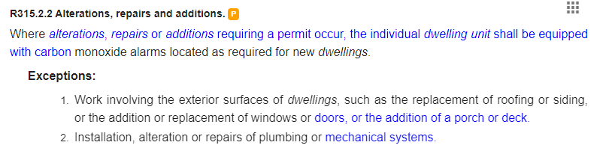
315.2 – Carbon monoxide alarms
Change of exception 3 will require alarms to be installed for all fuel fired appliance repairs or installation.
2021:
2.Installation, alteration or repairs of plumbing or mechanical systems.
3.Installation, alteration or repairs of mechanical systems that are not fuel fired

Slide 17
320 Accessibility for live / work units
This section reference will need to be amended to reflect our focus on Federal guidelines rather than chapter 11 of the IBC.

Slide 18
Building construction
Ch 4 through 10

Slide 19
BIPV (tesla?) do not need the MFD walk path – when no shock hazard
Firefighter impact?

Slide 20
Habitable attics - 326

Slide 21
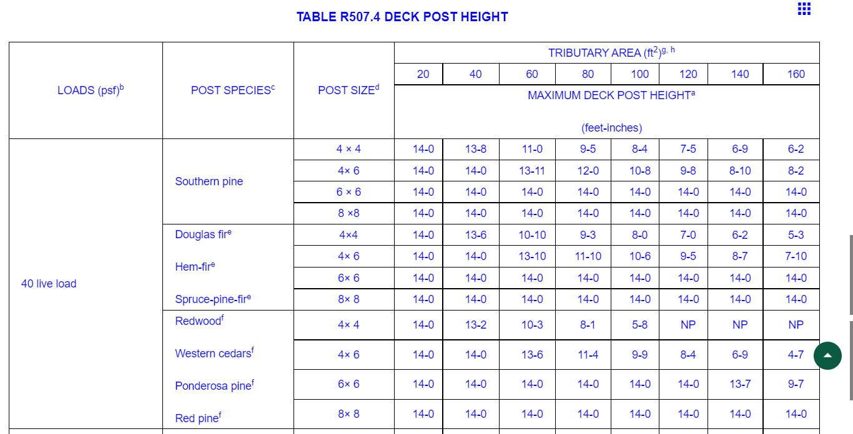
R507.4 Deck post height
Updated table
NOTE – this is an example of the code expanding in a way that benefits contractors. This table was much more conservative last edition.

Slide 22
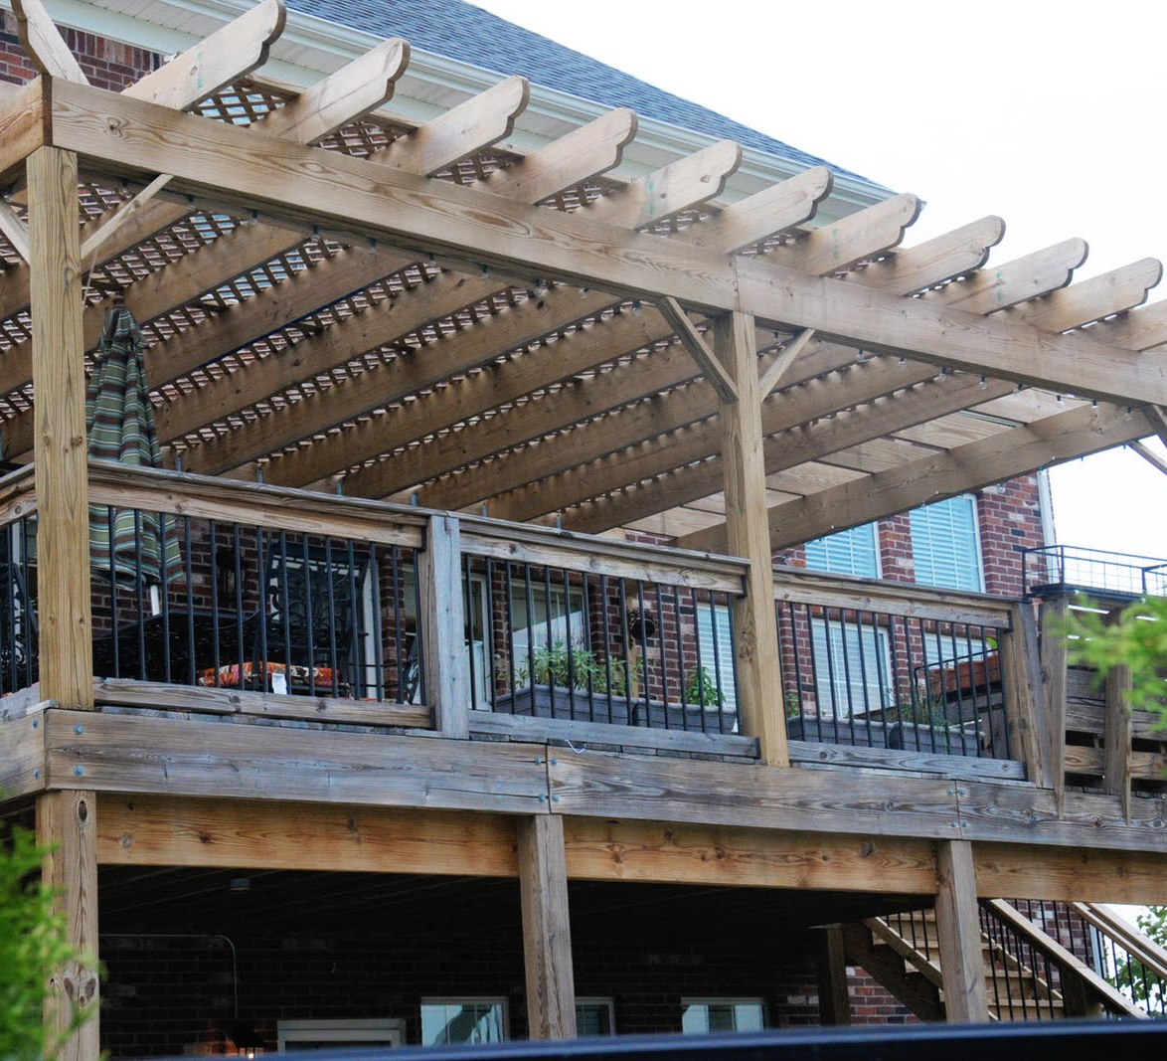
decks
R507.10 Exterior guards
New Section
R507.10.1 through R507.10.4
The new provisions reinforce the need for a load path from the guard and rail into the deck joists, beams or blocking to which a guard is connected. End grain connections for guard’s fasteners are prohibited.
This Photo by Unknown Author is licensed under CC BY-NC-ND

Slide 23
R507.10.1 Support of guards.
Where guards are supported on deck framing, guard loads shall be transferred to the deck framing with a continuous load path to the deck joists.
R507.10.1.1 Guards supported by side of deck framing.
Where guards are connected to the interior or exterior side of a deck joist or beam, the joist or beam shall be connected to the adjacent joists to prevent rotation of the joist or beam. Connections relying only on fasteners in end grain withdrawal are not permitted.
R507.10.1.2 Guards supported on top of deck framing.
Where guards are mounted on top of the decking, the guards shall be connected to the deck framing or blocking and installed in accordance with manufacturer's instructions to transfer the guard loads to the adjacent joists.
R507.10.2 Wood posts at deck guards.
Where 4-inch by 4-inch (102 mm by 102 mm) wood posts support guard loads applied to the top of the guard, such posts shall not be notched at the connection to the supporting structure.

Slide 24
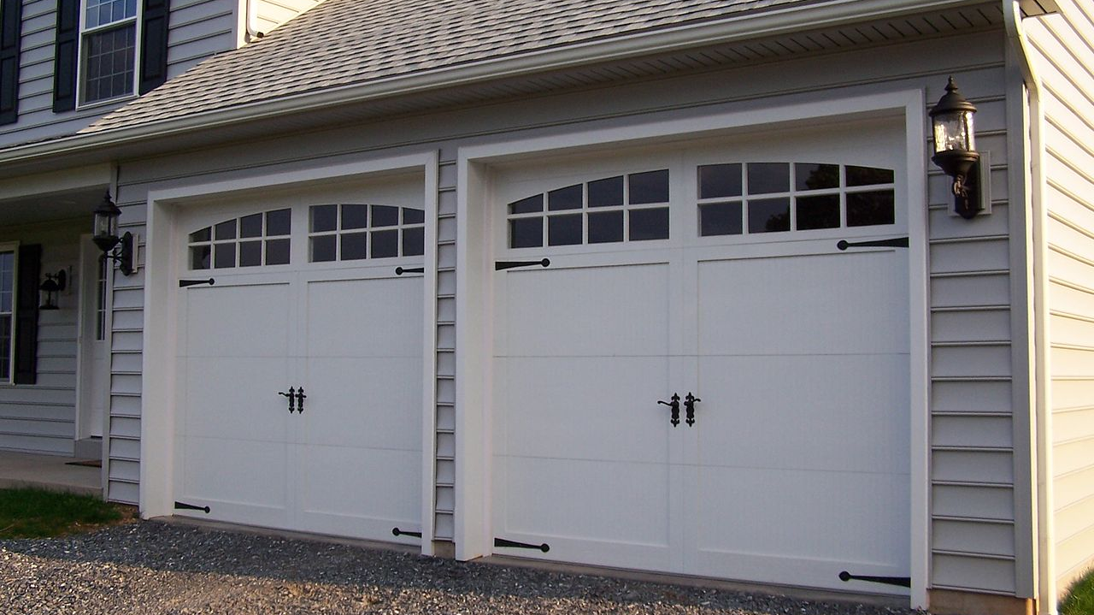
R609.4.1 garage door labeling
New Section
“Garage doors shall be labeled with a permanent label by the manufacturer.
The label shall identify the manufacturer, the model/serial number, wind pressure rating, installation instruction drawing reference number, and the test standard.”
This Photo by Unknown Author is licensed under CC BY-SA

Slide 25
R702.7 Vapor retarders
“A vapor retarder shall be provided on the interior side of frame walls of the class indicated in R702(2), including compliance with Table R702.7(3) or R702.7(4) where applicable.”
An interior vapor retarder is NOT required in our climate zone (4A).

Slide 26
Fuel gas
Ch 24

Slide 27
G2414.8.3 threaded joint sealing
“Threaded joints shall be made using a thread joint sealing material.”
Most common are pastes made with Teflon or Teflon tape.
Must be a material that does not harden over time.
Must be suitable for pipe and fitting materials used.

Slide 28
G2427.5.5.1 chimney lining
“Chimneys shall be lined in accordance with NFPA 211.”
The exception to allow existing unlined chimney to continue to be used when replacing the appliance vented by the chimney has been removed.

Slide 29
Plumbing
Ch 29 thru 33

Slide 30
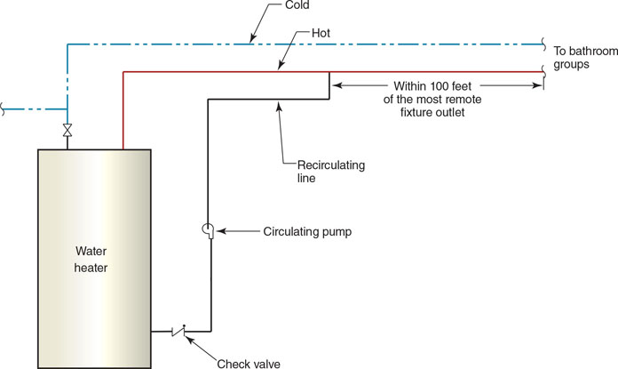
P2905.3 hot water supply to fixtures
New Section
“The developed length of hot water piping, from the source of the hot water to the fixtures that require hot water, shall not exceed 100 feet (30 480 mm). Water heaters and recirculating system piping shall be considered to be sources of hot water.”

Slide 31
electrical
Ch 34 thru 43

Slide 32
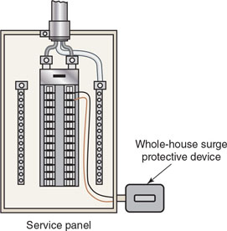
E3606.5 surge protection
New Section
“All services supplying one- and two-family dwelling units shall be provided with a surge-protection device (SPD)”
In response to a need to protect sensitive electronic devices including appliances, GFCI and AFCI devices and smoke alarms.

Slide 33
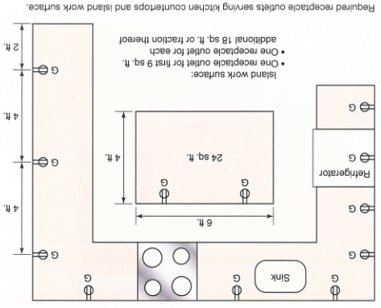
E3901.4.2 island and peninsular countertops and work surfaces spaces
One receptacle outlet for the first 9 sq ft.
One for every additional 18 sq ft.

Slide 34
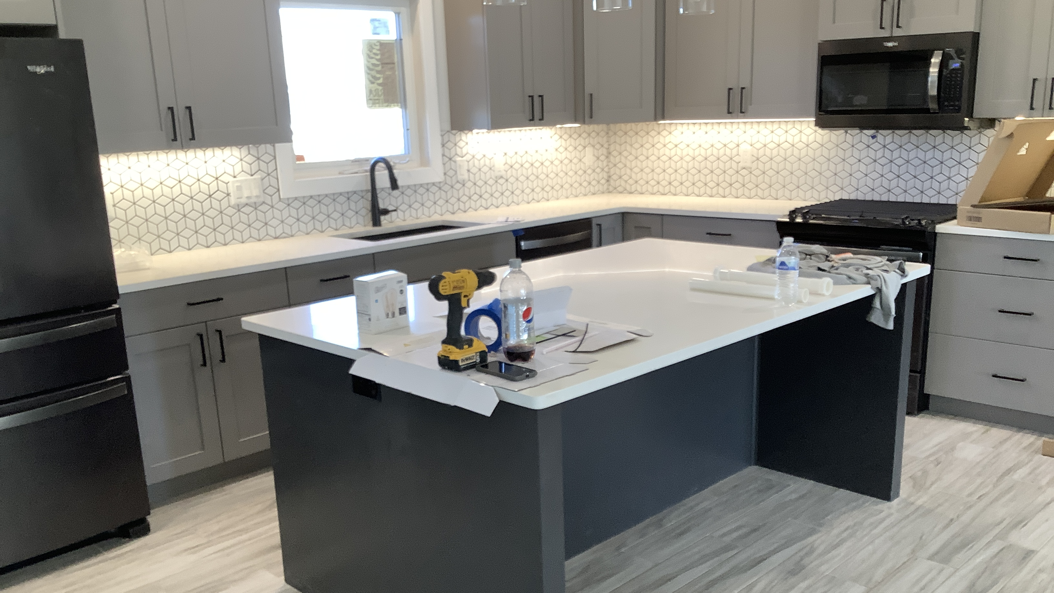

Slide 35
E3902.5 basement receptacles
“125-volt AND 250-volt receptacles installed in basements and supplied by single-phase branch circuits rated 150 volts or less to ground shall have ground-fault circuit-interrupter protection for personnel.”
The requirement for unfinished basement areas has been expanded to include all basement areas.

Slide 36
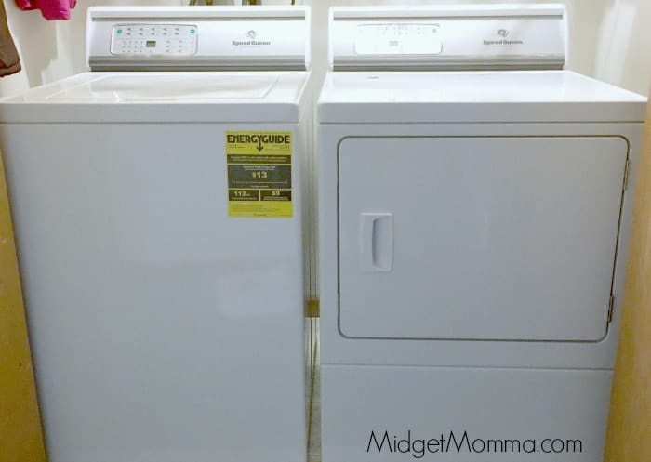
E3902.9 laundry areas
“125-volt through 250-volt receptacles installed in laundry areas and supplied by single-phase branch circuits rated 150 volts or less to ground shall have ground-fault circuit-interrupter protection for personnel.”
This Photo by Unknown Author is licensed under CC BY-SA-NC

Slide 37
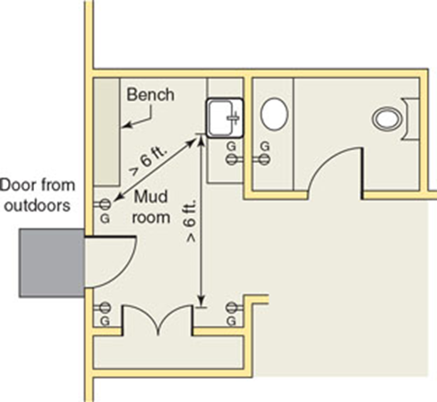
E3902.10 Indoor damp and wet locations.
New Section
“125-volt through 250-volt receptacles installed in indoor damp and wet locations and supplied by single-phase branch circuits rated 150 volts or less to ground shall have ground-fault circuit-interrupter protection for personnel. [210.8(A)(11)]”

Slide 38
E4002.11 bathtub and shower space
“Receptacles shall not be installed within a zone measured 3 ft horizontally and 8 ft vertically from the top of the bathtub rim of shower stall threshold.”

Slide 39
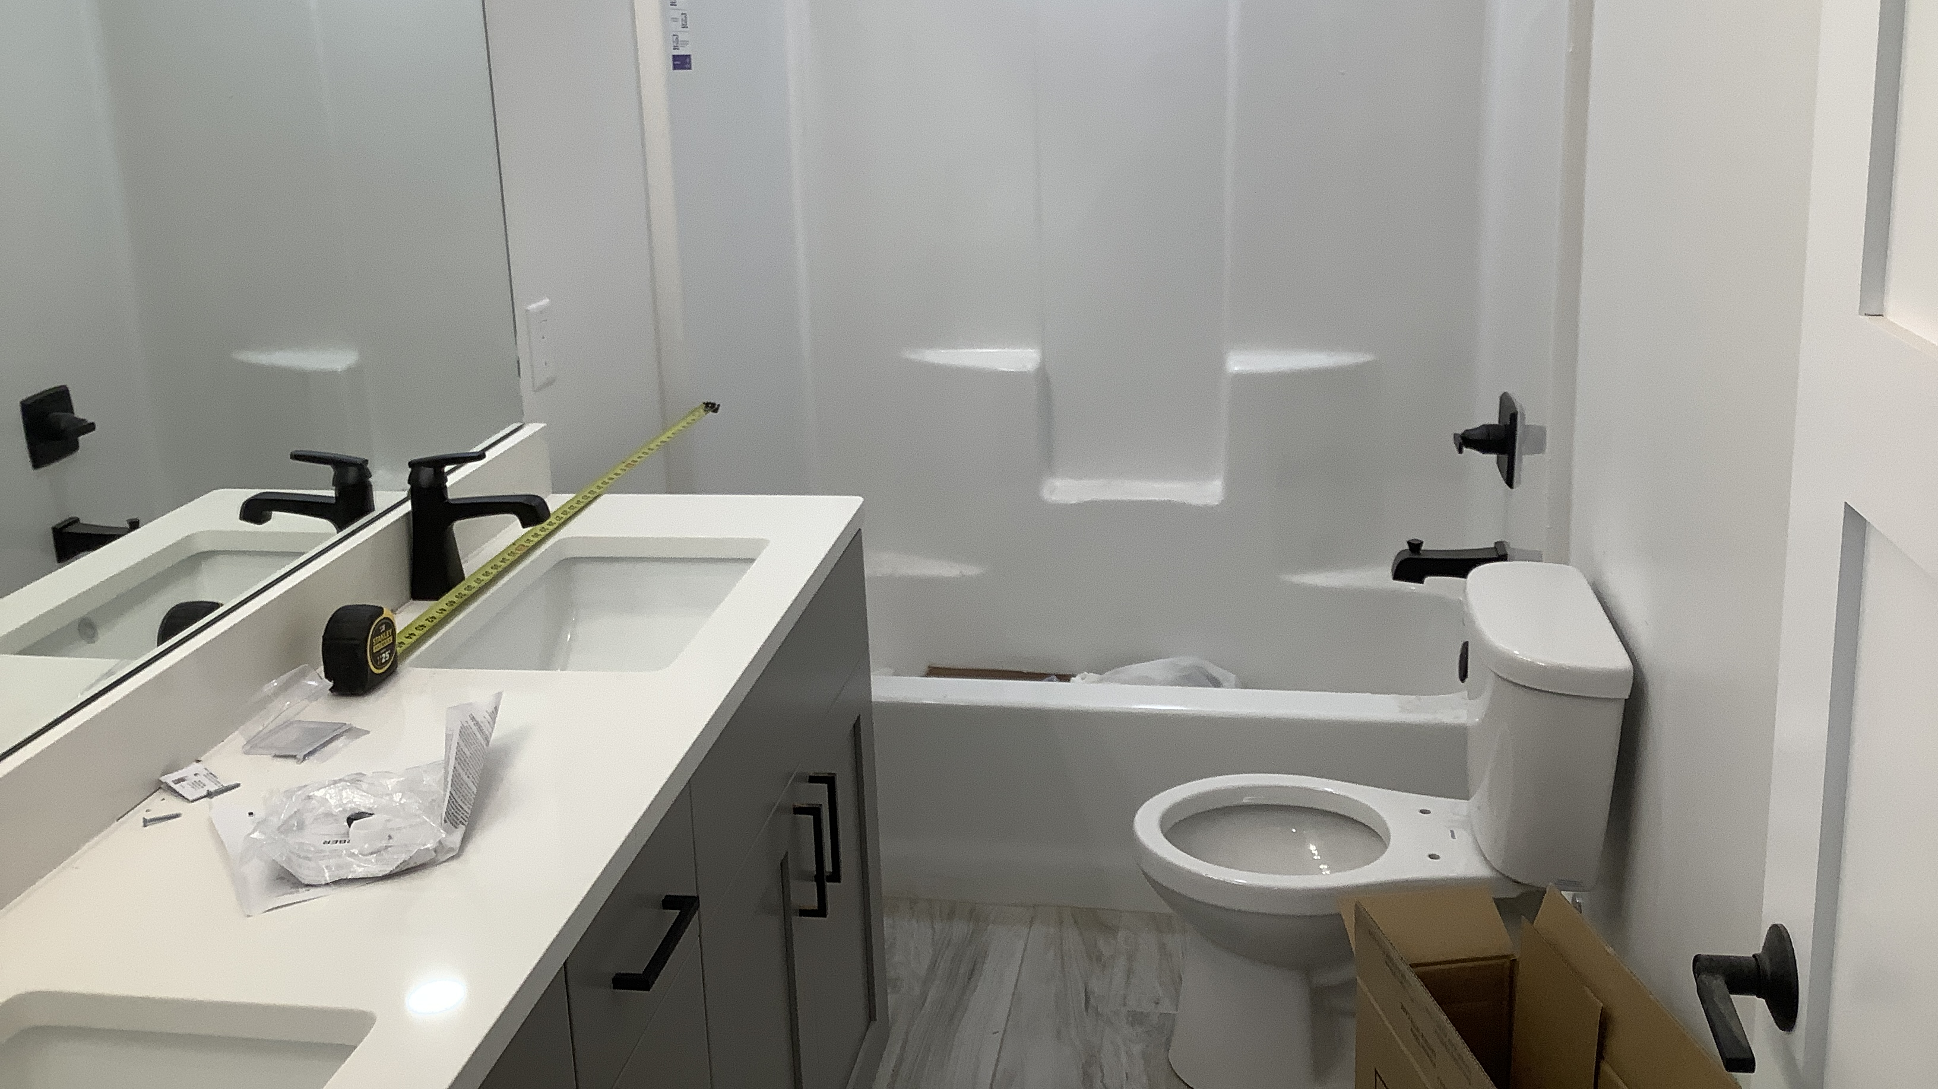

Slide 40
This is the end

